Slide 1
Priming modernity and work context strengthens the association between fairness/harm concerns and anger
Manqi Chen
Chinese Academy of Social Sciences
Email: chenmq@cass.org.cn
chenmanqi@126.com
Notes:
Dear all, the title for my presentation is Priming modernity and work context strengthens the association between fairness/harm concerns and anger. I am Manqi Chen from the Chinese academy of social sciences.

Slide 2
Moral intuitions and moral emotions
People make intuitive (vs. deliberate) moral judgments spontaneously in response to morally relevant events in a specific context.
Contextual factors (such as the level of economic development) can affect how people make sense of an event and emotionally respond to it (Haidt, et al., 2007, see also Alistair et al., 1995; Sivakumar Velayutham,2003; Emmanouil Dedoulis, 2006).
Notes:
According to the moral foundation theory, people make intuitive (vs. deliberate) moral judgments spontaneously in response to morally relevant events in a specific context.
Furthermore, contextual factors, such as the level of economic development, can affect how people make sense of an event and they emotionally respond to it.

Slide 3
Research Question
How do modernity and emphasis of fairness norms in modern work contexts affect moral emotions in response to moral events?
Notes:
The major research question in the current study is:
How do modernity and emphasis of fairness norms in modern work contexts affect moral emotions in response to moral events?

Slide 4
Joe Henrich found that as the level of market integration of a community increases, the norm of fairness becomes more prevalent in the community.
Notes:
What is the relationship between economic development and morality?
Joe Henrich found that as the level of market integration of a community increases, the norm of fairness becomes more prevalent in the community.
This relationship is shown in the next figure.
随着社会市场化水平的提高，公平将成为社会主流的判断标准

Slide 5
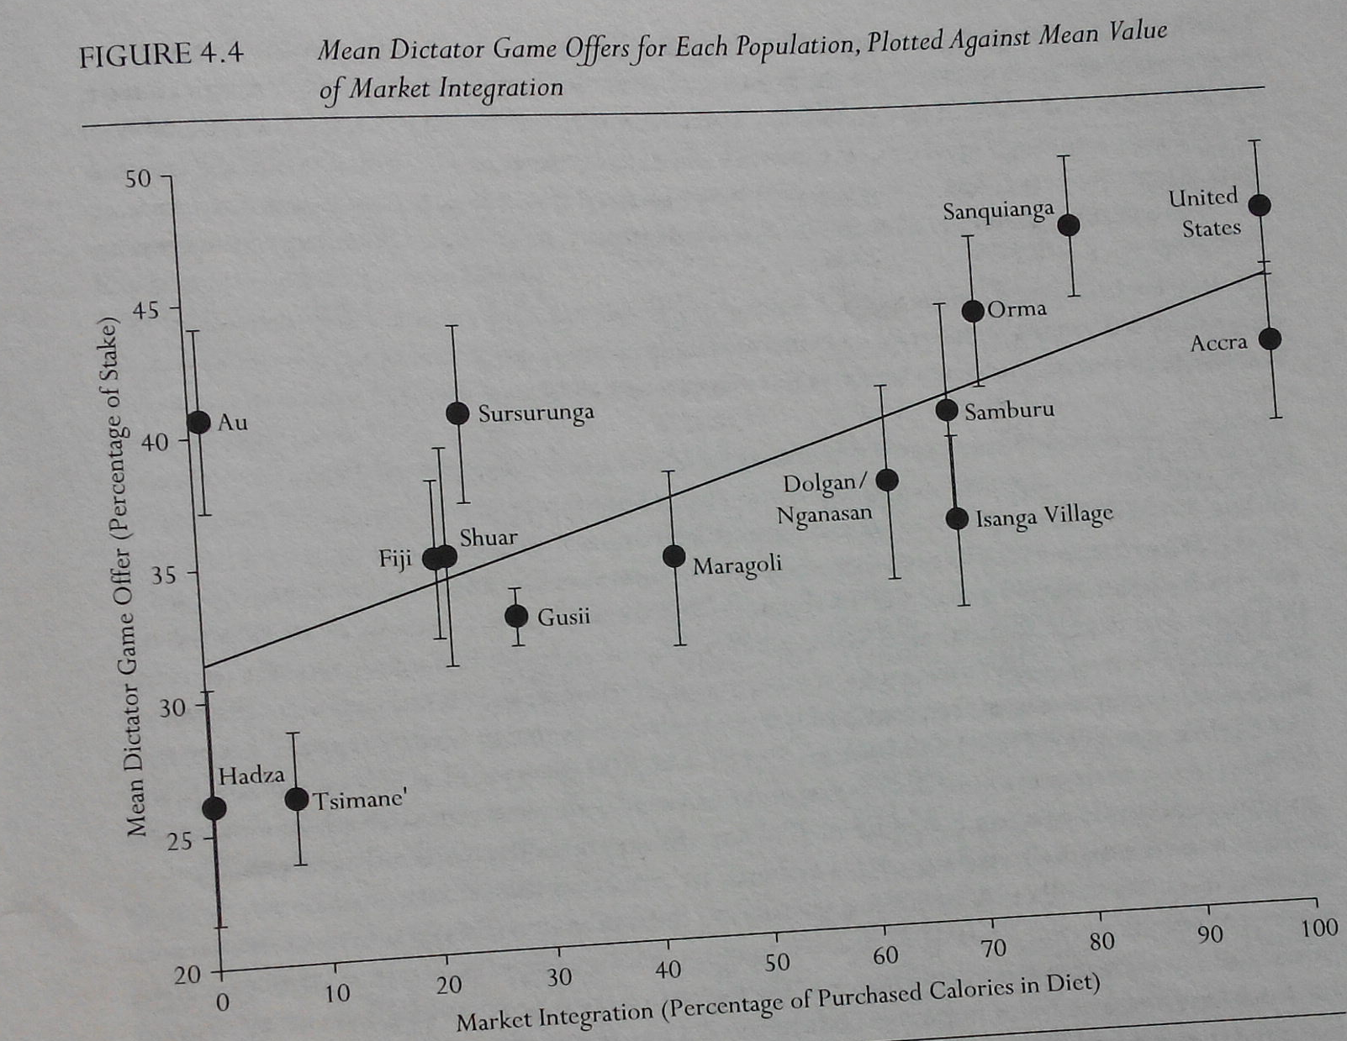
Notes:
The horizontal axis in this figure is the extent of market integration of a community. The vertical axis is the mean offer in the Dictator Game, which was used as a proxy for internalized concern for fairness. Each data point represents a community in a cross-cultural study. As the level of market integration of a community increases, intrinsic concern for fairness also increases. Market integration is closely tied to economic modernization.

Slide 6
According to the Joe Henrich, smaller and subsistence-based communities can rely on reputation-based costly punishment and indirect sanctioning to discourage self-maximization at the expense of the public good.
However, as the breadth and intensity of economic exchange increase, market efficiency requires trust, fairness, and cooperation among individuals engaged in infrequent or anonymous interactions, because fairness norms as a set of shared expectations and motivations help lower transaction costs and sustain long-term, mutually beneficial transactions.
In short, market integration provides the ecological foundation for the emergence and spread of fairness norms, which in turn support progress in market integration.
Notes:
What is the explanation for this relationship?
According to the Joe Henrich, smaller and subsistence-based communities can rely on reputation-based costly punishment and indirect sanctioning to discourage self-maximization at the expense of the public good.
However, as the breadth and intensity of economic exchange increase, market efficiency requires trust, fairness, and cooperation among individuals engaged in infrequent or anonymous interactions, because fairness norms as a set of shared expectations and motivations help lower transaction costs and sustain long-term, mutually beneficial transactions.
In short, market integration provides the ecological foundation for the emergence and spread of fairness norms, which in turn support progress in market integration.

Slide 7
Psychological theories of justice (e.g., Deutsch, Lerner, Greenberg)
Domain | Major concern | Justice principle
Work | Productivity maximization | Equity/ fairness
Friendship | Social harmony | Equality
Family | Welfare of ingroup members | Need
Notes:
The relationship between work context and concern over fairness is well documented in the social psychology of justice.
In the work domain, the major concern is the productivity maximization, and the preferred principle of reward allocation is equity or fairness.
In the friendship domain, the major concern is social harmony, and the preferred principle of reward allocation is equality.
In the family domain, the major concern is the protect the welfare of ingroup members, and the preferred principle of reward allocation is allocation according to need.
Previously, Prof. Chiu also mentioned that in China, economic growth has been accompanied by increased intellectual curiosity in fairness and frequency of collective action.

Slide 8
Hypothesis
Priming modernity (exp1) and work context (exp2) would strengthen the link between violation of autonomous morality and anger, such that following modernity/work priming (vs. control priming), Chinese participants would show stronger anger reactions in responses to violation of autonomous morality.
Notes:
Based on this past research literature, we make this hypothesis:
Priming modernity in experiment 1 and work context in experiment 2 would strengthen the link between violation of fairness-related autonomous morality and its associated emotion. Specifically, following modernity/work priming (vs. control priming), Chinese participants would show stronger anger reactions in responses to violation of autonomous morality.

Slide 9
Moral foundation theory
The moral domain a certain event is perceived to belong to can bias the primary foundational moral criterion used to evaluate the morality of the event as well as the type and intensity of emotional reaction to the event.
Moral domains | Moral foundations | Emotional reactions
Community | in-group/loyalty | Contempt
 | authority/respect
Autonomy | harm/care | Anger
 | fairness/reciprocity
Divinity | purity/ sanctity | Disgust
Notes:
Our hypothesized connection between concern with fairness and anger is based on the moral foundation theory.
The moral foundation theory has identified three major categories of moral foundations: ingroup loyalty- or authority–related morality, fairness- or harm-related morality, and purity-related morality. Furthermore, violation of fairness- or harm-related morality elicit anger; violation of ingroup loyalty- or authority–related morality elicits contempt; and violation of purity-related morality elicits disgust.

Slide 10
Experiment 1: Priming modernity
Participants
60 Mainland Chinese (9 men and 51 women; M_{age} =21.13, SD=2.33)
Design
Randomly assigned to one of the 3 Priming (tradition; modernity; control) conditions
Notes:
We conducted two experiments to test our hypothesis.
In the first experiment, we primed modernity to examine its effect on the link between violation of autonomous morality and anger.
60 Chinese Mainlanders from RENMIN University took part voluntarily in this experiment. Participants were randomly assigned to tradition Priming condition, modernity priming condition or the control condition.

Slide 11
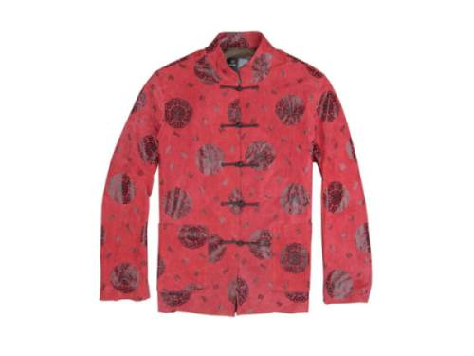
Priming materials
pictorial primes of tradition and modernity, 15 each, in matched categories
Notes:
the pictorial primes of tradition and modernity used in this experiment are shown here. They were 15 primes of matched categories in each condition.
Such as:
clothing (Tang suit VS Western-style suit)
national defense (Great Wall VS aircraft carrier)
Stationeries (Chinese brush VS pen, steelyard VS electronic balance)

Slide 12
control primes
Notes:
In the control, the primes were pictures of clouds and landscape.

Slide 13
Procedure
Priming (tradition; modernity, control)
answer two simple questions about each prime (e.g. what is in this picture?)
Stimulus events: 11 moral violation news events
Participants selected the most and second most appropriate emotion words (contempt, anger, disgust, or others) to describe their feelings after reading each news.
Participants also selected the two moral issues (fairness- or harm-related morality; ingroup loyalty- or authority–related morality; and purity-related morality) they were most concerned with.
Notes:
In the priming phase, the participants were asked to answer two simple questions about each prime (such as “what is in the picture?”)
In the test phase, participants were presented with 11 moral violation news events, one at a time.
Each news event was presented together with 4 emotion choices: contempt, anger, disgust, or others, and the participants were asked to select the most and second most appropriate emotion options to describe their feelings after reading the news.
Next, participants were shown three moral issues fairness- or harm-related morality; ingroup loyalty- or authority–related morality; and purity-related morality
and also selected the two moral issues they were most concerned with.

Slide 14
moral violation news
11 news were selected as stimulus events in the current study.
Selection of news events
Based on the results of an online study of moral judgments and emotional reactions to 464 news events, we selected 44 news events that elicited mixed moral emotions (emotions associated with 2 moral domains)
These news were edited to have similar writing styles and length (M = 223.22 Chinese characters)
An online survey (N = 69) was carried out to assess the emotions these news elicited.
A final list of 11 events that elicited mixed moral emotions were included in the final study.
Notes:
As mentioned, 11 news were selected as stimulus events in the current study.
How were those news selected?
Firstly, based on the results of an online study of moral judgments and emotional reactions to 464 news events, we selected 44 news events that elicited mixed moral emotions (emotions associated with 2 moral domains)
These news were edited to have similar writing styles and length (M = 223.22 Chinese characters)
An online survey was carried out to assess the emotions these news elicited.
A final list of 11 events that elicited mixed moral emotions were included in the final study.
We used events that can be viewed as violations of 2 moral criteria to leave room for the manifestation of the priming effect.

Slide 15
A sample stimulus news
5日晚11点许，佛山一女子跳江自尽，河堤上数十围观者无人相救，最终一流浪汉冒险跳入水中，将女子救到河边。因河堤太高，无法上岸，女子也已浑身无力坐不稳，跳下河堤时脚部受伤的流浪汉只得一直托着该女子坐在河边台阶上。直到半小时后，消防队员赶到用绳梯将二人救起，随即送往附近医院。医生对流浪汉脚部伤口进行了简单清洗，并告知伤口过几天还要进一步处理，需花费不少钱。流浪汉没钱治又怕自己感冒，只好赶紧回去换衣服。被救女子老公随后开着奥迪车赶来，给了他50元让他买药打车。
A woman committed suicide by drowning herself in a river. Among tens of bystanders, only a homeless person offered help to the woman. The homeless person was injured while rescuing the woman and did not have money to pay for the expensive treatment. The woman’s husband, who was rich, offered the homeless person 50 yuan (US$8) only for his treatment.
Notes:
This s a sample stimulus news.

Slide 16
Analysis
Multilevel analysis
Level 1 (within-subjects, unit of analysis: events)
DV = Anger
IV = Violation of harm/fairness criteria
Level 2 (between-subjects)
Priming
Cross-level interaction was significant
Notes:
We used multilevel analysis to analyze the data.
At level 1, we assessed the association between violation of fairness or harm and anger across events within each participant.
At level 2, we tested the effect of modernity priming on the association between violation of fairness or harm and anger.
The cross-level interaction was significant, indicating that modernity priming affected the strength of association between violation of fairness or harm and anger.

Slide 17
 | tradition |  | modernity |  | control
 | M | SD | M | SD | M | SD
Anger and the ethics of autonomy | 0.50 | 0.34 | 0.89 | 0.47 | 0.59 | 0.44
Disgust and the ethics of divinity | 0.07 | 0.45 | 0.29 | 0.49 | 0.20 | 0.32
Contempt and the ethics of community | 0.02 | 0.34 | 0.08 | 0.40 | 0.09 | 0.37
The mean of correlation coefficient under three priming conditions
Notes:
This table shows the mean normalized correlation between moral emotion and moral concern under three priming conditions.
Consistent with our hypothesis, the mean correlation between anger and violation of ethics of autonomy was stronger in the modernity priming condition than in the other 2 conditions.

Slide 18
Conclusion (Expt 1)
The linkage between fairness/harm concern and anger was stronger in the modernity priming condition than in the tradition priming or control conditions.
Priming modernity strengthens the association between fairness/harm concerns and anger.
Notes:
In conclusion, the linkage between fairness/harm concern and anger was stronger in the modernity priming condition than in the tradition priming or control conditions. This result shows that priming modernity strengthens the association between fairness/harm concerns and anger.

Slide 19
Experiment 2: Priming work context
Participants
N = 67 (18 men and 49 women; M_{age}=22.27, SD=1.86)
Design
a Priming (3 levels: work-related; 2 control conditions) between-subjects design.
Notes:
We conducted another experiment to test the effect of priming work context on the link between violation of autonomous morality and anger.
The procedures were as the same as those in Experiment 1, except that we primed work context instead of modernity in the current study.

Slide 20
Procedure
work context priming condition
describe a memorable work experience
Control 1
describe a memorable life experience
Control 2
no recall task
Notes:
In the work context priming condition, participants were asked to describe a memorable work experience.
We included two control conditions.
In the first control condition, participants were asked to describe a memorable work-unrelated life experience.
In the second control condition, there was no recall task.

Slide 21
Stimulus events, measures, and analysis
Same as Experiment 1
Notes:
There stimulus event, measures, and analysis were the same as those used in experiment 1.

Slide 22
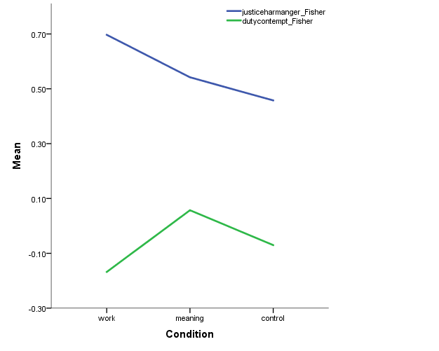
The mean linkage between moral emotion and moral concern (Fisher’s z) under work experience priming / life experience priming (control 1) / no priming (control 2)
Link between fairness/harm and anger
Link between duty and contempt
Work experience Life experience no priming
Notes:
Here is the main result.
On the vertical axis is the mean normalized correlation between concern with a moral issue and its associated moral emotion.
Of relevance to our hypothesis is the blue line, which depicts the strength of association between anger and concern with violation of fairness or harm,
As shown in the figure, this association was stronger in the work-experience priming condition than in the two control conditions.

Slide 23
General Discussion
As China modernizes, the Chinese respond to violation of the ethics of autonomy with higher intensity of anger.
Because fairness is emphasized in contemporary work context in China, priming work context also elicits stronger anger reactions to violations of ethics of autonomy among Chinese Mainlanders.
Consistent with the Moral Foundation Theory, these results show that the level of social development can affect emotional reactions to moral issues.
Notes:
In two experiments, we found consistent evidence for our hypothesis that the linkage between concern with ethics of autonomy and anger was stronger following either modernity or work experience priming.
Those results imply that as China modernizes, the Chinese respond to violations of the ethics of autonomy with higher intensity of anger.
Because fairness is emphasized in contemporary work context in China, priming work context also elicits stronger anger reactions to violations of ethics of autonomy among Chinese Mainlanders.
Finally, consistent with the Moral Foundation Theory, our results show that the level of economic development can affect emotional reactions to moral issues.
随着中国的现代化进展的加快，人们对于违反自主道德的事件其愤怒感增强。
由于在现代中国的工作环境中，公平问题日益彰显，因此当启动工作背景中，人们对于违反自主道德的事件其愤怒感也随之增强。
可见，社会的发展水平影响了人们对道德问题的情绪反应。

Slide 24
Thank you!
Notes:
Thank you for your attention. Looking forward your suggestions.

