Slide 1
Becoming CITIZENS in the inner city renewal
Shi Yunqing
CASS

Slide 2
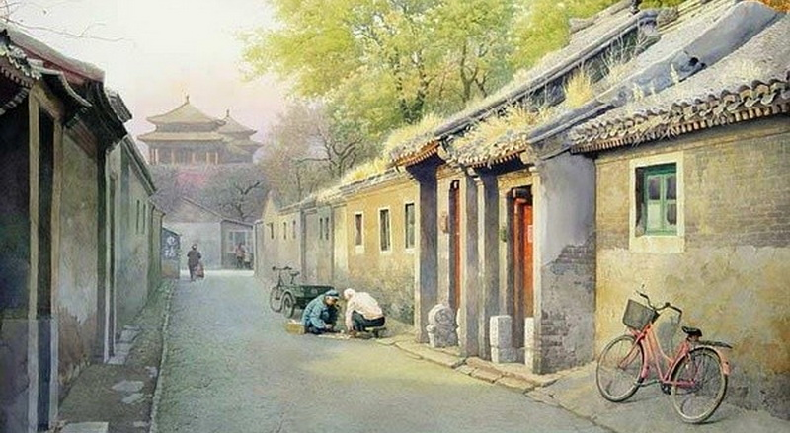
Beijing in dream

Slide 3
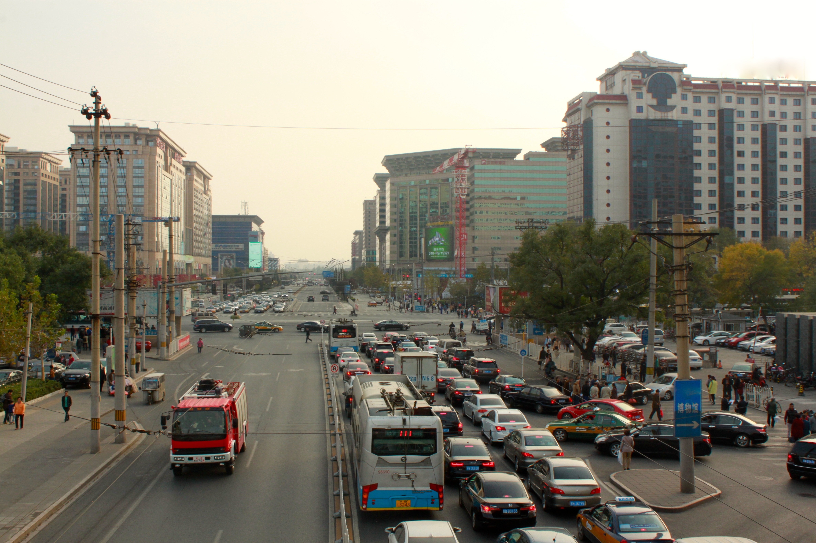

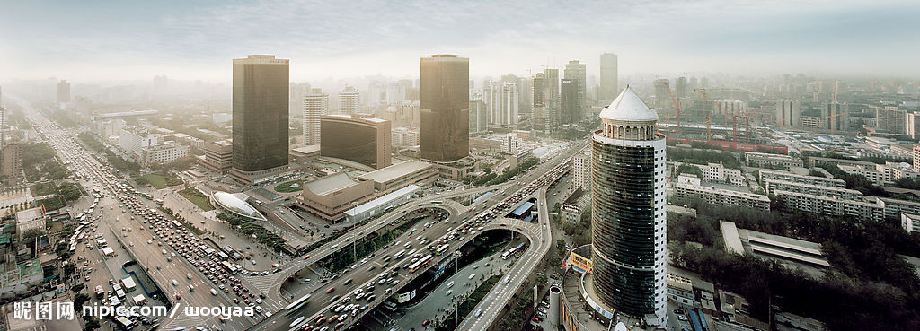
Beijing in reality

Slide 4
Background
The first phrase of urbanization (1991-2000)
Starting from inner city renewal
Data:
  the total size of the relocated population was 281,200 households, or 878,600 person;
  647,800 houses that occupied 9,155,300 square meters were demolished

Slide 5
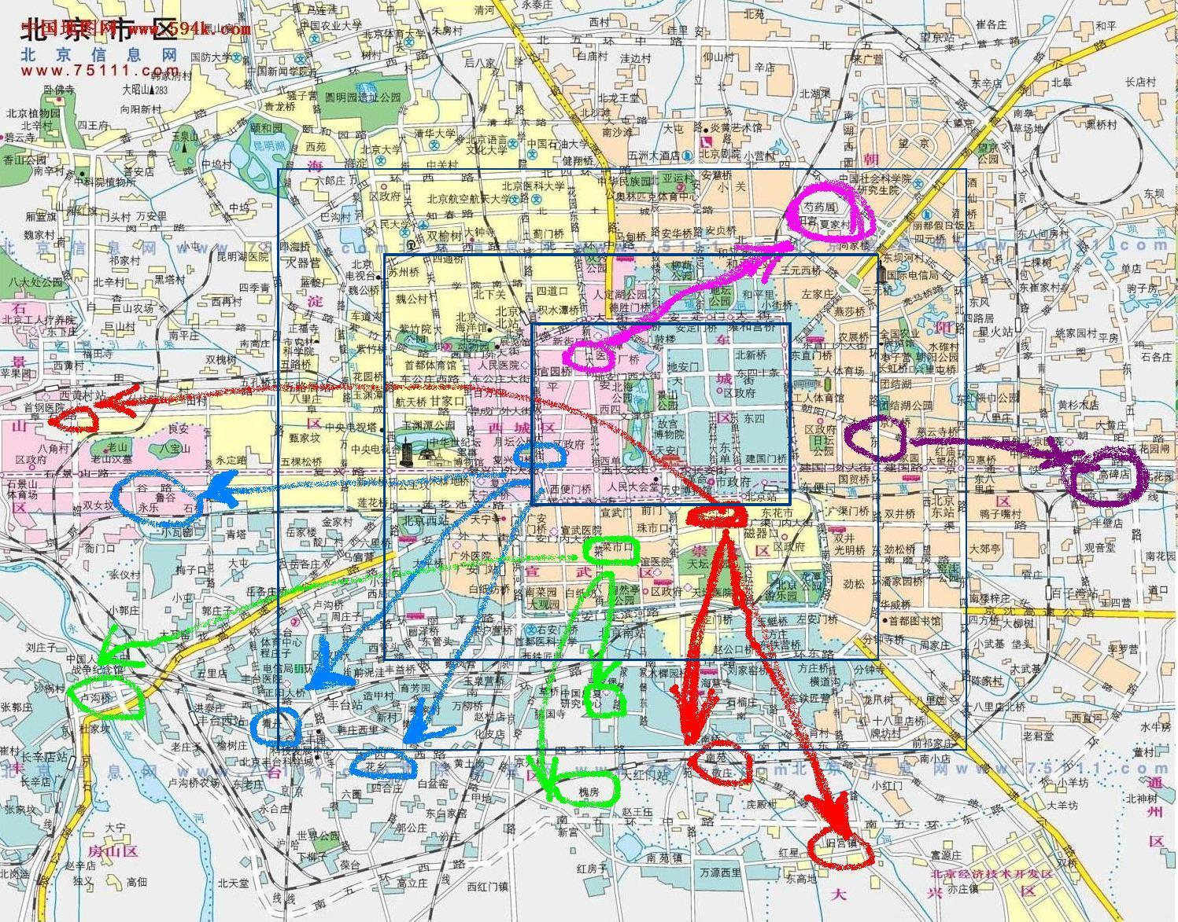
Moving out of the inner City
5 districts in the inner city：
Red： CW
Blue： XC
Green：XW
Pink： DC
Purple：CY
Notes:
The opposite face of gentenlization

Slide 6
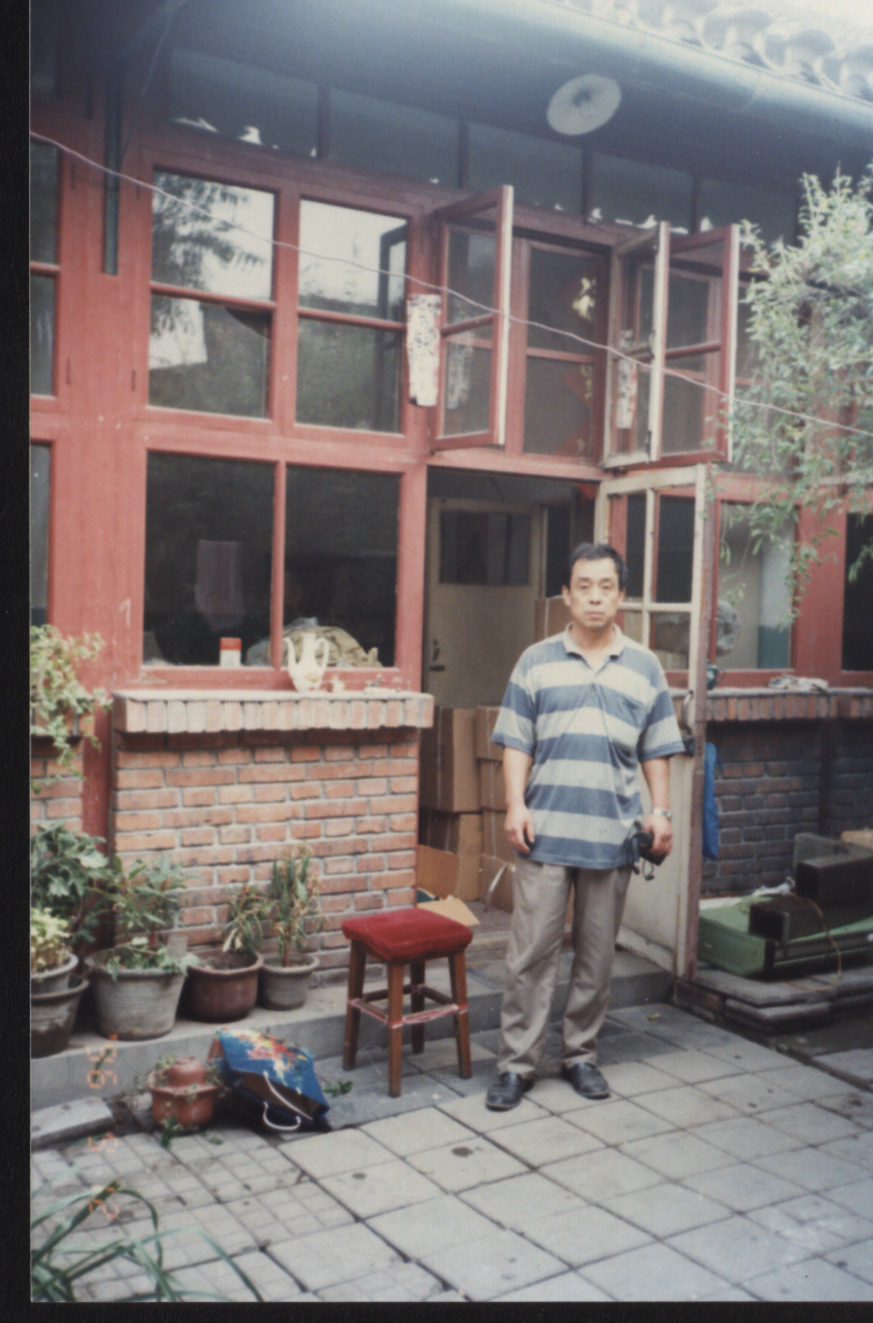
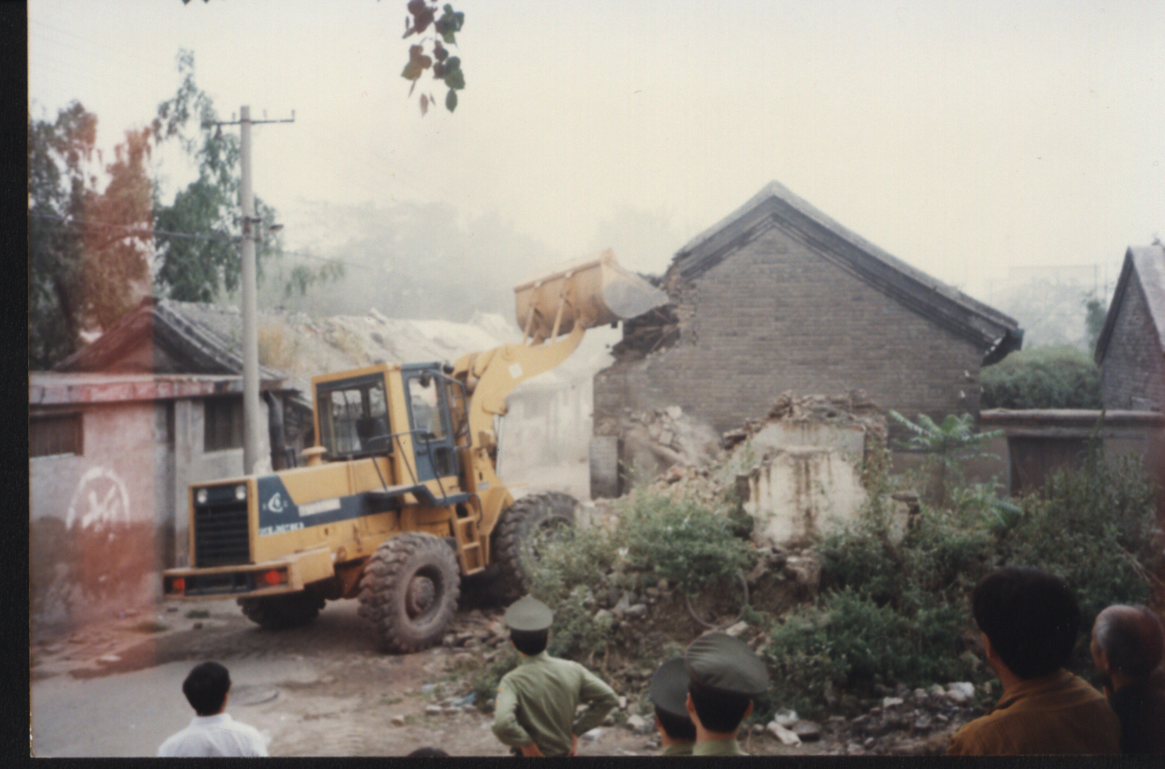
Demolition
Photo by Mr. Luo, the interviewee (1995)

Slide 7
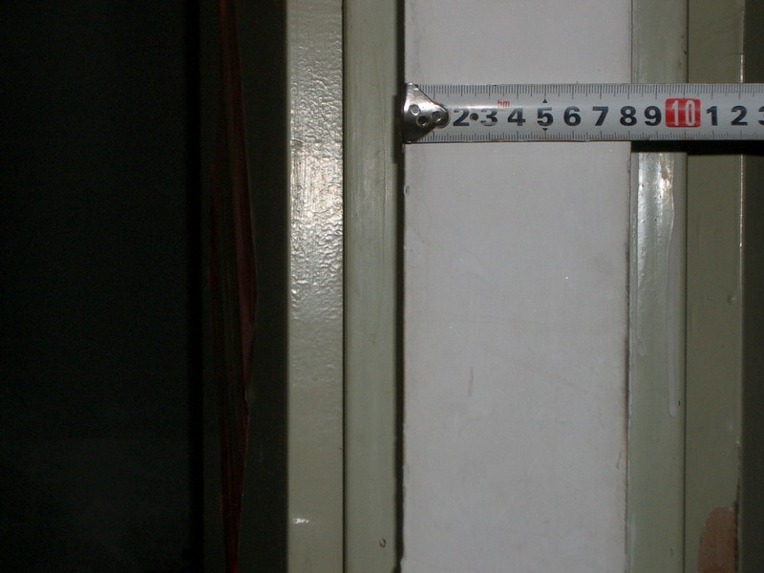
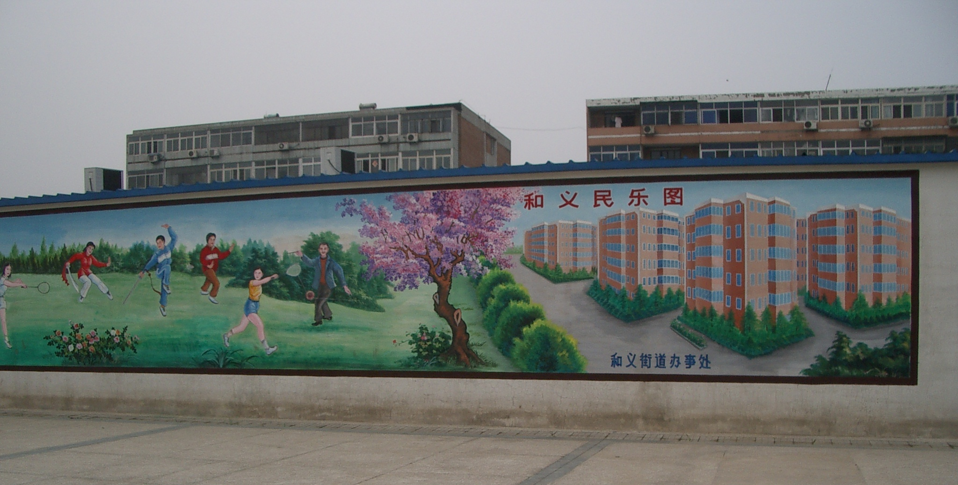
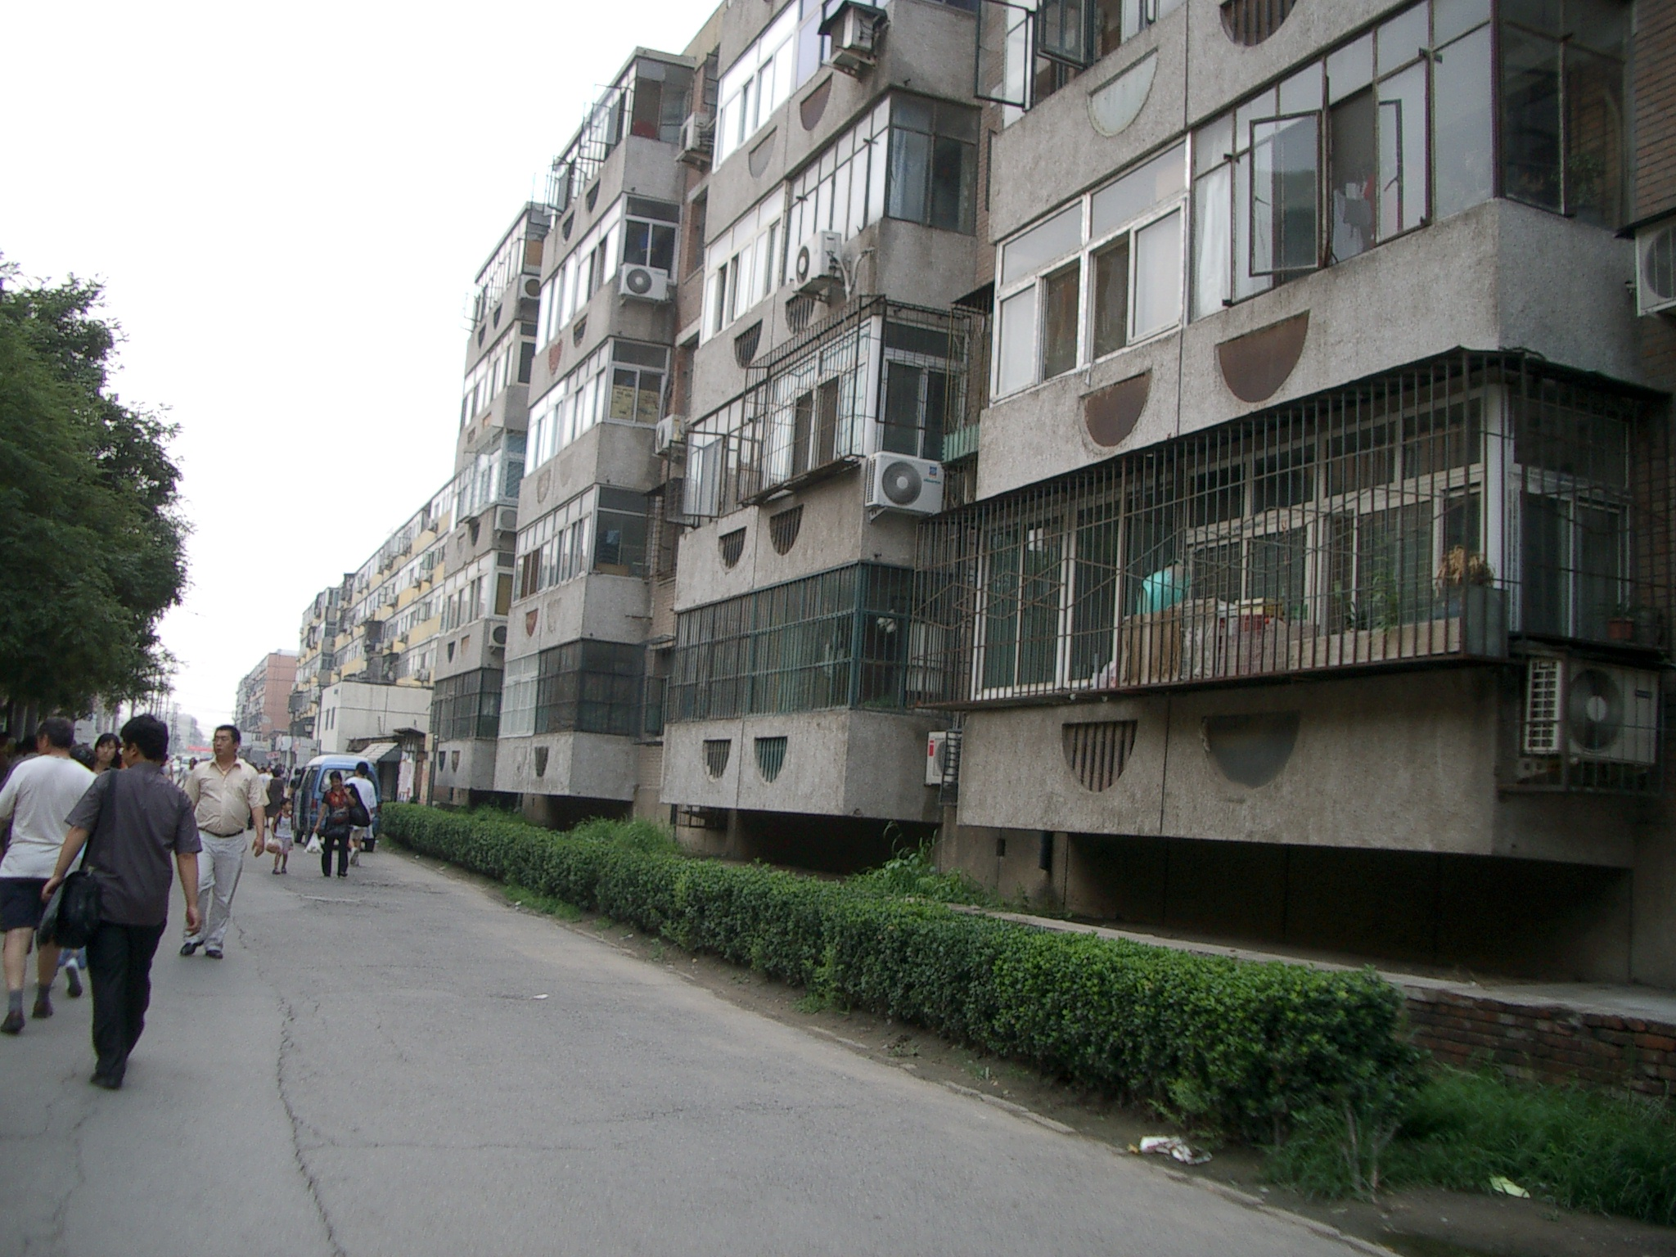
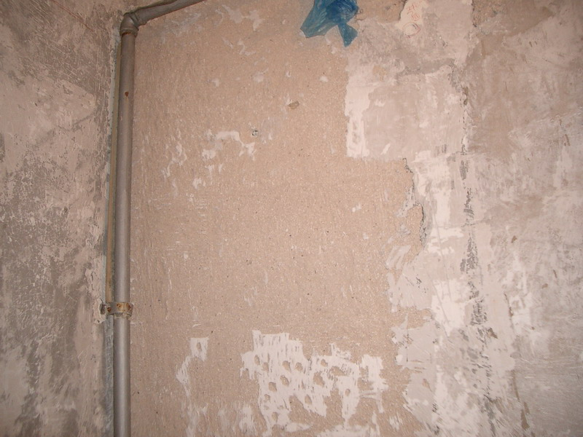
Community for replacement
The outlook of the community
The wall inside the house
Notes:
Water,a suite suppose to have 2 rooms is rebuilted to 3 rooms

Slide 8
Case: the Grand Litigation of Ten Thousand Plaintiffs
On Feb 22nd, 2000, 7 representatives of citizens submitted to the Second Intermediate People‘s Court of City B an administrative proceeding with 10,357 plaintiffs,suing the Municipal Housing and Land Administration Bureau of municipal B’s government.
For the first time, local people suing the government
Largest, longest and rationalist
Claiming for land-use rights and then for citizenship during the last 20 years

Slide 9
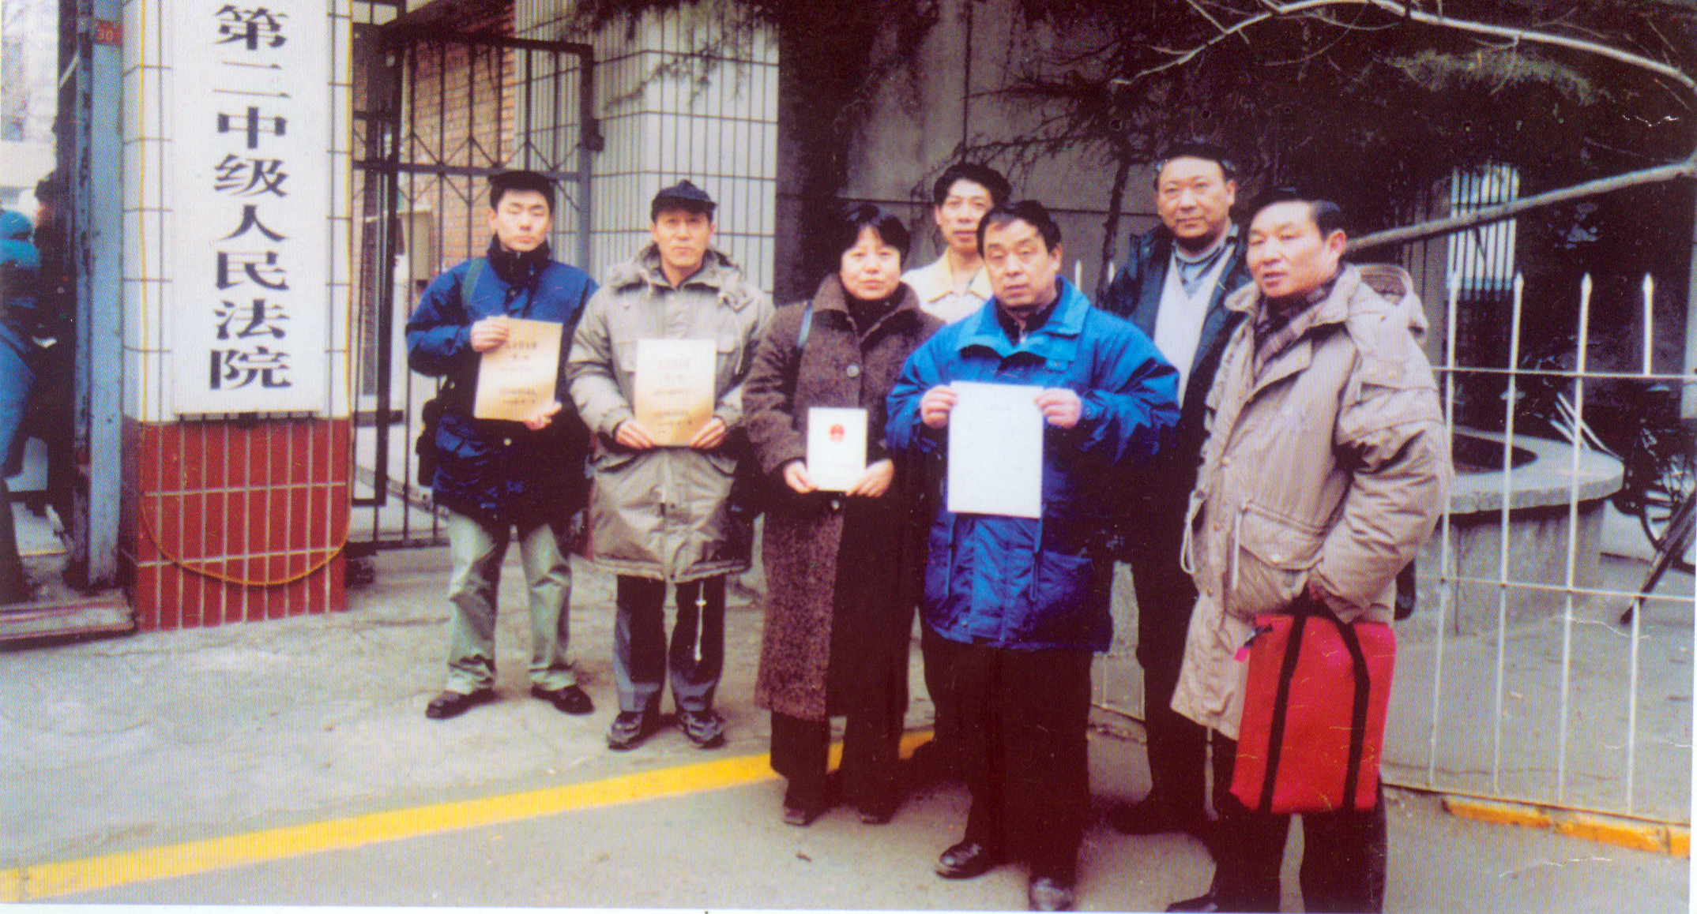
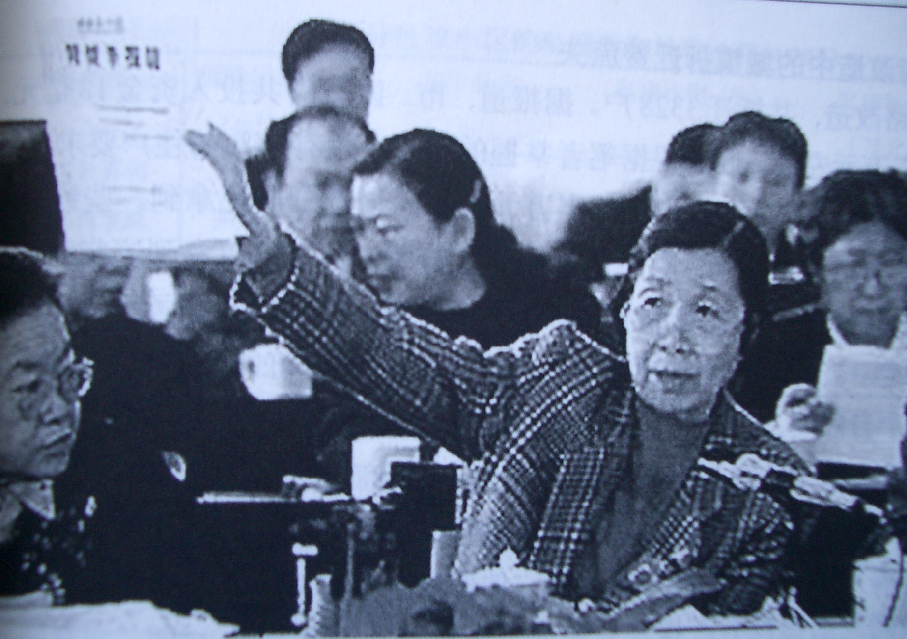
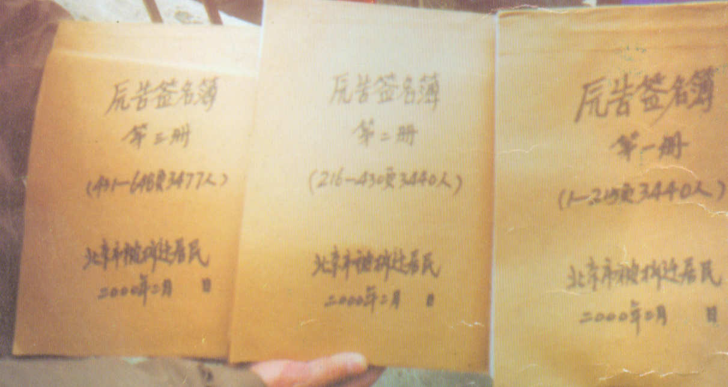
The Grand Litigation
The report letter was submitted in the 9th National People’s Congress (1999)
22nd, Feb, 2000. 7 representatives of the Grand Litigation in front of the court with the plaint and the book of 10357 people’s signatures.

Slide 10
Question
Chines background
  Nearly no tradition of civil society
  Limited opportunities for ‘legal’ protest
How could this Grand Litigation be possible in Chinese background?
  How could it be safe? (legitimacy )
  How could it be effective? (protesting space)
Notes:
As people suing government, in Chinese background.
Should be both safe and effective. Stratege must be very exiquist. Always stemping on but not cross the line. How do they do it? Very complex

Slide 11
SUBJECTIVITY of actors: Self-empowerment
Redefining “people”
  People being evicted/ “刁 (tricky, slyness, unruly) 民 （people）”
  V.S. Owners of property rights/ Citizens
Redefining the discourse of “demolition”
  subordinated individuals’ obligation to the city development as a common good
  V.S. The adjustment of property relations between independent subjects
Self-empowerment as starting point
  Focusing on “Rights” based on the Law
  Making individuals an equal subject to the state
Notes:
Who we are? What is happening? What we are doing.

Slide 12
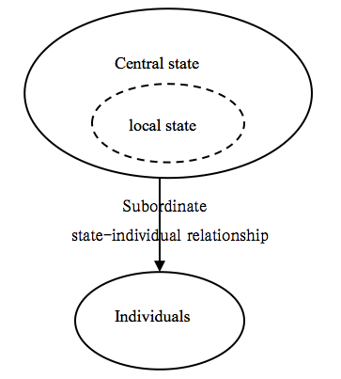
Framing: SPLITTING the state based on the law
Before
Now
Separate policy from law
Separate local government from central government
Separate individual officials from local government
  It is several corruptive officials in local government that broke the law, used policy made by themselves, betrayed central government, thus our rights were infringed, our loss were caused and the state image was damaged.

Slide 13
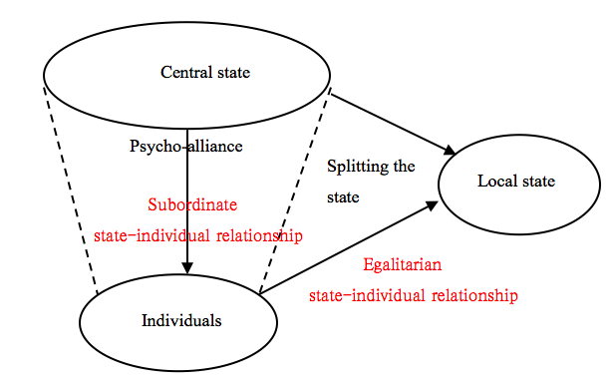
After: Two conditions considering the state-individual relationships

Slide 14
Key of strategy: Multiple roles of law
Law as the rule
  Land use rights—property rights—citizenship
  Rights owners & Citizens & equal subjects in Law
Law as the symbol (of the spirit of central gov)
  Differing laws by levels
    The law (policy) issued by the local government should be subordinated to the law (basic law on the land, Constitutions) issued by the central state
  Defending the basic laws and Constitutions means following the spirit of central state (CPC & state council (against some corruption part of local state)

Slide 15
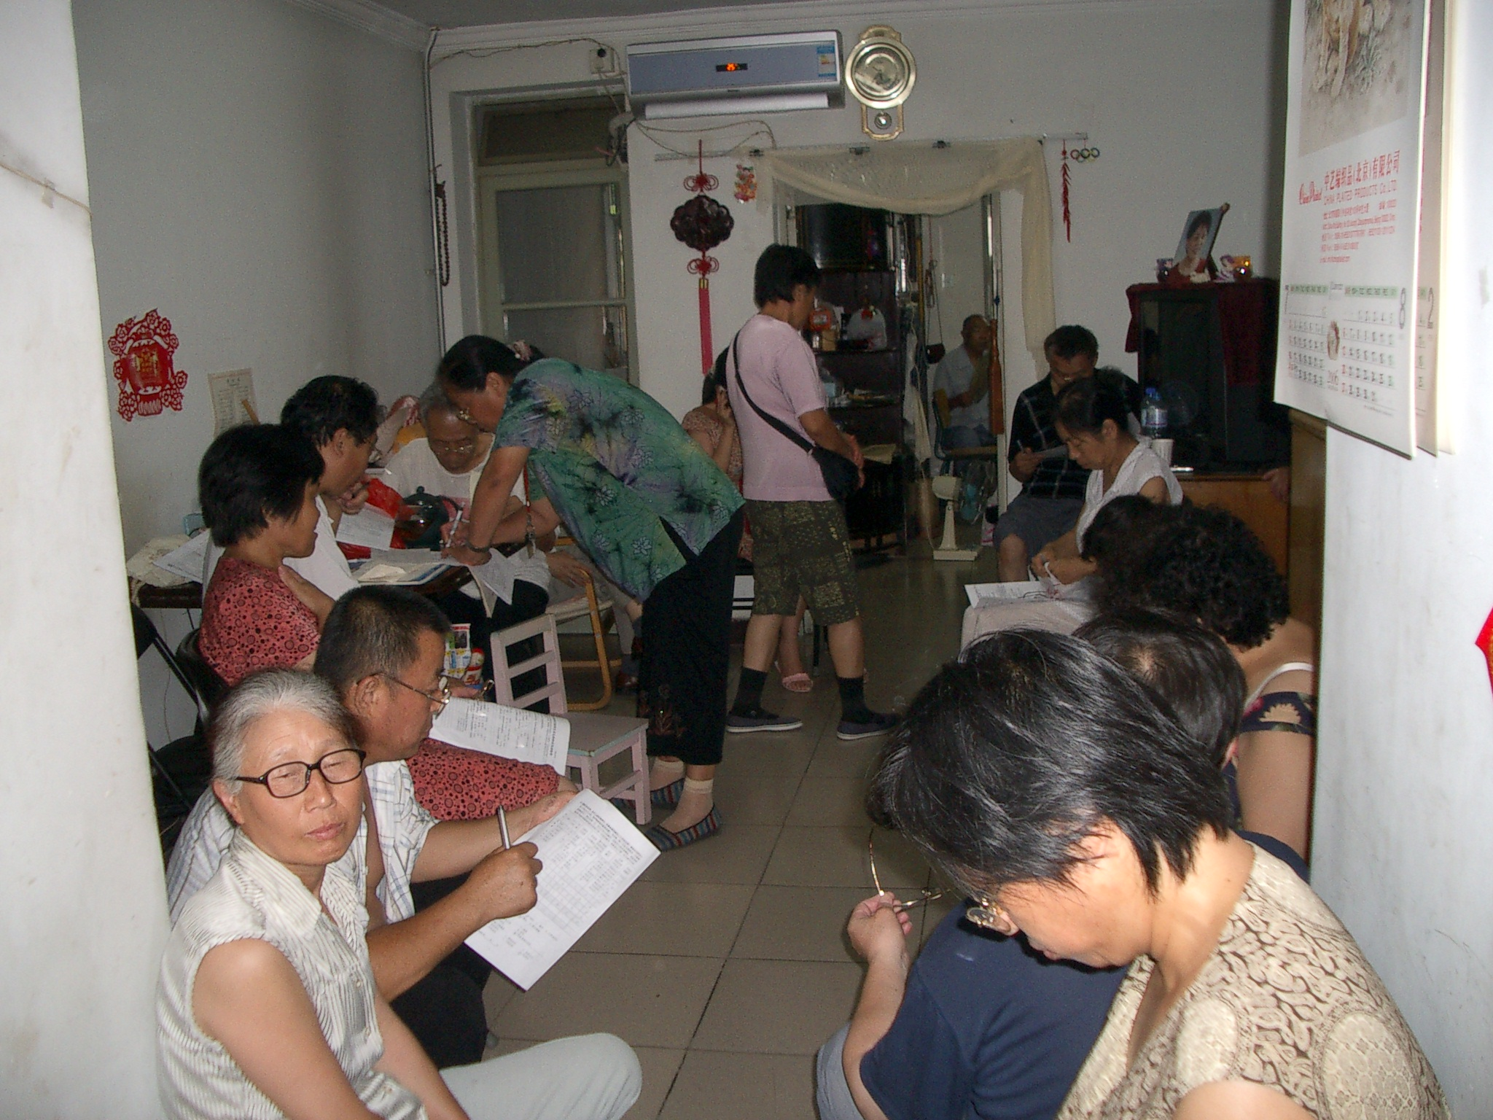
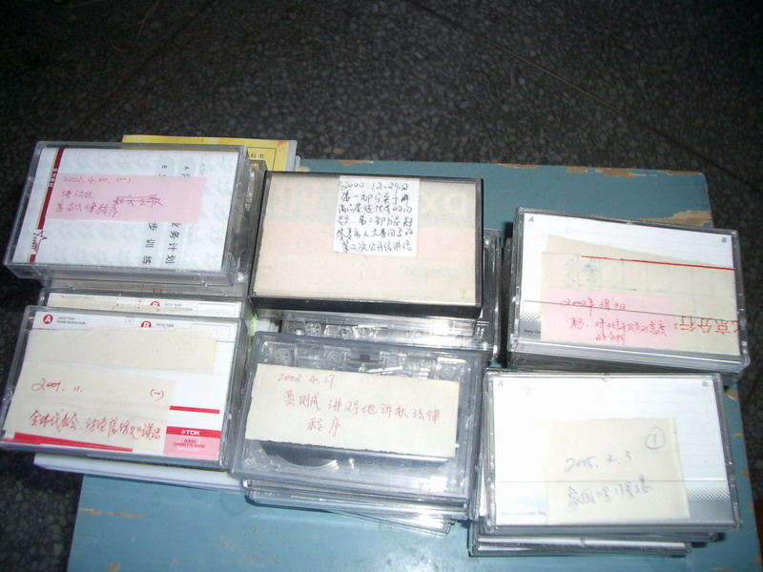
Law as mobilization mechanism
Law learning group
Self-empowerment
&
Safeguarding
Notes:
Context: Buying law books, talking law and using law in everyday life. To self-empowernment
Protecting from the police

Slide 16
Positive Social heritage
Becoming citizens during movement
    Citizen =Action—— Using Rights！
    “The law not in use is nothing difference to paper. This is just a book. It won’t be your rights until you use it.”
    “If you don’t use your rights, you are like grass. If you use your rights, you are a citizen.”
Citizens - equal relationship to the state
Citizens – emergence of society

Slide 17
Claim: Citizens are entitled to rights
“ If there is no definition about these rights, citizenship should be indicated in fighting for these rights.
If there has some definition in the law already, we should use it sufficiently. Don’t waste even a tiny piece of it. The right itself is protected by the law.
Don’t expecting certain upright official come to save you. No one can rescue you but yourself.
But don’t be so foolish to fight something illegal by doing something illegal. We have to govern our own behavior.”

Slide 18
Thank you!
shiyq@cass.org.cn

Slide 19
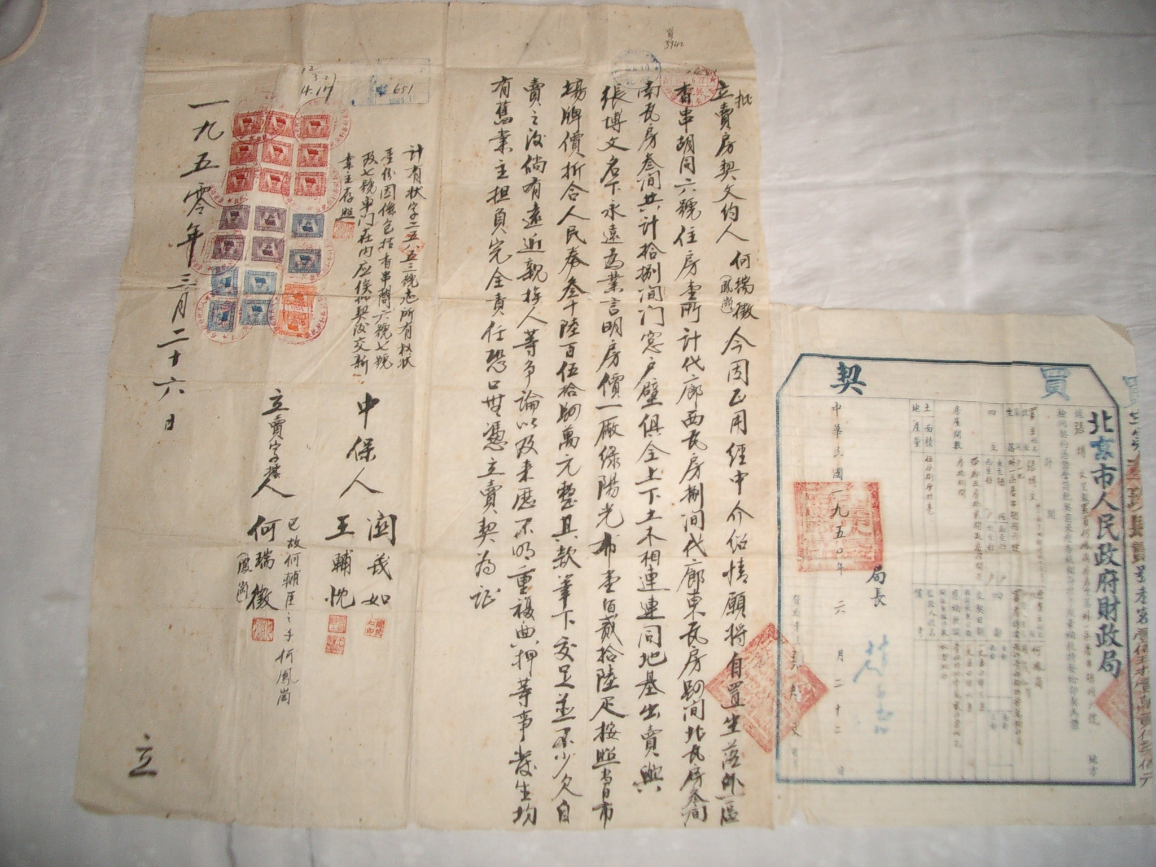
Land & House Contract

Slide 20
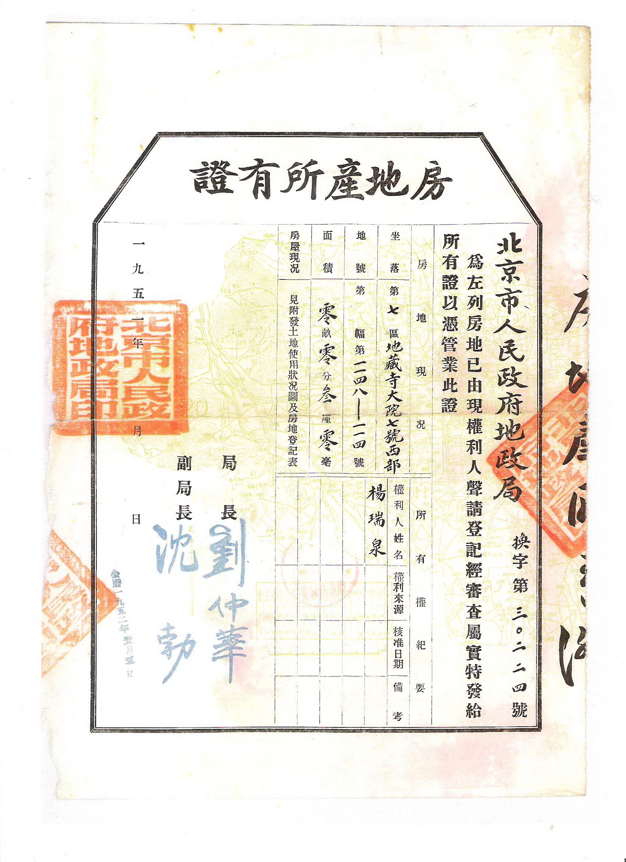
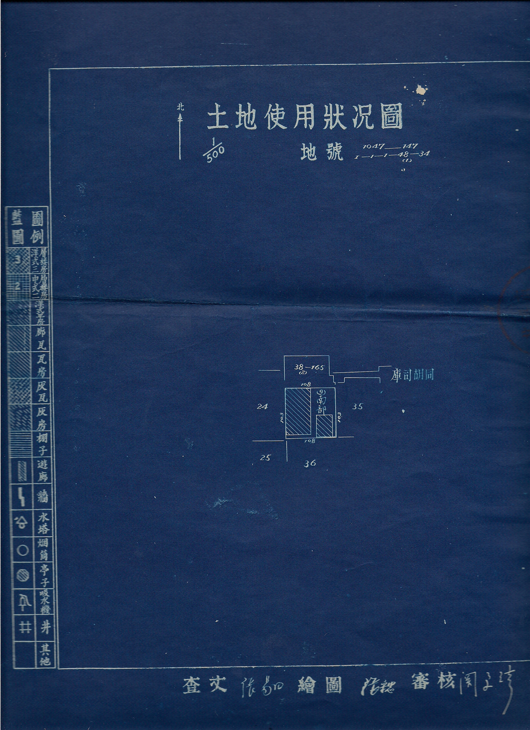
Property Ownership Certificate for House and Land

