Slide 1
Mosaic Familialism in Post-Reform Urban China: A Sequential Symbiosis of Generation, Gender, Love and Money
Yingchun Ji
January 12th, 2018
Post Western Sociology in Europe and in China: Gender, Migration, Emotion
Workshop LIA CNRS-ENS Lyon/CASS

Slide 2
Background：
Economic Transition and Globalization
Socialist to Market Economy Transition
Resurgence of Confucian Patriarchal Tradition
Globalization and Neoliberalism

Slide 3
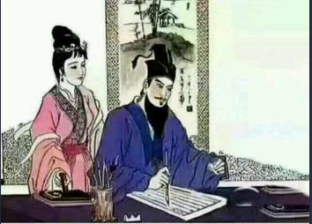
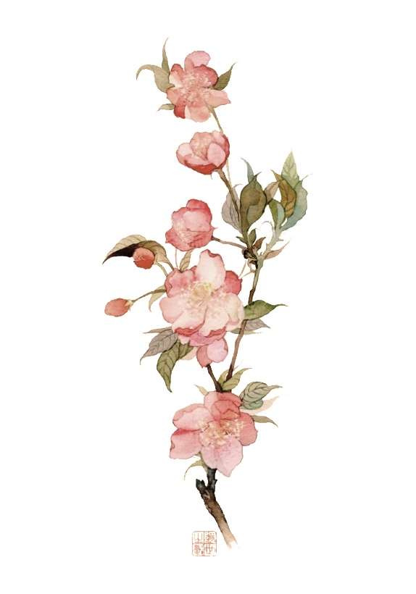
  唐宋时期，老婆对老公说：官人你我年龄也不小了，你也该娶个小的了，要不左右邻居肯定说我不懂事。
  老公专心写字，头也不抬地说：没见我天天在忙么，哪有空想这事。
  老婆说：要不我帮你相一个，你看中就点个头，剩下的我来操办行不？
  老公仍不抬头，说：你看着办吧……
  这么优秀的传统文化，居然丢了，唉……
唉，丢了的传统文化…

Slide 4
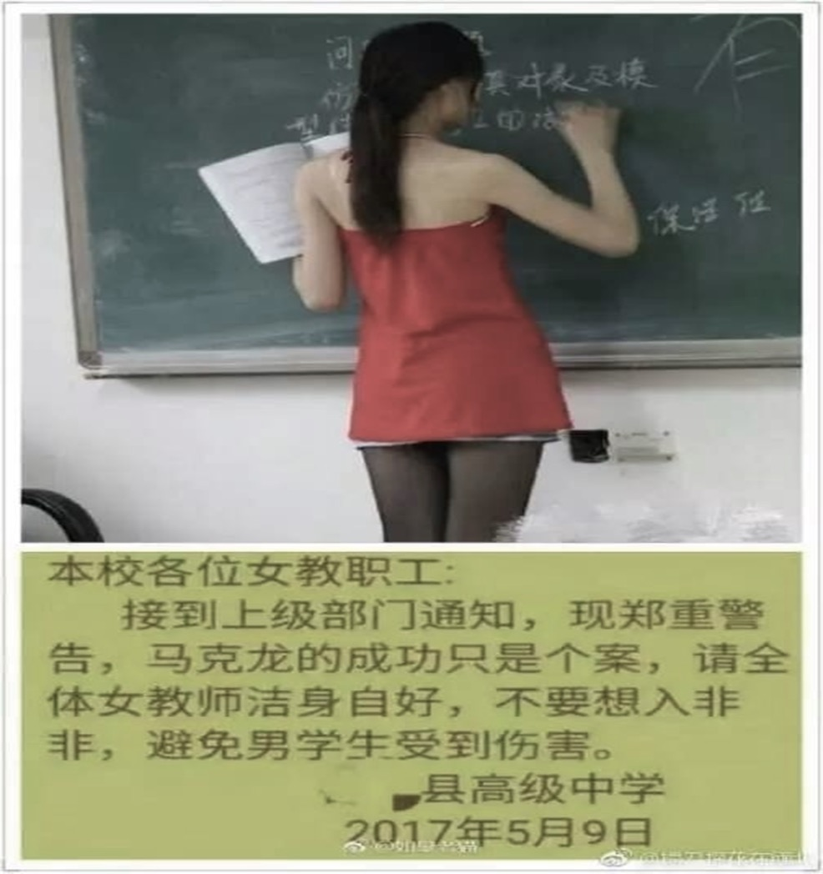
危险的女教师

Slide 5
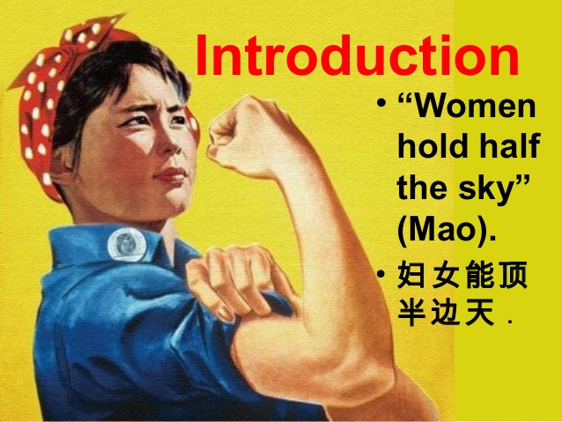
Mosaic Temporality
and Perplexing Gender Dynamics
Dual State Apparatus in the Socialist Time
  Danwei System and Marxist Egalitarian Gender Ideology
  Private Embedded in the Public Spheres
  Simultaneous Construction of Family and State

Slide 6
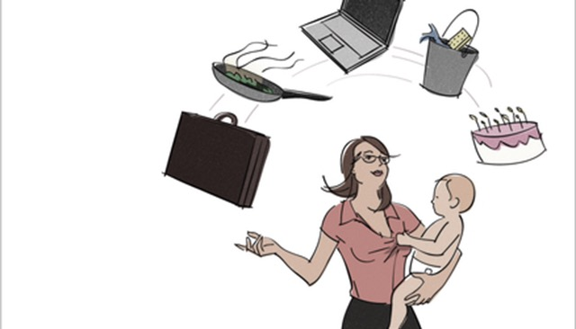
Mosaic Temporality
and Perplexing Gender Dynamics
The Public and Private Sphere Separation in Post-Reform Urban China
  Marketization of Reproductive Responsibilities
  Changes in the Labor Market
    Employment Rate
    Gender Earning Disparity
    Gender Discrimination
    Occupation Segregation
    Motherhood Penalty
    Dual Earner Family and Women’s Work-family Conflict

Slide 7
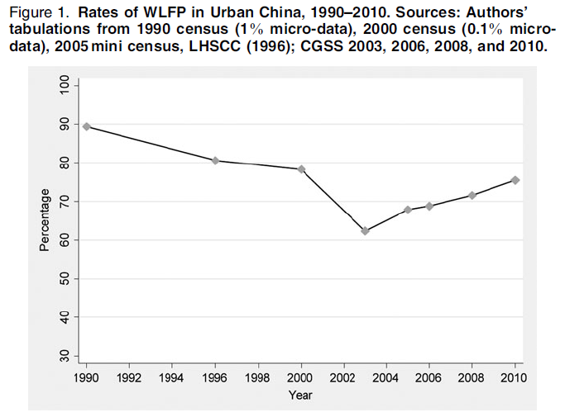
Source：Wu, Y., & Zhou, D. (2015).Chinese Sociological Review

Slide 8
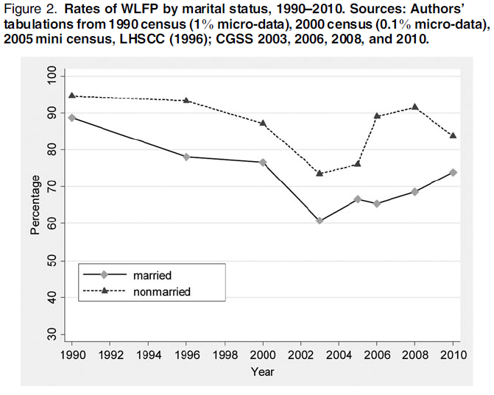
Source：Wu, Y., & Zhou, D. (2015).Chinese Sociological Review

Slide 9
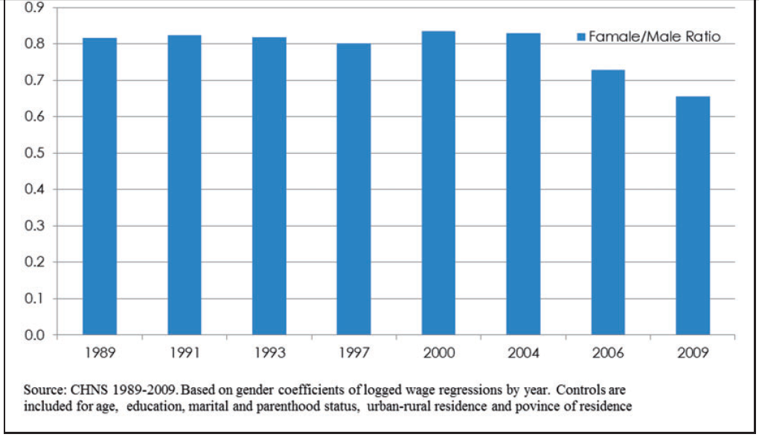
Figure 1. Female to male ratio in wage income
Source: Zhang, Y., & Hannum, E. (2015). Chinese Journal of Sociology

Slide 10
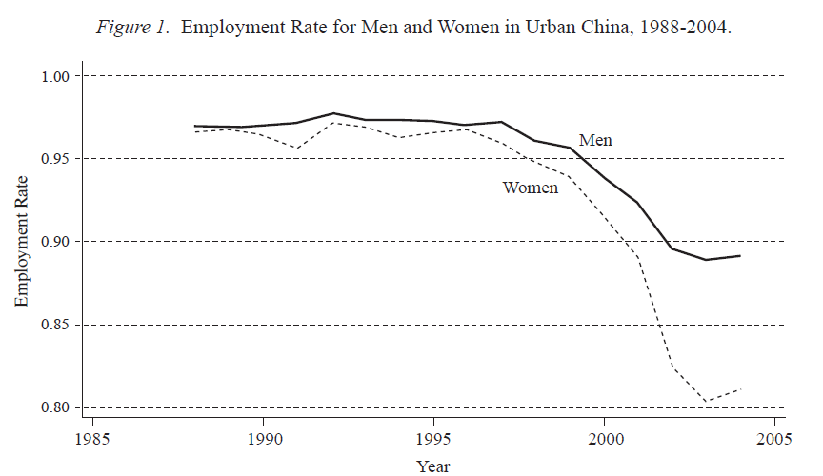
Source: Zhang, J., Han, J., Liu, P. W., & Zhao, Y. (2008). Industrial & Labor Relations Review

Slide 11
Perplexing Gender Ideology
  Resurgence of Confucian Patriarchal Tradition
  The Personal Quality Discourse in Early Marketization
    Personal Quality and Competency
  Globalization and Neoliberalism
      Personal Responsibility and Personal Choice
  The mysterious Meeting between Neoliberalism and Confucianism

Slide 12

Reinstitutionalization of Family：
Intergenerational Dynamics
Importance of Family
  Family under the Danwei system
    Iron Bowl
    Danwei welfare
  Family in the Market
    From big family to small family
    From son for old age support to boomerage kid
    Functions and meaning of family
  Intergenerational symbiosis

Slide 13
Reinstitutionalization of Family：
Marriage Formation
Why to Marry?
  The Institutional Link between Marriage and Fertility
  Single Child and Raising Sons for Old Age
  Resurgence of Patriarchal Tradition and Women’s Traditional Role Expectation

Slide 14
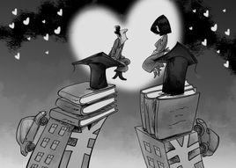
Reinstitutionalization of Family：
Marriage Formation
Matching Doors or Hypergamy？
  Matching doors? The Feudal Arranged Marriage?
    Family? Individuals?
    Money? Emotion?

Slide 15
Reinstitutionalization of Family: Gendered Pattern
家务劳动时间的性别模式：2017年上海都市社区调查数据

Slide 16
Reinstitutionalization of Family: Gendered Pattern
家庭权力分配的性别模式：2017年上海都市社区调查数据

Slide 17

Discussion and Conclusion
Mosaic Familialism: Generation-Gender Symbiosis
Complex Temporalities
Perplexing Gender Dynamics

Slide 18
讨论和结论
马赛克现代性
  传统
  社会主义现代性
  市场经济现代性
  全球化和新自由主义的影响
  从宏观到微观的杂糅性

Slide 19
@Yingchun Ji

