Slide 1
« Differences in the difference » :
When the Distinction Between love & Friendship Differs Across Children’s Gender and Social Background
Workshop LIA CNRS-ENS Lyon/Chinese Academy of Social Sciences
“Post Western Sociology in Europe and in China”
Gender, Migration, Emotion
01/12/2018
Kevin DITER
PhD Candidate in Sociology at CESP-Inserm U1018, University Paris Saclay (Paris Sud)
Supervisors: Muriel DARMON & Nathalie BAJOS

Slide 2
Introduction
“Hey Kevin, do you know what is the difference between love and friendship? […] I am wondering how we know we are sure to be in love with a girl? You should know: you are the ‘specialist of love’!” Luke (6 years old, middle-class family) (Field note on Valentine’s Day)
“The big difference [between friends and sweetheart] is that you don’t kiss your friends! You don’t go out with them, you don’t kiss them and so one and so forth... Anyway, I never kissed my friends. It never happened to me” Zach (11 years old, working-class family)
“With your boy friends, you can get married, and then you can have children. [...] You do not marry with your female friends ! [KD: Oh? Why not?] Because they are your female friends, they are not your boy friends! This is not the same. […] You marry the boy you are in love with and you play and have fun with your friends, that’s it” Mary (7 years old, upper-middle class family)

Slide 3
Introduction
The questions about the definition of love, friendship and the difference between this two feelings are common among children, especially when they talk privately and secretly about their intimacy with their same-sex friends;
Despite the frequency of these ‘private talks’ (sic) and their importance in boys’ and girls’ discussions about everyday life, little is known in social sciences about:
  Children’s perceptions of love and friendship (Bréchet, 2015; Bright, 1997)
  Or whether and how girls and boys manage to distinguish female or male friends from girlfriends and boy friends (Cannoni and Bombi, 2016; Martin et al., 2007) .

Slide 4
Introduction
Most scholars, even those who are interested in children’s voice and peer culture, neglect the (socially differentiated) way boys and girls define and characterize the two feelings and their borders.
The research in social sciences tends to pay greater attention to :
  the gendered experiences of friendship and love during childhood (Giordano, 2003; Renold, 2000, 2005; Thorne and Luria, ; Thorne, 1993)
  the social conditions and the different stages by which girls and boys have to pass through to become friends or to fall in love (Corsaro, 2003, 2005; Delalande, 2001 ; Ahn, 2011)

Slide 5
Introduction
By focusing primarily on these topics (experiences and processes) rather than on children’s own representations, scholars forget several elements :
  1/ Girls and boys have a more or less precise idea of what love and friendship are and this idea is not an exact reproduction of adults’ one. Children can relatively negotiate, reinterpret, reshape adults' injunctions, norms and definitions thanks to their peer and the symbolic resources that the latter partly provide (Corsaro, 1993; Lignier, Pagis, 2017).
  2/ The different limits of the adult-centered perspectives that analyze children behaviors from adults’ definitions of love and friendship, namely: the risk of over-interpretation, misinterpretation, adultomorphism and miserabilism (Ahn, 2011; Corsaro 2005)
  3/Children’s perceptions and definitions of love and friendship play an important role on the (socially and gender-differentiated) experiences of romantic feelings, as well as the place these two feelings have in boys’ and girls’ daily life.

Slide 6
Aims of the Communication
The paper aims at fill this gap by mapping the space of ‘styles’ (Bourdieu, 1979) of love and friendship among boys and girls. More specifically, it is about highlighting that:
  1) contrary to what adults think, the majority of children are able to define and to distinguish love and friendship from an early age;
  2) children’s representations of these two feelings (and their borders) differ across gender, age and social background.
  => There are “differences in the difference” (Passeron, Singly, 1984) between love and friendship and these differences are mainly due to the gendered and class-based socialization to emotion that children received within the family

Slide 7
Methodology
This communication is based on two different types of materials :
    A one-year participant observation in a Parisian school located in a socially mixed neighborhood (in process of gentrification);
    A quantitative survey conducted among all school children from ages 6 to 11 (n=116).
Notes:
Cette « triangulation des données » permet de pallier les limites de chacune de ces méthodes prise individuellement en combinant leurs apports respectifs.

Slide 8
The Quantitative Survey
Two types of questions were used in order to grasp children’s definitions of love and friendship (and their borders):
    First, questions about the distinctive features of the two feelings, and especially their ‘age’ and their ‘gender’ :
        Is love more important for children? for adults? for both of them? for neither of them? Same questions w/ friendship.
        Are girls generally more interested in love stories than boys? (Totally agree or disagree) Same question w/ friendship in my fieldwork.
    Secondly, two multiple choice questions concerning the type of activities that boys and girls perform with their friends and sweetheart so as to underline ‘‘practical differences’’ that children make between love and friendship (as well as their social variations/conditions):

Slide 9
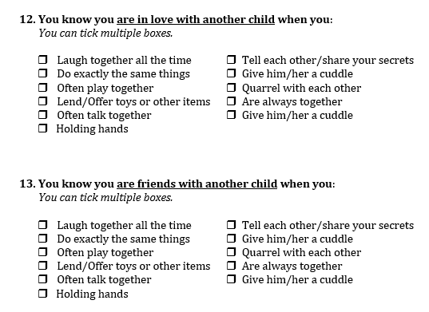
The Two multiple choice questions
Notes:
Petite précision : ces différents items ne sont pas de mon seul fait. Ils m’ont été suggérés par les enfants eux-mêmes lors des entretiens ou directement sur le terrain lorsque nous abordions l’un ou l’autre sujet.

Slide 10
I. The Gender and Age of (Romantic) Feelings
The first difference children make between love and friendship is about Gender :
    (a) The gender of (romantic) feelings : love is perceived as a feminine topic/(pre)disposition, while friendship is considered as a more gender neutral area. According to the children, the latter feeling is as interesting and important for boys as it is for girls.
    (b) The gender of the child with whom children interact: A similar interaction, whatever its form or content, will not be defined in the same way if it involves two children of the same sex or two children of the opposite sex. In the first case, the interaction will be considered as a friendship relationship, while, in the other, the interaction will be re-labelled as a romantic relationship.

Slide 11
I. The Gender and Age of (Romantic) Feelings
(A) The gender of (romantic and friendship) feelings :
  Contrary to friendship, love is mainly perceived as a feminine topic or (pre)disposition:
    Indeed, almost two out of three children think that “girls are more interested (by nature) in love and/or in love stories than boys” (70% of boys and 64% of girls respectively);
    Conversely, girls and boys are less than 5% to assign a gender to friendship. Only three children have defined this feelings as a feminine topic. All the others said that friendship is as important to girls as it is to boys.

Slide 12
I. The Gender and Age of (Romantic) Feelings
(A) The gender of (romantic and friendship) feelings :
  This feminine label of love is due to several reasons (Cancian, 1987 ; Diter, 2015; Swilder, 2001; Thorne, Luria, 1986) :
    1/ With the exception of anger, almost all emotions are considered to belong to women. Men are thought to be both less emotional and more rational (Schrock, 2014; Shields, 2002)
    2/ Women’s involvement in romantic feelings because of `gender division of emotion work'. They (learn to) display more interest and more concern in this topic than men (Duncombe, Marsden, 1993 ; Hochschild, 1983)
    3/ The hyper-ritualization of the feminine gender of love (Goffman, 1976 ; Toliver, 2016) (cf. the following pictures)

Slide 13

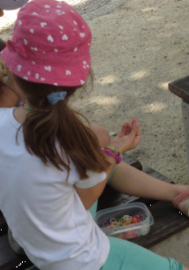
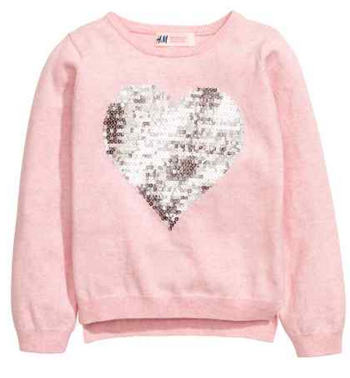
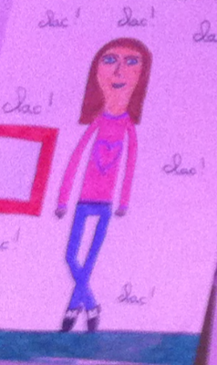



Slide 14
I. The Gender and Age of (Romantic) Feelings
(A) The gender of (romantic) feelings :
  This feminine aspect of romantic love is not share by all children :
    Girls, upper(-middle) class children and older boys and girls tend to have a less gendered perception of this feeling. They think that even if girls and women are more involved in love, men and boys are also interested in this topic, that this feelings matters for them.
  The socially differentiated perception of romantic love is due to emotion education received by children within family:
    Concerted cultivation vs Accomplishment of natural growth (a laissez-faire parenting style) (Lareau, 2003)
    This distinction between these two types of education helps to understand why romantic feelings remain still gendered in working-class families while they tend to ‘lose” their gender in upper-middle class families.

Slide 15
I. The Gender and Age of (Romantic) Feelings
(B) The gender of the child with whom children interact, discuss or play contributes to help boys and girls to distinguish between love & friendship:
  When a boy and a girl play, speak, stay together in face-to face relationship (without sign of struggles), the interaction is perceived as a romantic relationship by the majority of children;
  While a same interaction between same-sex children will always be labelled as a friendship relationship. None of the children named a same-sex relationship as a romantic relationship.
  Cf. children’s drawing concerning love & friendship

Slide 16
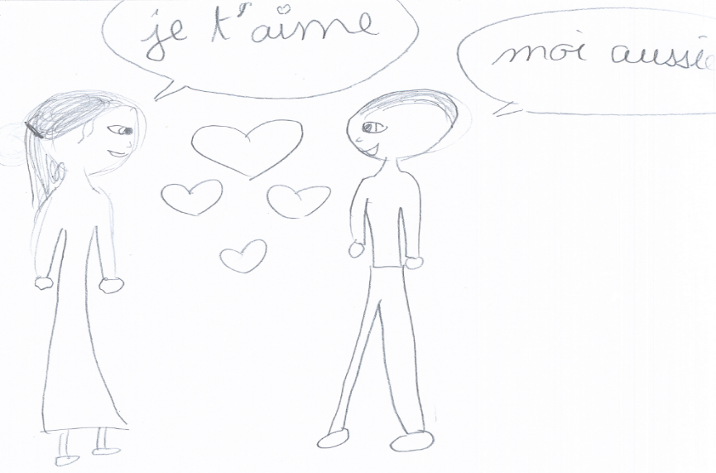
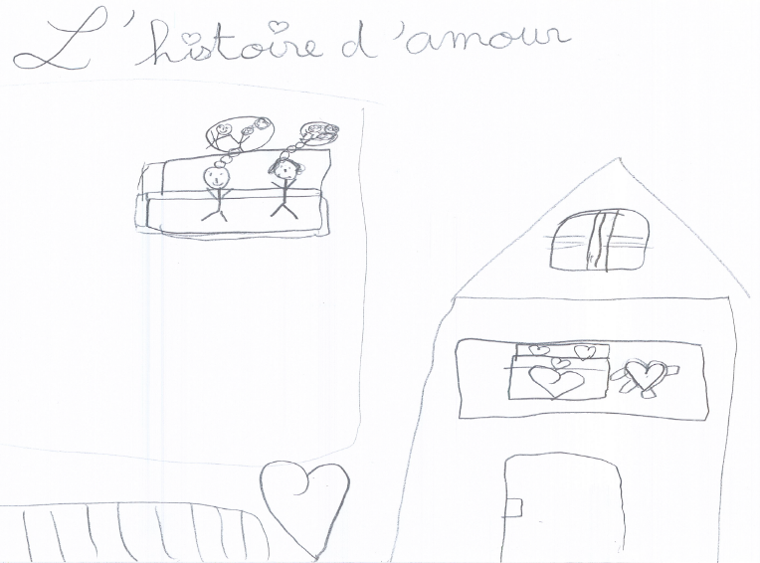
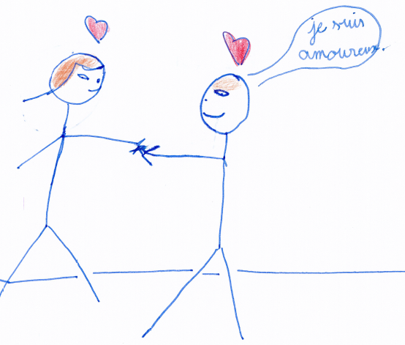
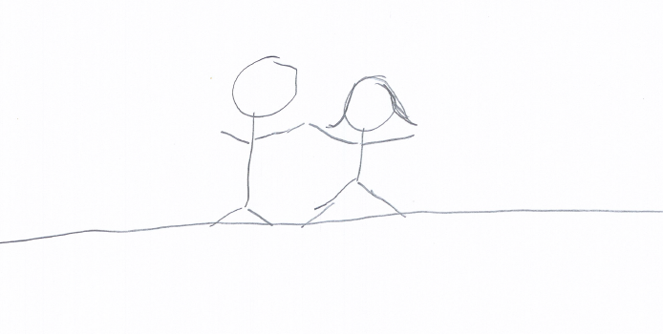
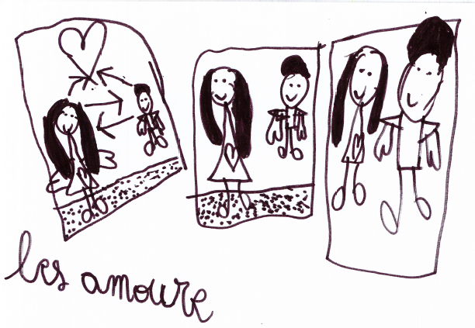
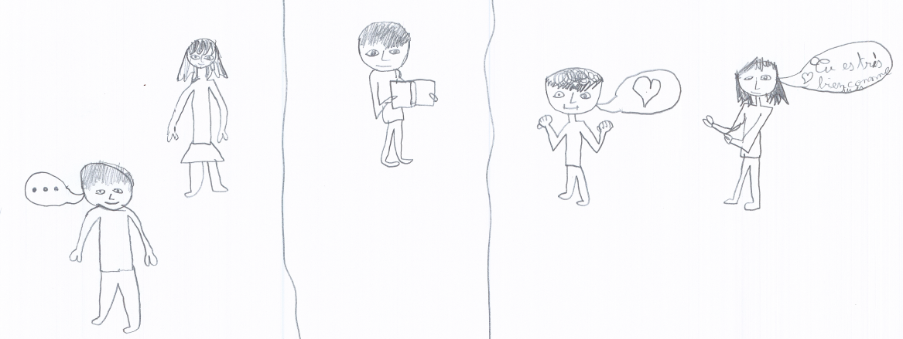

Slide 17
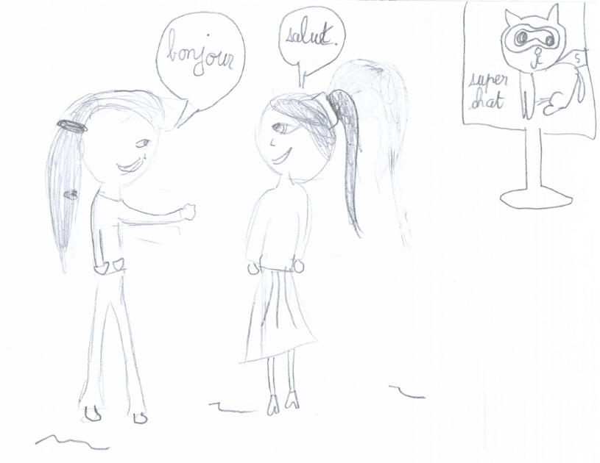
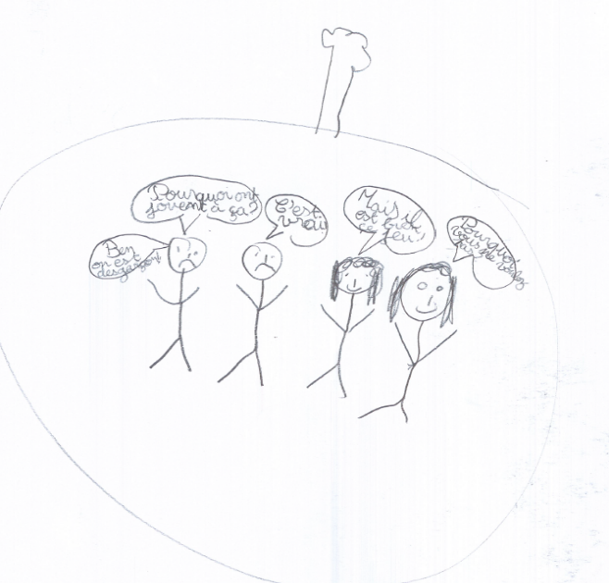
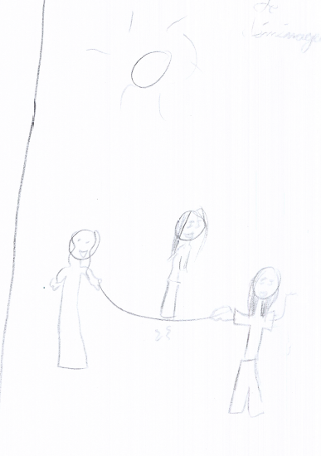
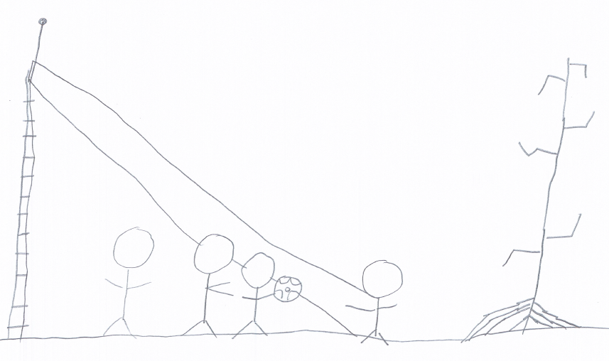
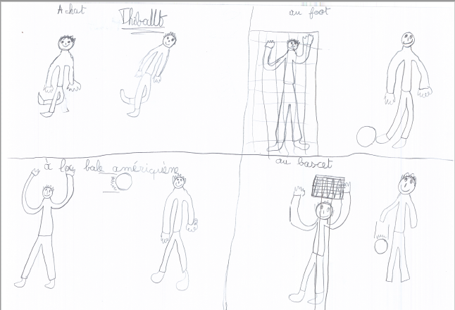
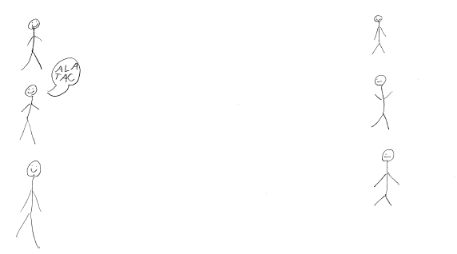

Slide 18
I. The Gender and Age of (Romantic) Feelings
This important role of the children’s gender in the process of labeling a relationship as romantic relationship or as a friendship relationship highlights two central elements:
    1/ Love is always seen as a heterosexual relationship by children and heterosexuality is perceived as a natural evidence;
    2/ Friendship is mainly understood as a same-sex relationship (gender-based homophily) as shown by the quantitative data in the following table

Slide 19
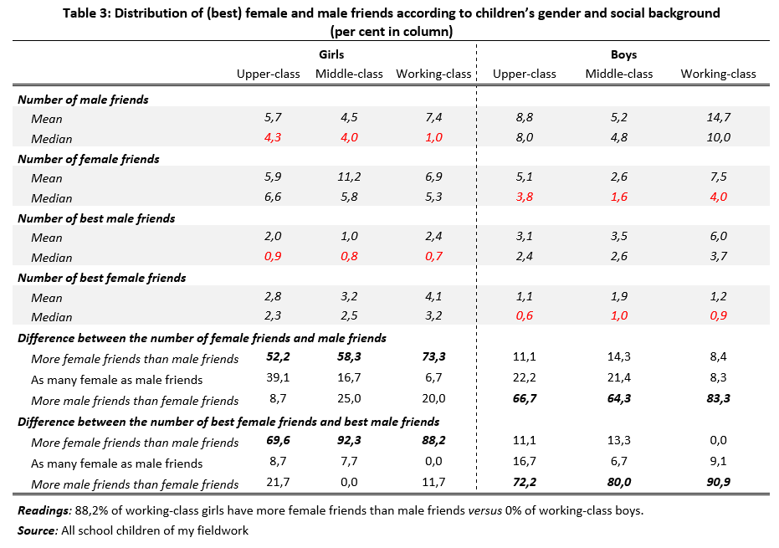
I. The Gender and Age of (Romantic) Feelings

Slide 20
I. The Gender and Age of (Romantic) Feelings
0

Slide 21
I. The Gender and Age of (Romantic) Feelings
0

Slide 22
I. The Gender and Age of (Romantic) Feelings
The second difference that children make between love and friendship is about the age of (romantic) feelings:
    Friendship is mainly viewed as a children’s disposition or activity
    While love is considered as a (feminine) adult’s topic.

Slide 23
I. The Gender and Age of (Romantic) Feelings
    According to both children and adults, (very young) boys and girls only experience ‘fling’ or ‘passing romance’. They don’t know what love or ‘serious’ relationships are. They will learn these romantic feelings when reaching adulthood.
        “Falling in love at my age? That doesn’t mean anything. You know, I am too young…” (Alexia, 9 yo, Upper-Class)
        “I don’t know very well [how to define what love is]. It’s difficult to say. […] I did not experience it. I am way to young. It will be easier when I grow up” (Tim, 11 yo, Middle-Class)
        “Love is more important for adult than for children! Children, they don’t really know what true love is. They don’t date, they don’t have kids. […] They just have small love stories” (Prune, 7 yo, Upper-Middle Class)

Slide 24
I. The Gender and Age of (Romantic) Feelings
Also, according to both children and adults, friendship is mainly considered as a children’s disposition. Having friends is a part of the “occupation as child” (métier d'enfant) (Chamboredon, Prévot, 1973).
    “Without friends, life would be worthless” (Pierre, 11 yo, upper class)
    “You know, it's important when you're a child to have friends, otherwise you're always alone and you do nothing. [...] For children, nothing is more important than having fun” (Lea, 10 yo, working class)
    “Having friends, it’s for children! It’s children who play with their friends. Have you ever seen adult play football ? They only sit down and discuss…” (Diane, 9 yo, middle class)

Slide 25
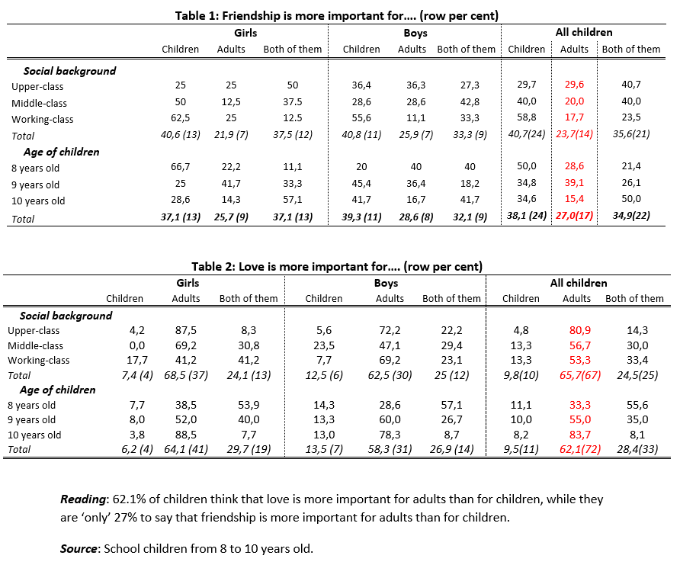
I. The Gender and Age of (Romantic) Feelings

Slide 26
I. The Gender and Age of (Romantic) Feelings

Slide 27
I. The Gender and Age of (Romantic) Feelings
The ages of romantic and friendship feelings are not randomly distributed in the social world:
    Among working-class families: Love & friendship seem to be more associated with a specific age/life period: adult and children respectively.
    Among upper-middle class families: The two feelings appear to be more neutral in terms of age. Boys and girls are more likely to consider that love and friendship are as important for children as for adults.
These socially differentiated representations of love and friendship:
  Have different consequences about children’s (future) involvement in romantic and friendship relationships and the importance they (will) attach to these two feelings
  Are also due to the different types of emotional education children received within family, namely: concerted cultivation vs accomplishment natural growth).

Slide 28
II. The “Practical” Differences between love & Friendship among Children
Beyond the age and the gender of the two feelings, children distinguish love from friendship thanks to the different activities they perform :
  when they are with their friends;
  or when they are with their boy friends or girlfriends;
Two questions helps us to highlight how boys and girls distinguish ‘in practice’ love and friendship are the following ones

Slide 29
II. The “Practical” Differences between love & Friendship among Children

Slide 30
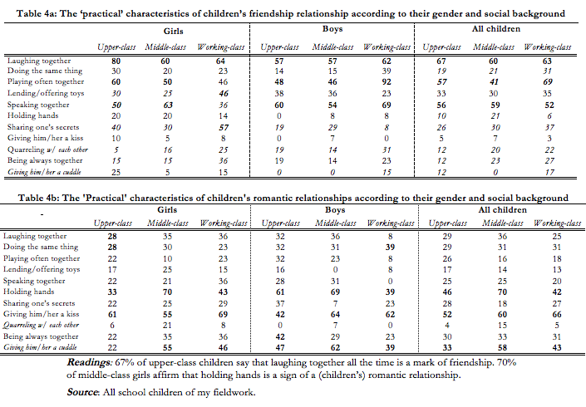
II. The “Practical” Differences between love & Friendship among Children

Slide 31
II. The “Practical” Differences between love & Friendship among Children

Slide 32
II. The “Practical” Differences between love & Friendship among Children

Slide 33
II. The “Practical” Differences between love & Friendship among Children
Three main results:
  1/ Friendship is mainly characterized by children as a ‘proximity of doing’ : friends laugh together, play and speak often together and
  2/ Love is is mainly characterized by children as a ‘physical proximity’: lovers kiss, cuddle, and hold hands.
  3/In children’s ‘practical’ definitions of love & friendship, the central difference appears to be what children can consider as sexuality, namely kissing and cuddling.

Slide 34
II. The “Practical” Differences between love & Friendship among Children
The role of sexuality in children’s distinction between love and friendship is not share by all boys and girls:
  Sexuality is more present in the words of working-class boys and younger children (6 yo).
  According to upper-middle class children and girls think that sharing feelings and secret are the main border between love & friendship
These differences are due to their styles of friendship and love.

Slide 35
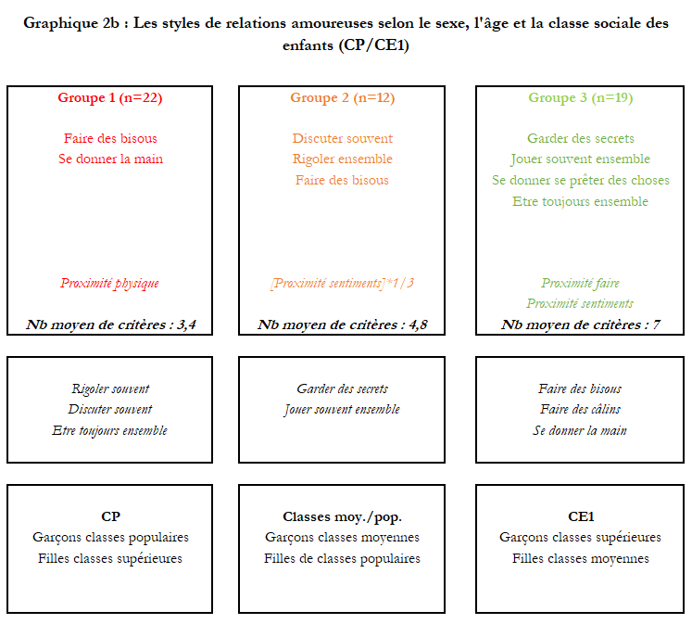
II. The “Practical” Differences between love & Friendship among Children

Slide 36
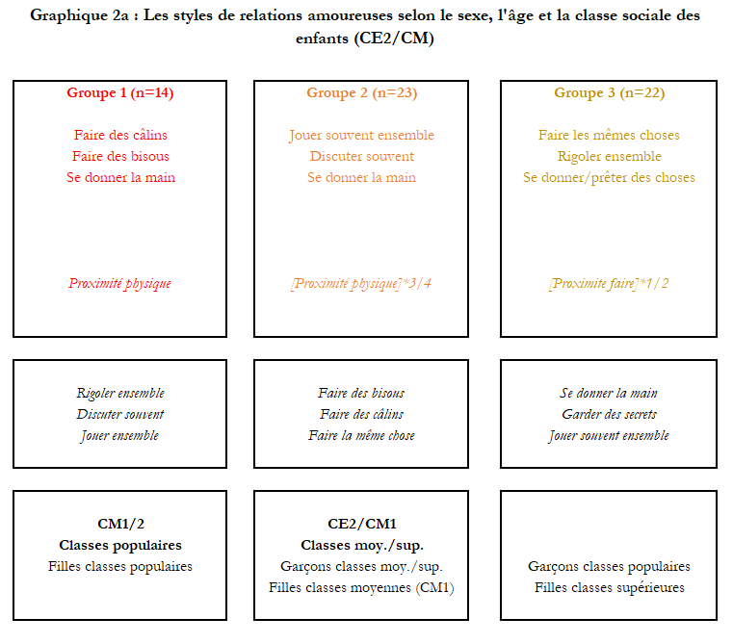
II. The “Practical” Differences between love & Friendship among Children

Slide 37
What can be concluded?

Slide 38
Thank you for your attention!

Slide 39
Methodologic Reminder: The Roles of MCA & HAC
In order to define and characterize the different ‘styles’ of friendship and love among children, two methods were used:
    1/ Multiple Correspondence Analysis (MCA) ;
    2/ And then Hierarchical Ascendant Classifications (HAC) based on the coordinates of the different items located on the main dimensions of the MCA.
This two methods complement one another and help to map the social space of children’s representations of love and friendship within a relational perspective (Bourdieu, 1979 ; Lebaron et al., 2016 ):
    Firstly, because both of them allow to gather children who tick the same ‘practical’ characteristics to define romantic or friendship relationship ; Secondly, because they help to oppose and distinguish children who selected specific modalities from others who choose different items.
    In brief, combining these two methods allow us to draw a typology of styles of friendship & love where the intragroup variance is minimal and the intergroup variance is maximal.

Slide 40
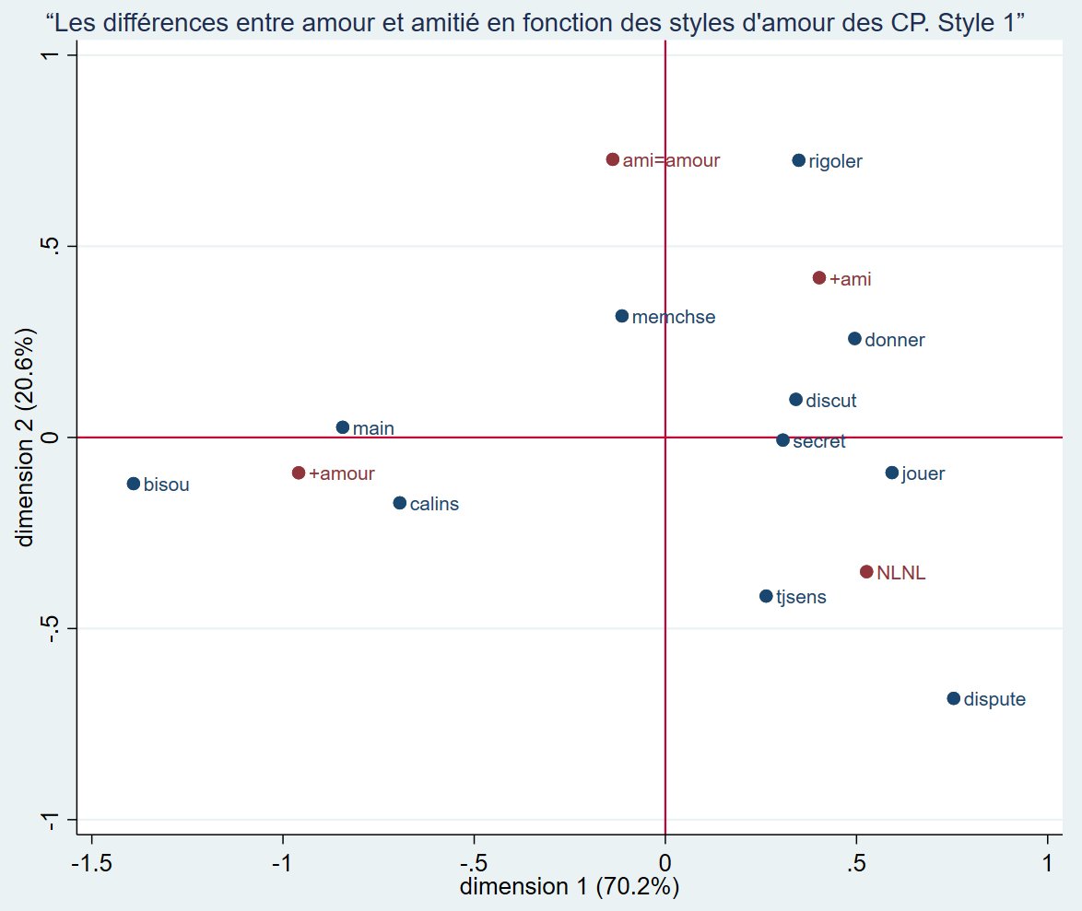
Appendix

Slide 41
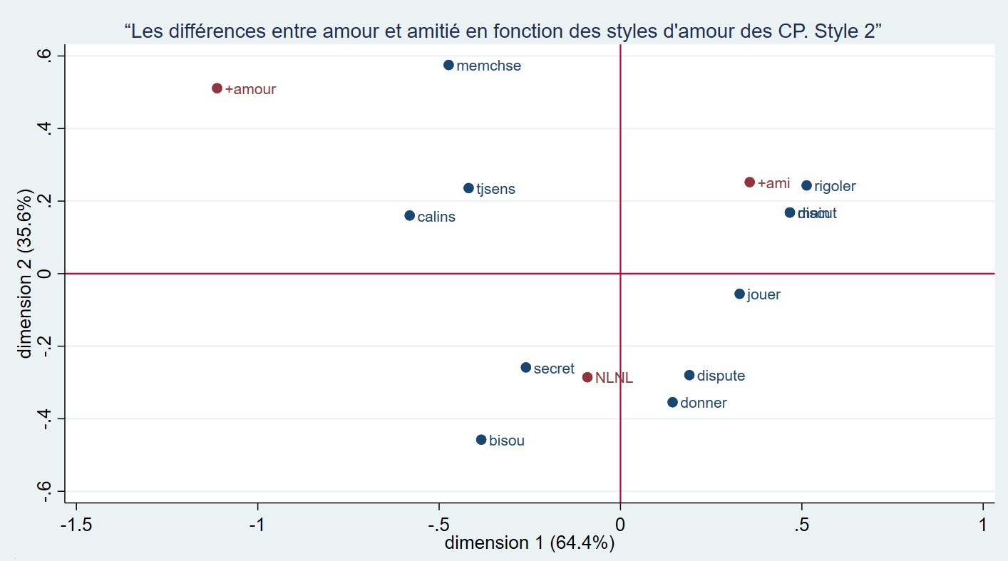

Slide 42
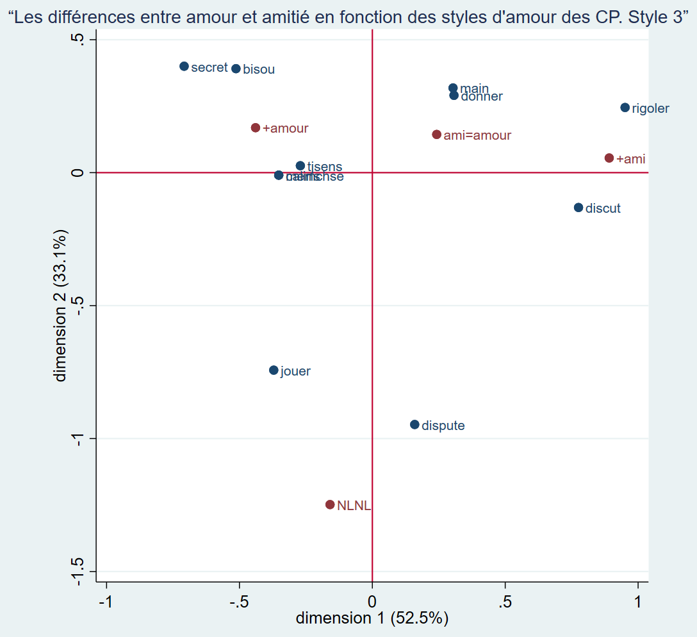

Slide 43
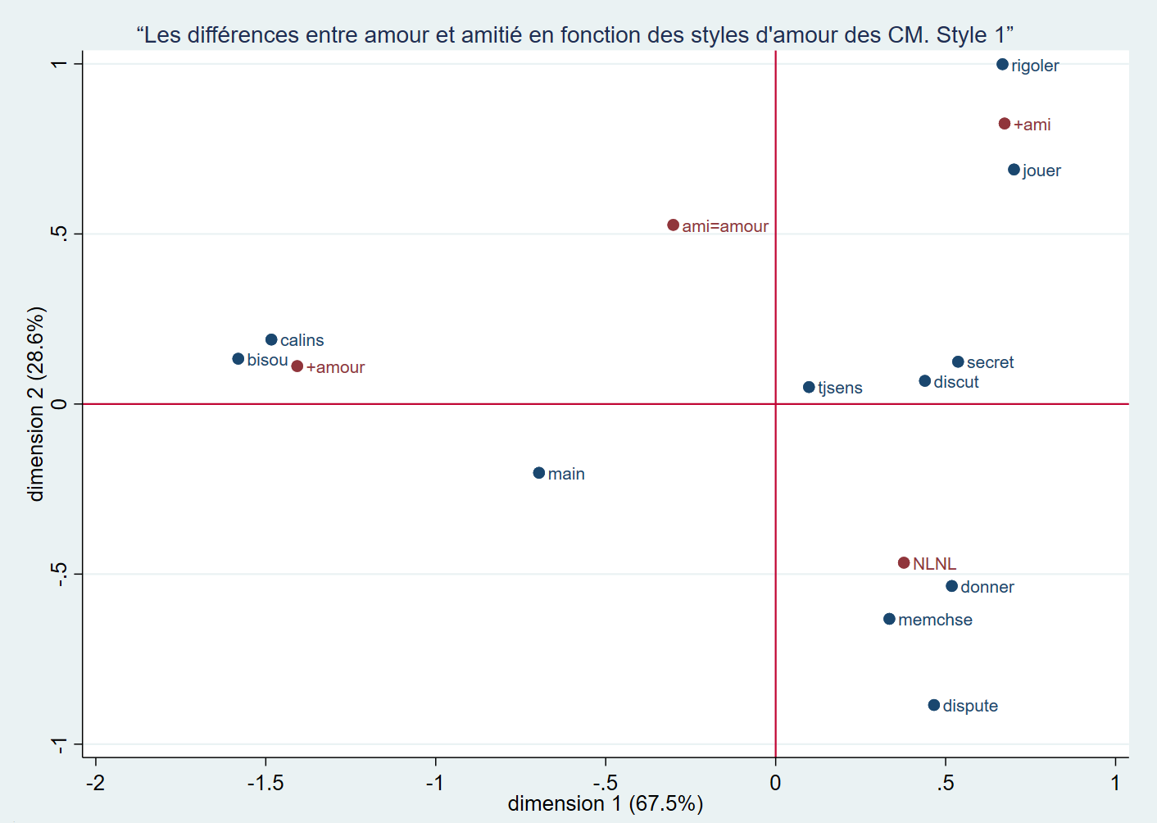

Slide 44
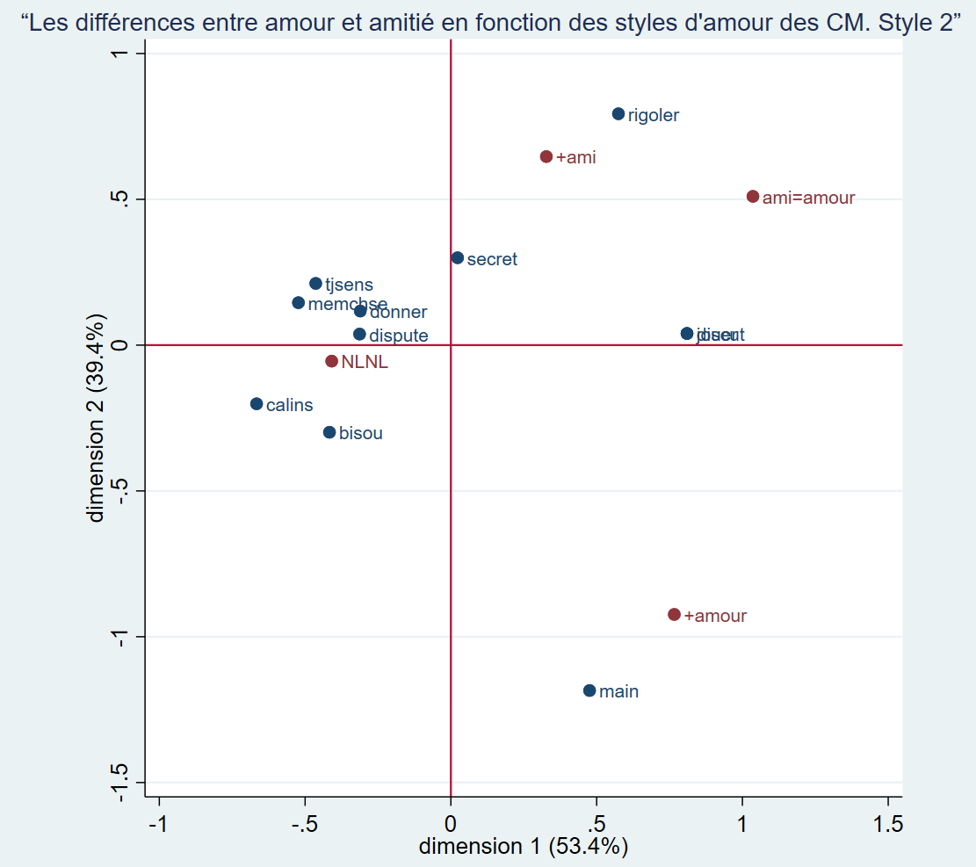

Slide 45
