Slide 1
"Liberation of the Mind" or
"Liberation of Emotions" ? the practice dilemma New Woman in Hunan faced when they " leave home" at the beginning of the Republic of China
Hang Suhong
Institute of sociology, CASS

Slide 2
Three girls……
research objects
"New Women" refers to women who grew up in the 1920s, educated, escaped from marriage, entered big cities such as Shanghai and Beijing, and sought to gain their own independent statu.

Slide 3
Migration & women emancipation
the event of “ leave home”
three meanings of liberation (individual liberation & social liberation & class liberation )
the dilemma of “ leave home”
limits of “ liberation of emotions"

Slide 4
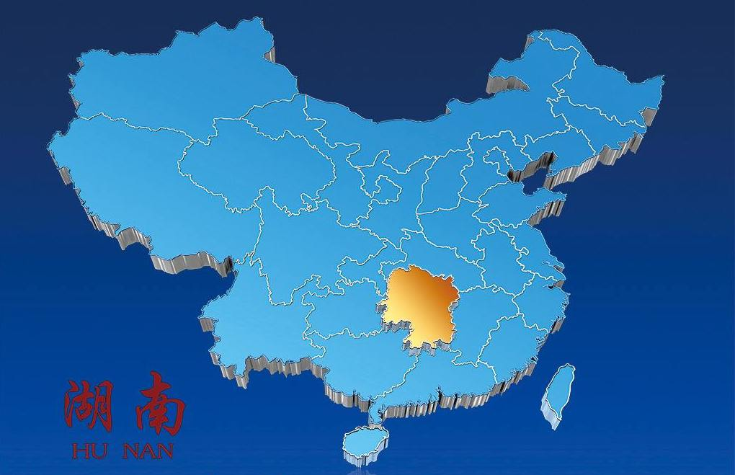
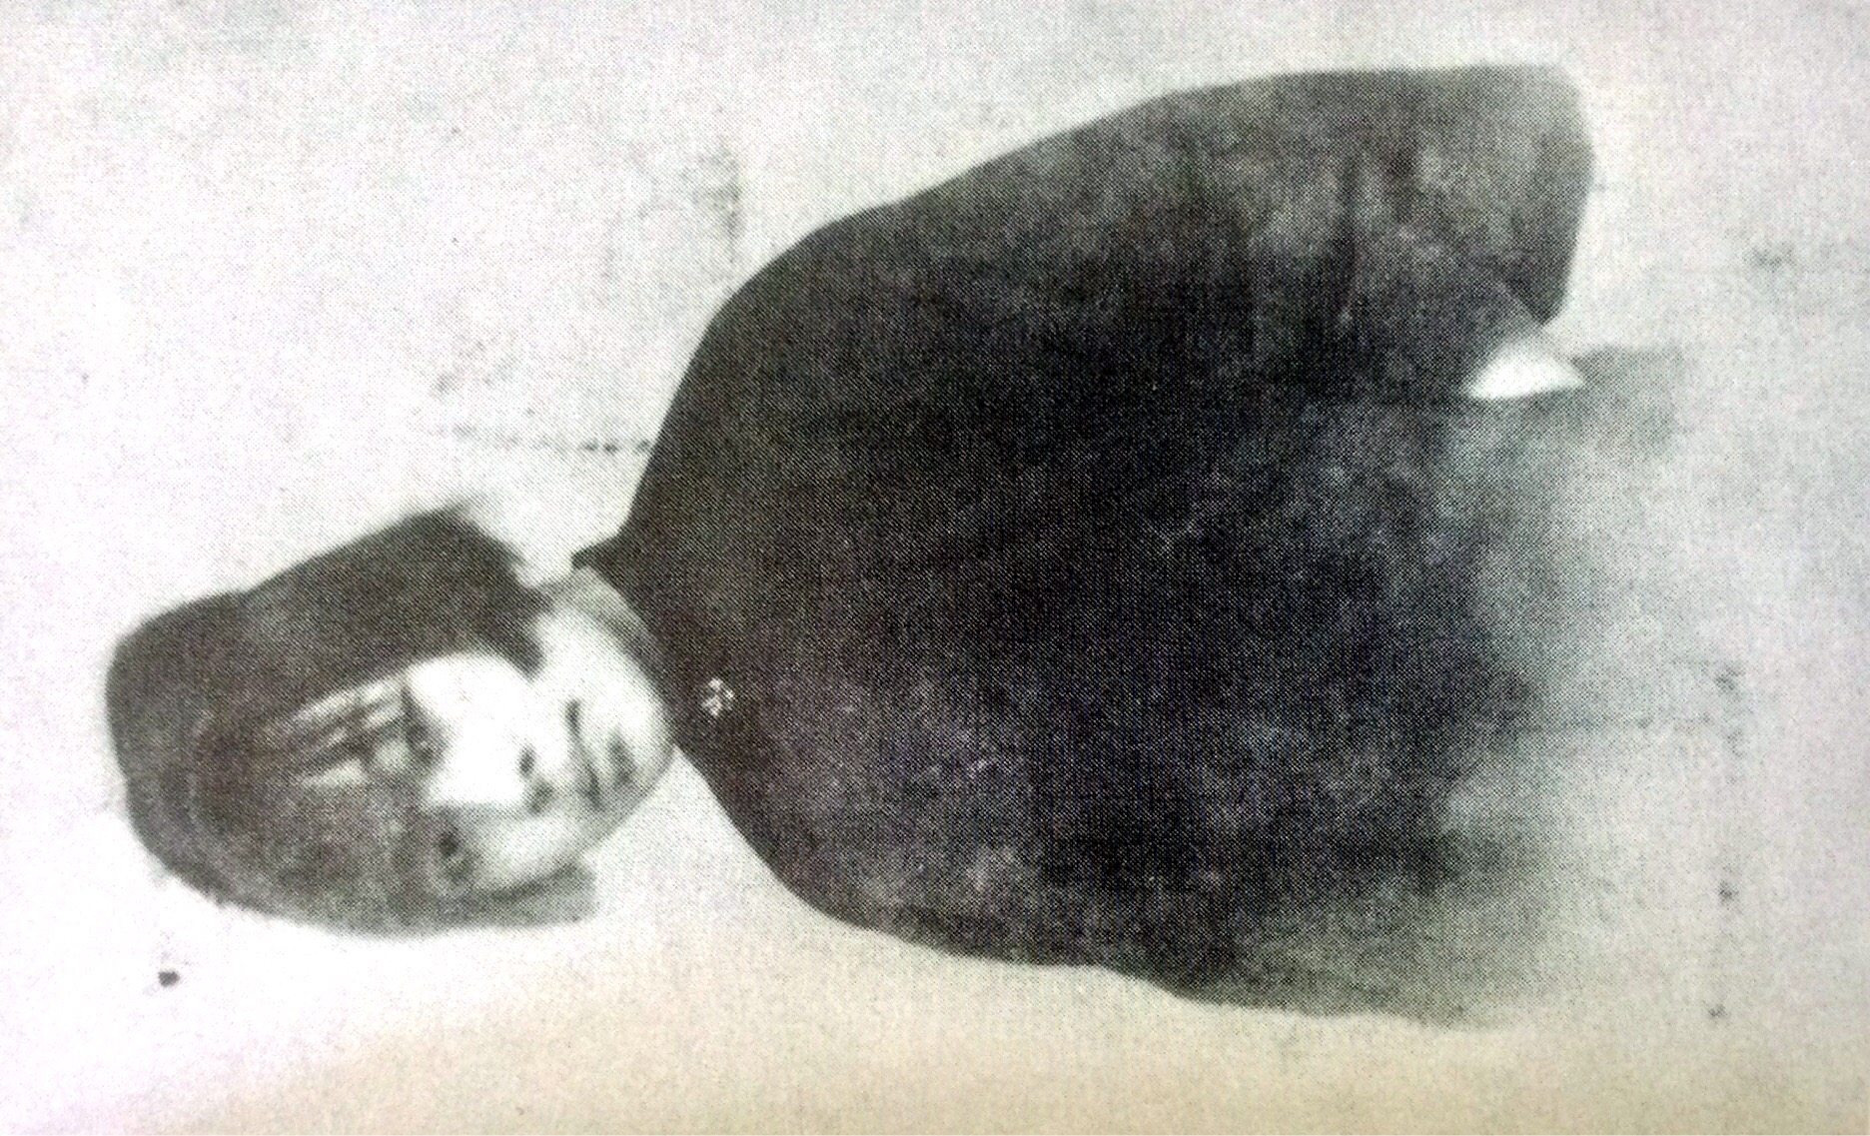
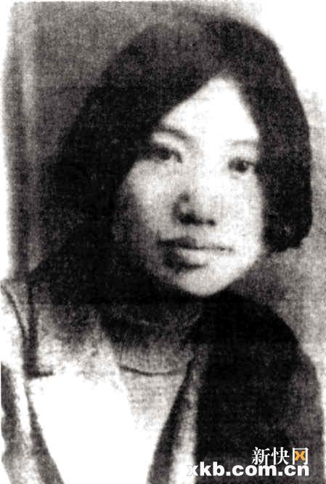
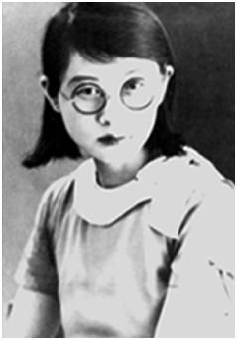
the New Woman from Hunan（1911- 1926）

Slide 5
History materials
Ding Ling. Complete Works of Ding Ling (volume 10) [M]. Hebei People's
Publishing House, 2001.
Xie Bingying. A female soldier's autobiography [M]. China International
Broadcasting Publishing House, 2013.
Bai Wei. Jump off remember [A]. Autobiographical selection of female
writers [C]. Cultivation Press, 1943.
Bai Wei. Tragedy career [M]. Literature Publishing House, 1936.
Bai Wei. My growth and development [J]. Literature Monthly, 1932, (1).
Biyao. Mourning the fourth sisiter [J]. Female voice, 1948, (10).

Slide 6
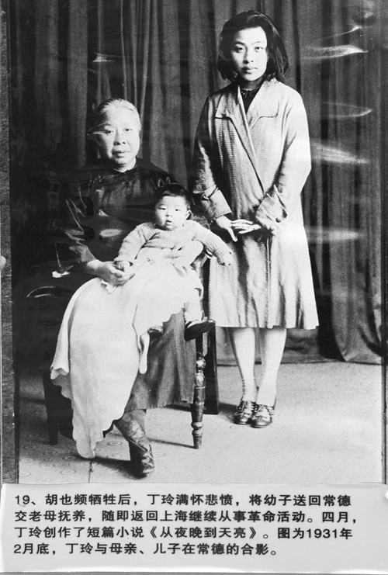
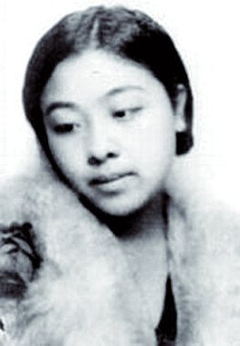
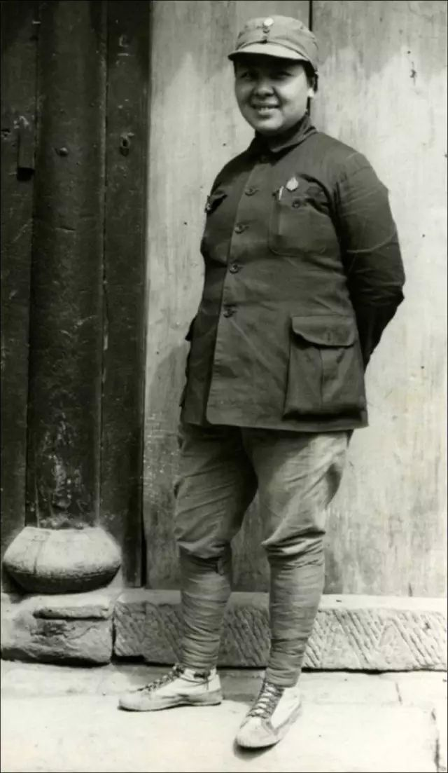
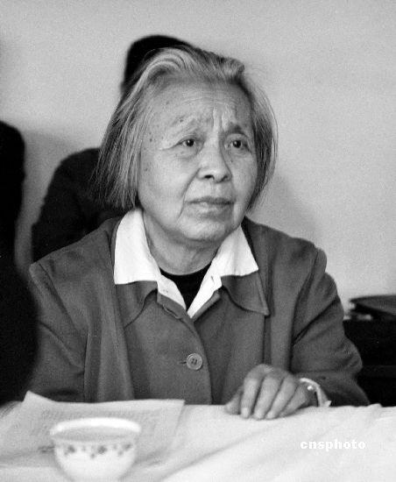
Ding Ling （丁玲）
Before leaving home, 1919, 15 years old. Participate in the parade,cut braids.
Modern Woman after leaving home, dressed in fur
in Yan'an

Slide 7
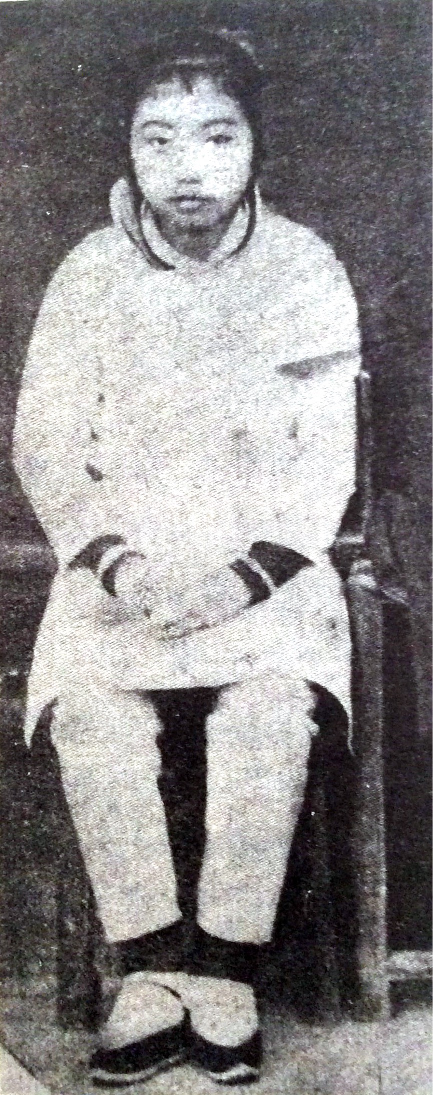
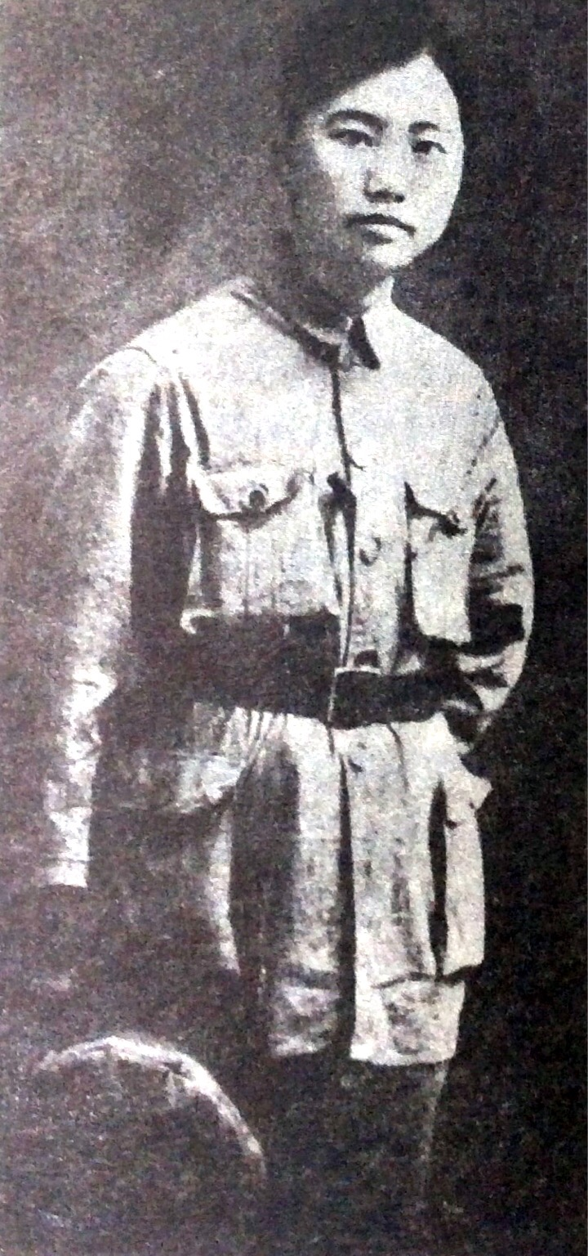
Xie Bingying （谢冰莹）
before leaving home, Footbinding
in army,
also as a
writer

Slide 8
Bai Wei （白薇）and her sisters

Slide 9
their similar features……

Slide 10
1. they were born in the early twentieth century, and grow up during 1919s
1904~
1906~
1893~

Slide 11
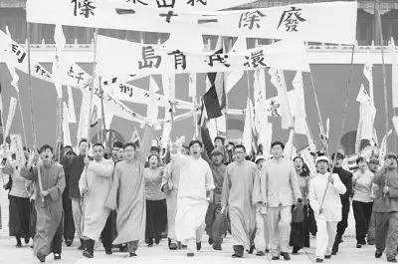
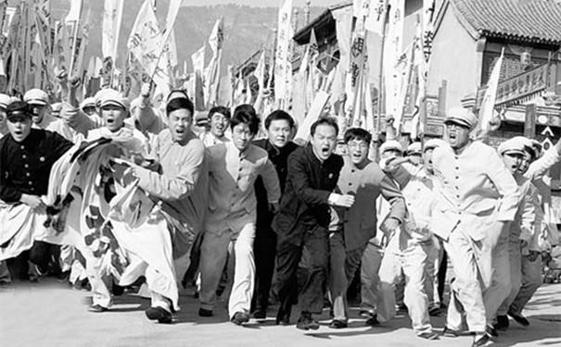
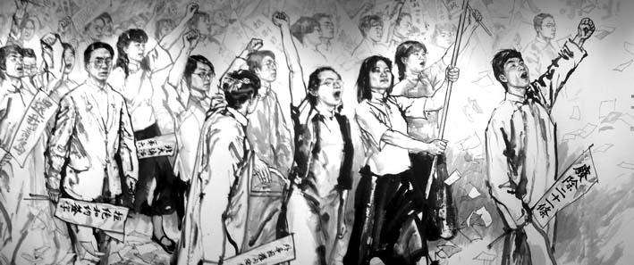

Slide 12
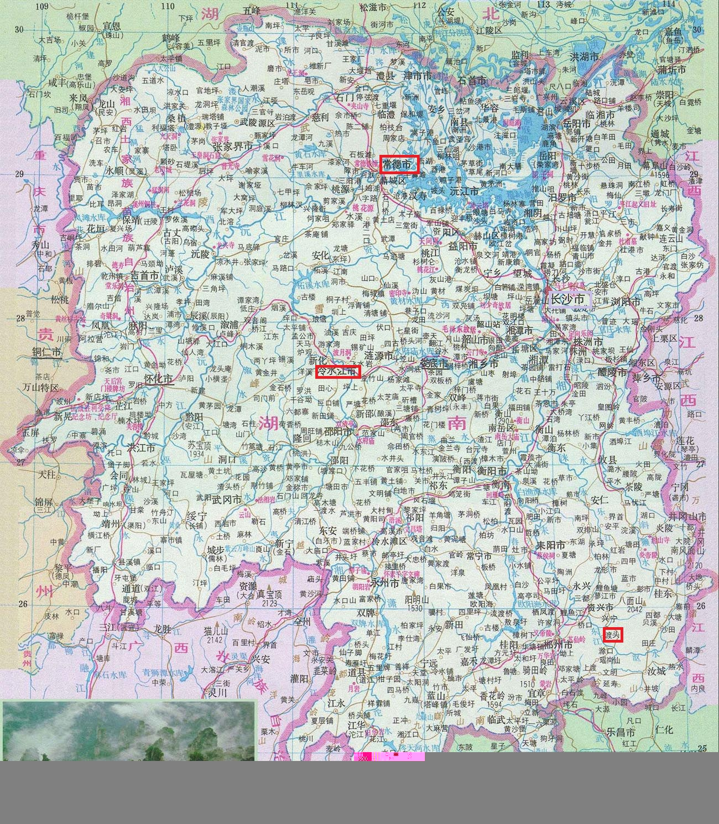
2. they come from prominent families in villages in Hunan

Slide 13
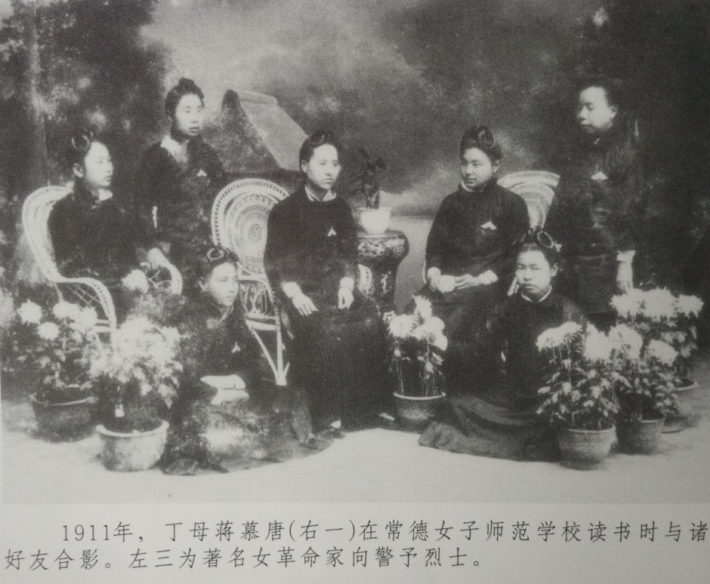
3. they all study in provincial women's normal school, such as the normal schools in Changsha, Taoyuan and Hengyang .
After 1912, when Tan Yan-k'ai's enlightened regime established six women's normal schools, the number ranks first in the country (Xiaoping, 2004). From 1922 to 1923, the number was nine, ranking first in the country with
Jiangsu Province, with 771 students.
(China Education Improvement Society,
1923)
The tuition, accommodation fees free.

Slide 14
the meaning of “leave home"……

Slide 15
Why the New Woman must leave home?
“leave home” as an event: three meanings of liberation
1. individual liberation Bai Wei
2. social liberation Xie Bingying
3. class liberation Ding Ling

Slide 16
1. The pursuit of individual freedom. (individual liberation) Bai Wei
In 1918, 24-year-old Bai Wei left school, escaped to Japan .On the one hand, she was not willing to be forced by her father to return to her husband's family, on the other hand, she long for new knowledge and the new world.

Slide 17
2. Promote social change. (social liberation )
Xie Bingying
As another new Hunan woman, Zhou Tiezhong said "This time we came to serve as soldiers. We have the determination to sacrifice. We left the family to join the revolution in order to help the suffering people and the painful self. "

Slide 18
3. Against the class differences. (class liberation)
Ding Ling
She published a paper on Republican Daily, which criticized her mother's brother for exploiting young infants and poor people in the county.

Slide 19
the dilemma of “leave home"……

Slide 20
1.“leave home or not”: emotional considerations
comparative analysis of Bai Wei and her sisters
The fourth sister’s hesitation, could not bear "parents’ sadness."
The fifth sister at first also gave up leaving home, but after her marriage, she was still unable to adapt to the life, so she left home with her child.

Slide 21
2. “Yuanmu” (怨慕, dissatisfaction / yearning ): leaver’s spiritual plight
Father, God with me, my mentor, doctor when I am ill, nurse and fairy-like, who love me but also will kill me ...... he is the judger who will sentence me to death.
(Bai Wei, 1943: 39)

Slide 22
I want to drop to my knees before my mother’s bed and beg for forgiveness. For four years, I gave her too much pain. Just for my freedom and happiness, mother can’t sleep for all night long......
(Xie Bingying, 2013: 224-225)

Slide 23
“Yuanmu” (怨慕, dissatisfaction / yearning )
Mencius(孟子） used this word to express Shun(舜, a saint in china)’s emotion when he was disgusted by his parents and half-brother, or even to be killed by them. (Mencius, 1983: 302).
“Yuan” means dissatisfaction;"Mu" means "children cry and call for parents ", it’s an instinctive behavior, natural and congenital. When these two emotions are together, it’s disharmonious, full of tension and anxiety.
In the feeling of “Yuanmu”, did the leavers really get liberation? If not, what factors caused this "incomplete" liberation?

Slide 24
Reflections on the theory of Women's Liberation……

Slide 25
Conventional theory more concerned about women's liberation of the mind. (Ouyang He xia, 2004; Yin Danping, 2009; Yao Fei, 2009)
However, compared with the mind, "emotion" also has a more profound impact to liberation. We will explore the possibility and the limits of “Liberation of emotions” in women’s emancipation.

Slide 26
(A) Compared with the liberation of mind, why does the liberation of emotions is so hard?
Compared with mind, emotion has following characteristics:
Emotion between parents and children is instinctive and natural.
The social attachment which is formed by living together in a family is hard to break up.

Slide 27
(B)The possibility of “ liberation of emotions" : Emotional Transformation
Emotion in a family——Emotion in a new community
Such as: Students groups & lovers & revolutionary groups

Slide 28
(C) the limits of “ liberation of emotions"
"Liberation" means completely free state, mind can reach this state, but emotion can’t.
"Emotion" need an object. When a New Woman gets rid of family emotions, she tries to look for emotional satisfaction in other communites. It is still an attachment relationship, which means uncomplete freedom. This is the plight of "Liberation of Emotions" .

Slide 29
The end, thank you!

