Slide 1
Intimate feelings, economic transactions and production of local norms among hostesses working in a KTV in Beijing
International Associate Laboratory “Post Western Sociology in France and in China”, CASS/ CNRS-ENS Lyon
2018 January 9th-12th
LIA International workshop “Gender, Migration, Emotion”
Organizer: Triangle, ENS Lyon
Co-Organizers: Institute of Sociology, CASS
School of Political Science and Sociology, Shanghai University
Marie Astrid Gillier,
Ph D Candidate in Sociology, Lyon 2 University, Triangle

Slide 2
Introduction
Reaserch question:
How do women working in KTVs deal with the social and moral rule that condemns prostitution activities and what does this rule become in the context of the KTV ?
Underlying issues :
What is prostitution and what is not ?
How are norms produced ?
I - the role of feelings in labelling a relationship as a prostitution one or not
II - how do the two protagonists of a relationship negotiate the emotions that will run between them and the reciprocal obligations that go with these emotions
III - how new local “feeling rules” [Hochschild, 1979] are created among women working in the KTV, that will serve as a neutralization of the big social rule that condemns prostitution

Slide 3
FIELDWORK (1)
10 life stories interviews
- women aged 22 to 52 y. o.,
rural origin, low level of qualification
Biographical careers
multiple experiences of work in different cities : experiences of discriminations based on their gender and their migrant status
vulnerability to uncertainty [Roulleau-Berger, 2010]
encounter with another woman working in a KTV

Slide 4
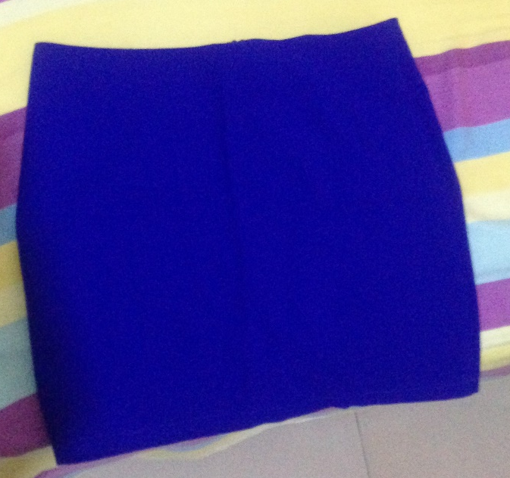
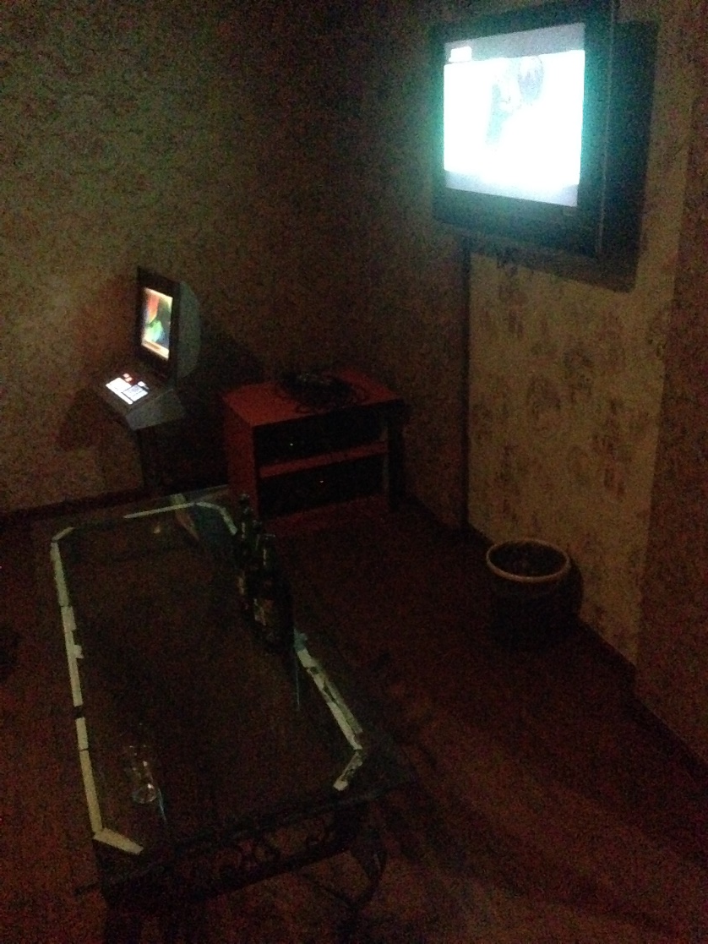
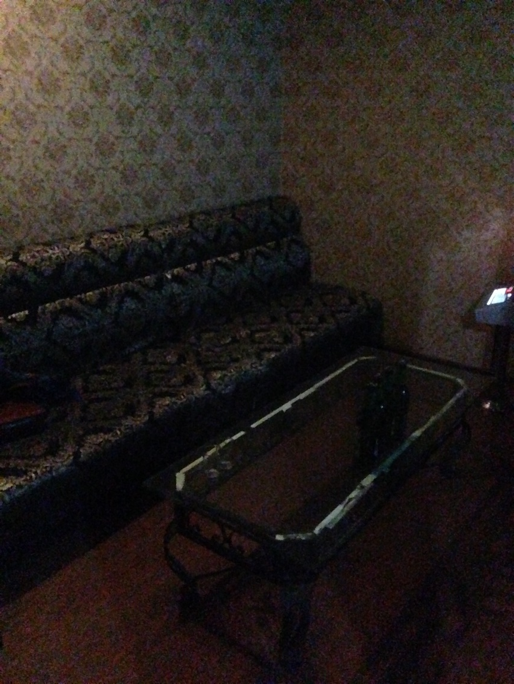
KTV and prostitution

Slide 5
1. Sexual morals, intimate feelings and relationship labels
Viviana Zelizer [2005] : that there is a very widespread belief that intimate relationships and economic transactions belong to separate spheres. The first sphere being a sphere of emotions, feelings and solidarity, the second one a sphere of calculation and efficiency: this belief also go with a strong normative injunction that these two spheres SHOULD remain separate and never merge.
In that perspective, intimate feelings like attachment, friendship, let alone love, cannot occur in prostitution relations: the occurrence of these feelings in relations guided by the quest for profit can only be instrumental and their authenticity is therefore suspicious.
The identification of emotions that run through a relationship is a way, for its participants, to label it.
Arlie Hochschild [1979] : feeling rules are linked to specific situations and individuals conduct an emotional work to adapt their feelings to have them match what they are supposed to feel.
Different feeling rules are associated with these different relationship labels. By negotiating this label, participant to a relationship also negotiate the emotions that run between them.

Slide 6
2. Economic transactions as a medium for emotional communication
Jingjie :
“ I asked him for just several hundred, but he refused me. Did he really want to be with me? I asked him this question, he said yes, he was sincere about our relationship. I asked: “If you are really good to me, why not give me just several hundred?” It’s because of you that I didn’t spend the New Year with my parents. I spent it with you here. I had no money to return. I had no face to meet my parents. […]
A sister persuaded me: “Don’t make a fool of yourself. What could you get from living with him ? he is cheating you every day. And you give him money, subsidizing yourself. How does he spend your money, do you know that?” “He gives all the money from you to his wife and child. He didn’t spend anything for you.
I thought she was right. Finally I felt this relationship was meaningless, he has a wife and a son. I didn’t want to be a mistress. I gave up.”
In the end, the stigma lying on relations established in the KTV is quite heavy, its power in framing the relations as prostitution is strong and hampers the efforts to label the relations as socially legitimate ones.

Slide 7
3. Local feeling rules vs dominant sexual morals
This experience has changed the meaning Jingjie grants to relationship she forms in the KTV :
“It is just like staying with your boyfriend, although we are not together every day. Only he has his own family. You don’t have a future. It is a bit like boyfriend and girlfriend relations. The only difference is that you could not get married.”
Feelings can now be part of the relation but it doesn’t grant it a higher subjective or social value. Jing Yu has established a hierarchy where her family ties are more valuable than any ties she will form in the KTV context.

Slide 8
3. Local feeling rules vs dominant sexual morals
Displacement of social proscriptions attached to prostitution : feelings for clients are socially accepted, but only if they don’t endanger prior family relations.
Gujie :
“Some women in this trade are detestable. Some woman share their earnings with one man rather than their child, which I think is a terrible behavior. One woman named *** does such kind of thing. She shares her earnings here with one man for him to set up a store, but later he will leave her. She has experienced so many difficulties to earn such kind of money here. Before her husband found other women and she still work hard to earn money. Now her life is so difficult, why she still believes the man and uses her earning to support him to set up a store. I think she is so detestable that there is no need for us to take compassion on her.”
Sex work as a means for supporting the family : neutralisation of dominant sexual morals

Slide 9
CONCLUSION

