Slide 1
Compressed Modernity, Authoritarian State and Subjectivation in China
Shi Yunqing
Institute of Sociology
Chinese Academy of Social Sciences

Slide 2
A typical case for Time-Compassed Modernization
Field:
Urbanization V.S. other process
Space:
Inner-city renewal V.S. city expanding
Time:
1990-2000 V.S. second/third phrase
Actor:
People born in 1950’s V.S. other age groups

Slide 3
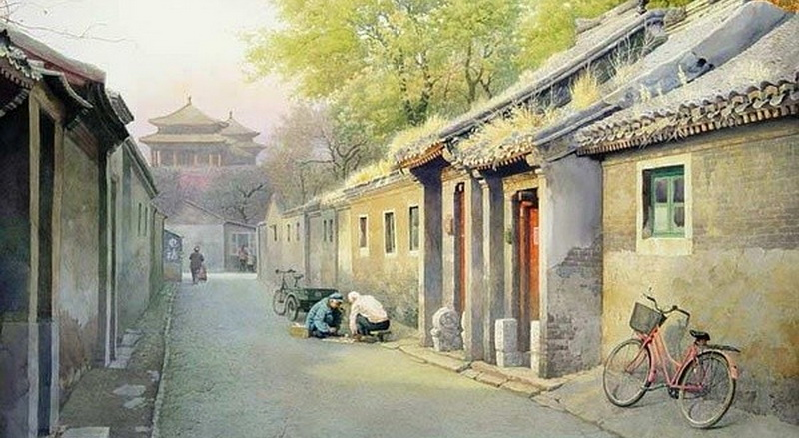
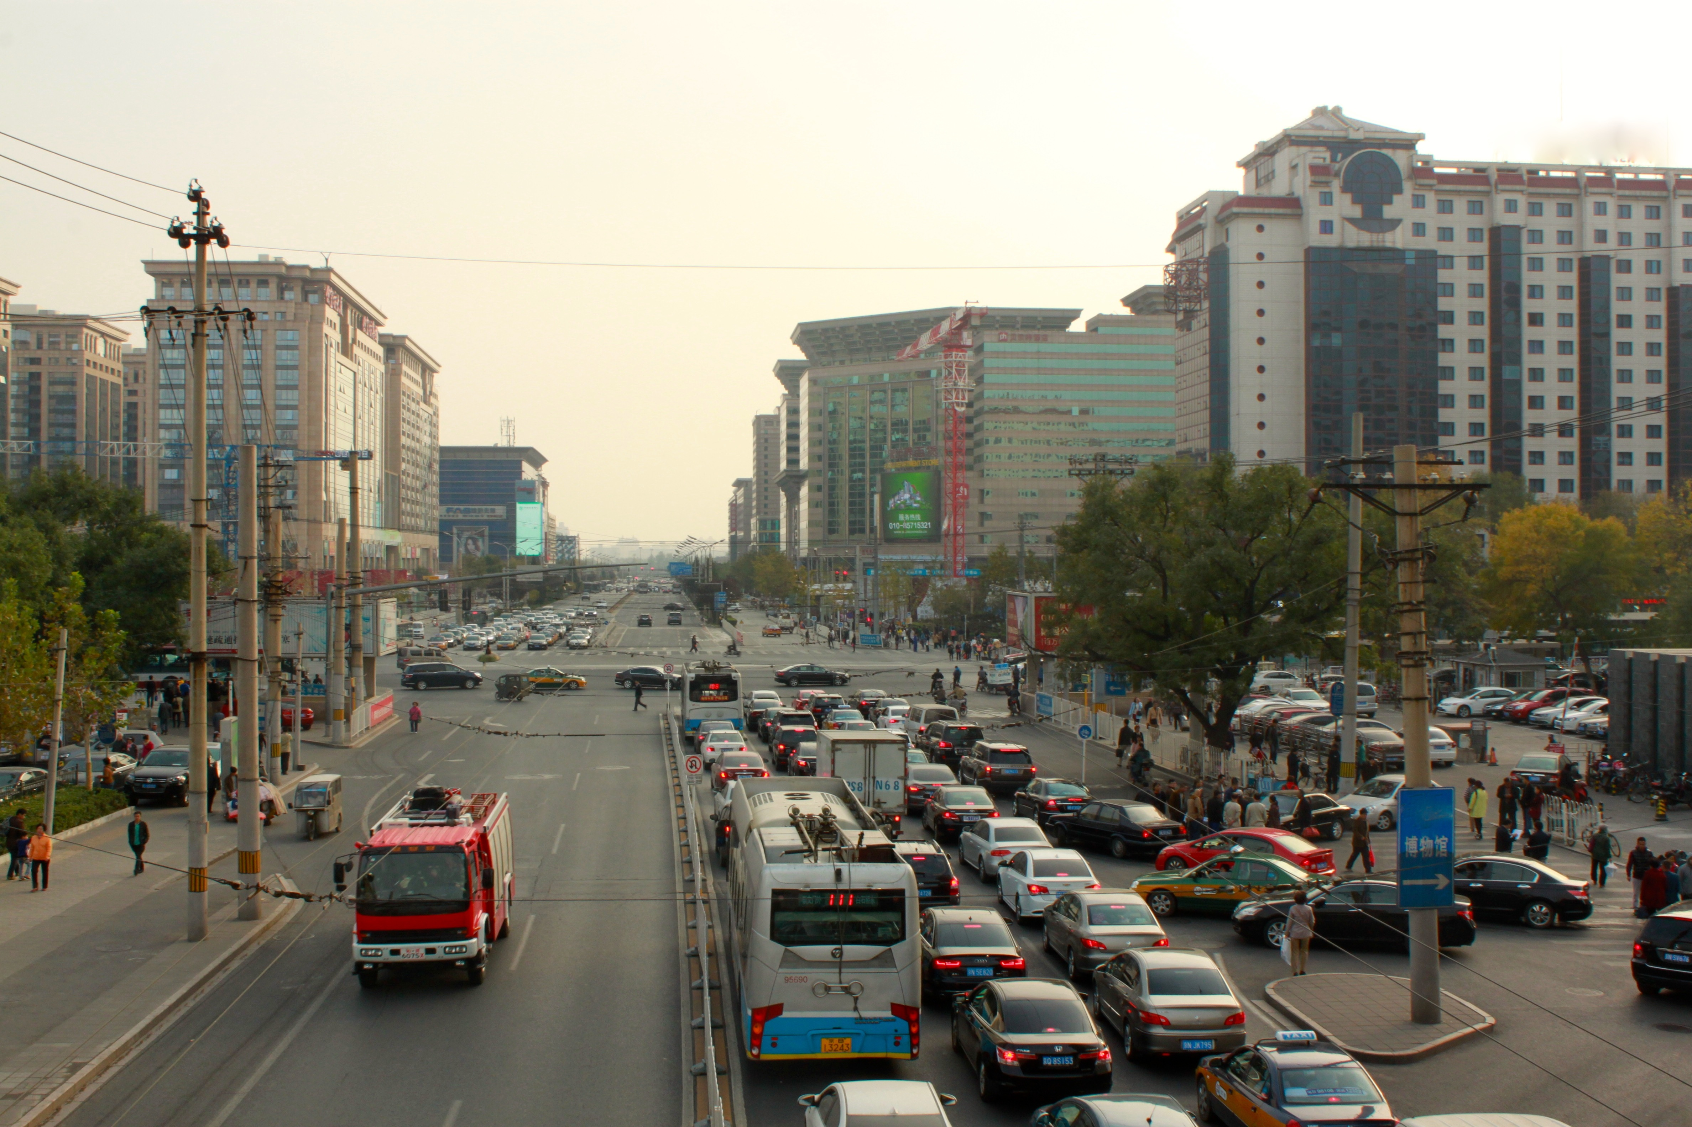
The
First Phrase of Urbanization during 1990-2000
The total size of the relocated population was 281,200 households, or 878,600 person;
647,800 houses that occupied 9,155,300 square meters were demolished

Slide 4
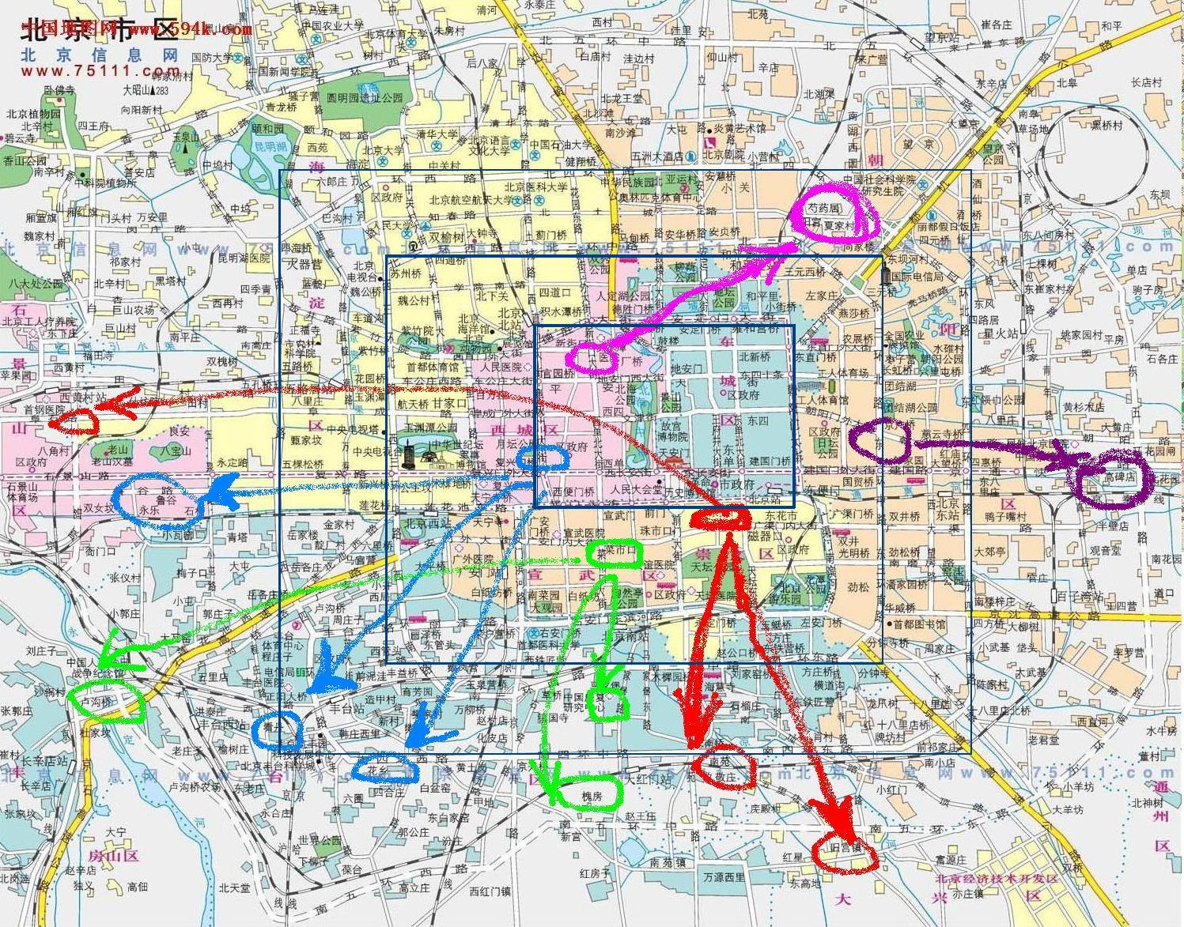
Moving out of the inner City
5 districts in the inner city：
Red： CW
Blue： XC
Green：XW
Pink： DC
Purple：CY
Notes:
The opposite face of gentenlization

Slide 5
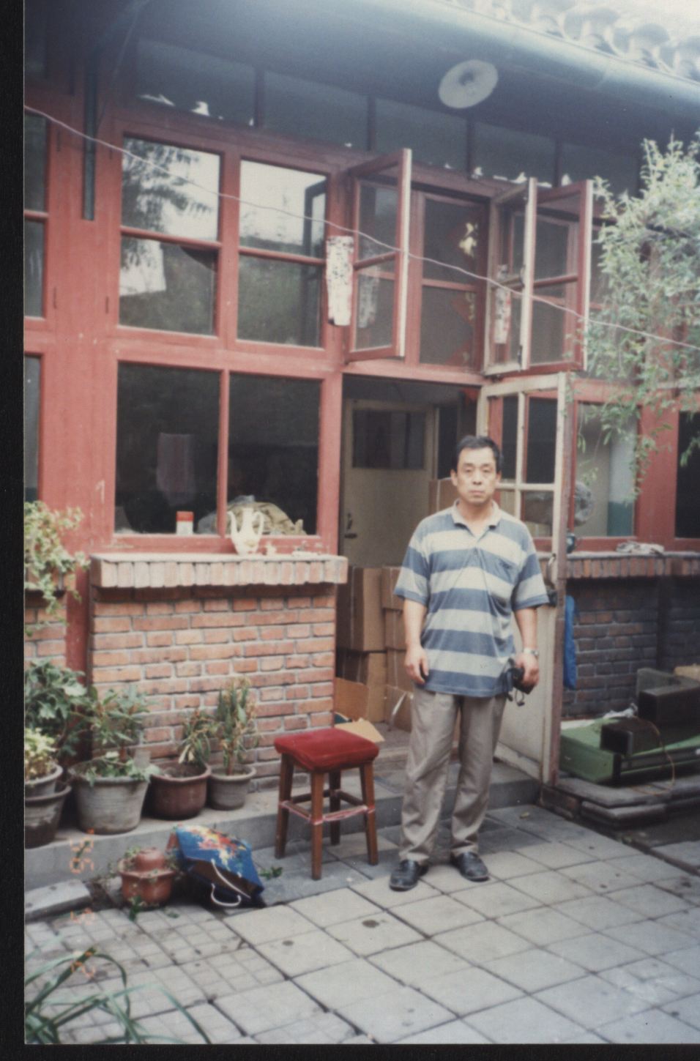
Demolition
Photo by Mr. Luo, the interviewee (1995)

Slide 6
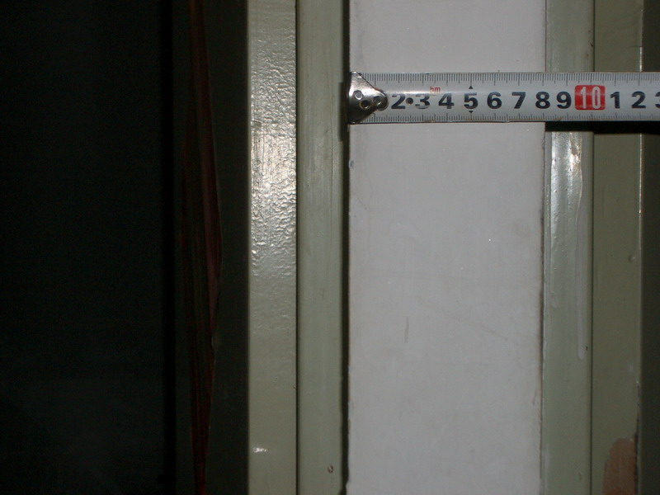
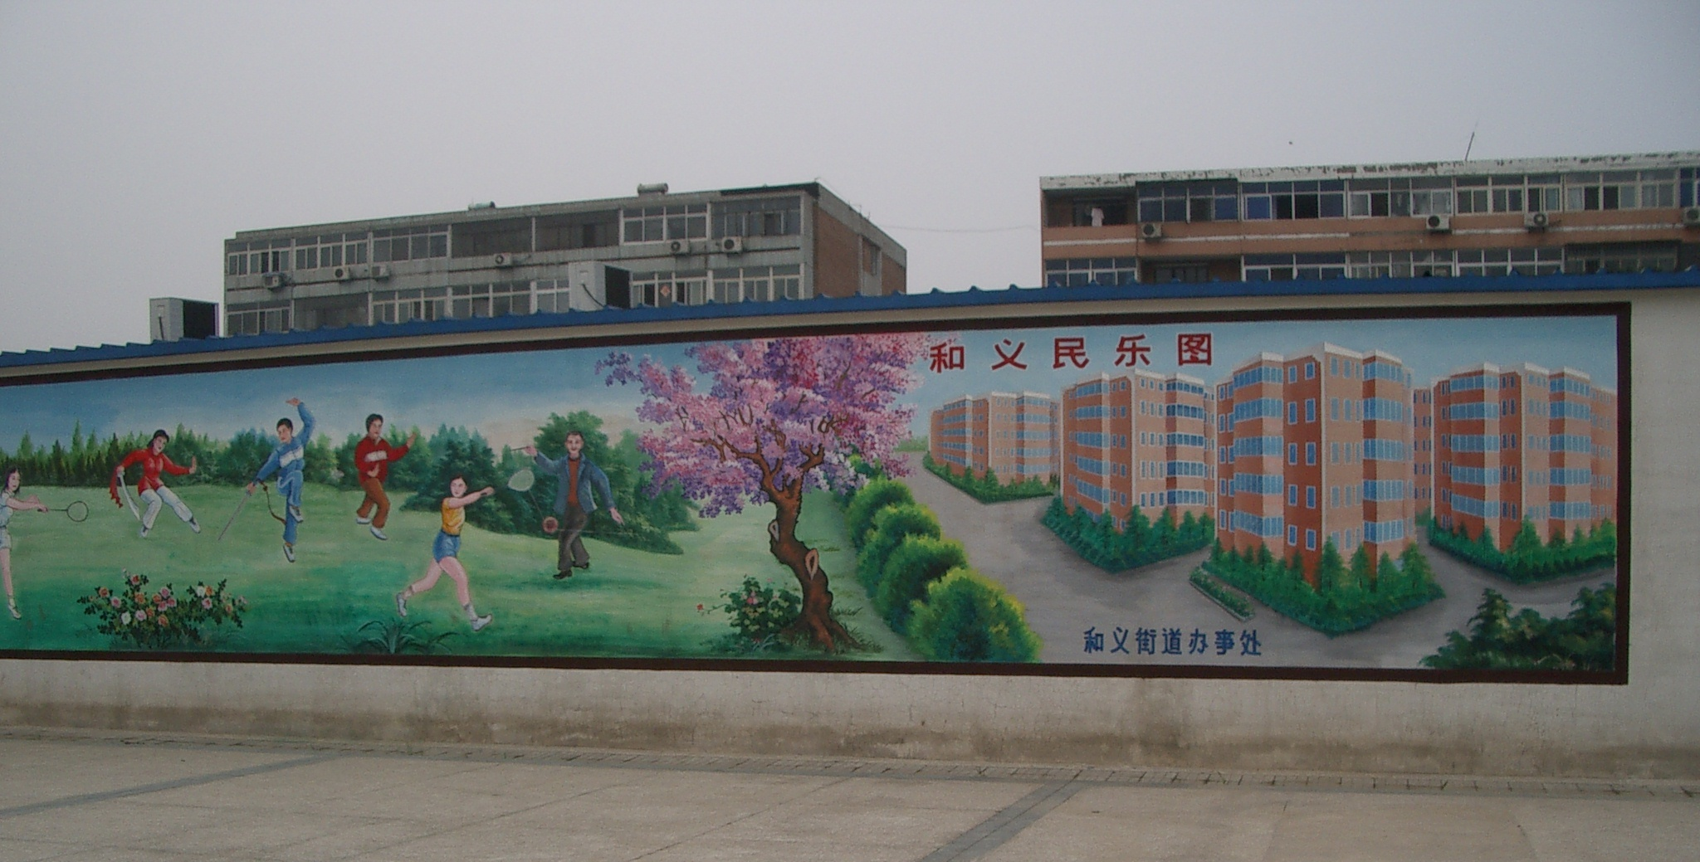
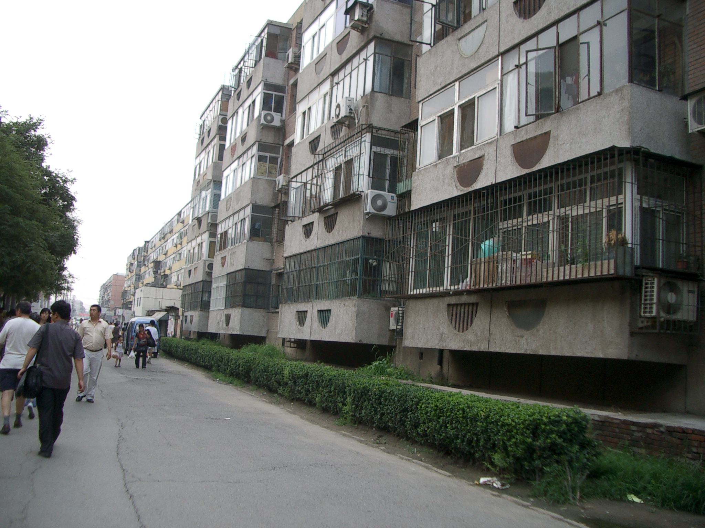
Community for replacement
The outlook of the community
The wall inside the house
Notes:
The quality is not very well

Slide 7
Case: the Grand Litigation of Ten Thousand Plaintiffs
On Feb 22nd, 2000, 7 representatives of citizens submitted to the Second Intermediate People‘s Court of City B an administrative proceeding with 10,357 plaintiffs,suing the Municipal Housing and Land Administration Bureau of municipal B’s government.
For the first time, local people suing the government
Largest, longest and rationalist
Claiming for land-use rights and then for citizenship during the last 20 years

Slide 8
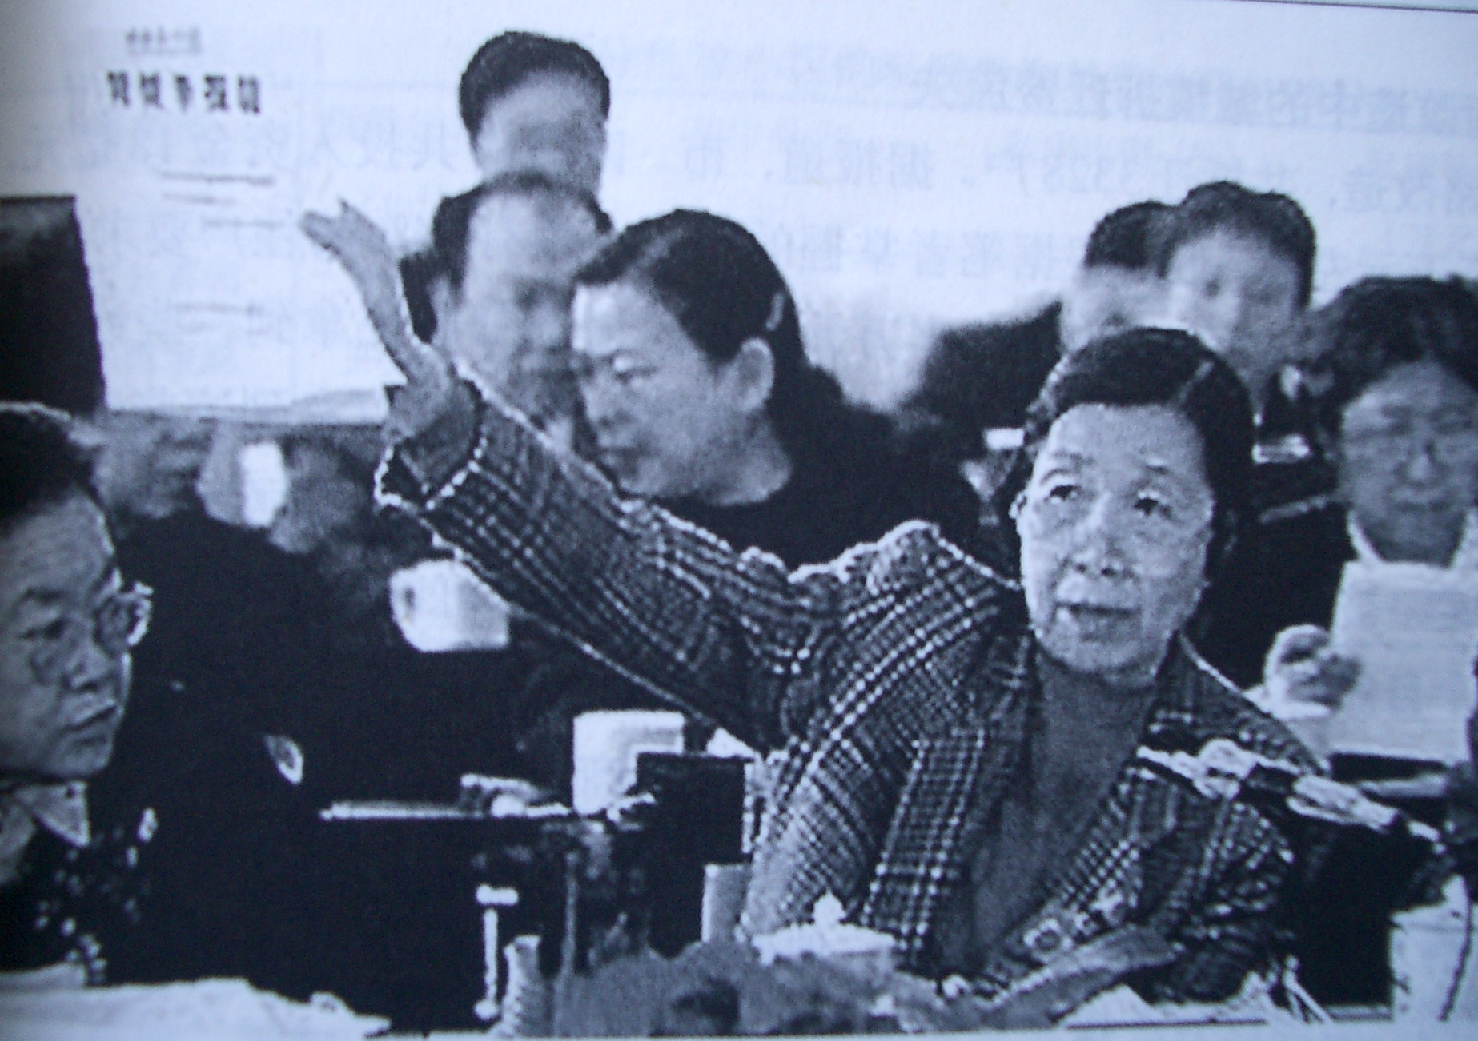
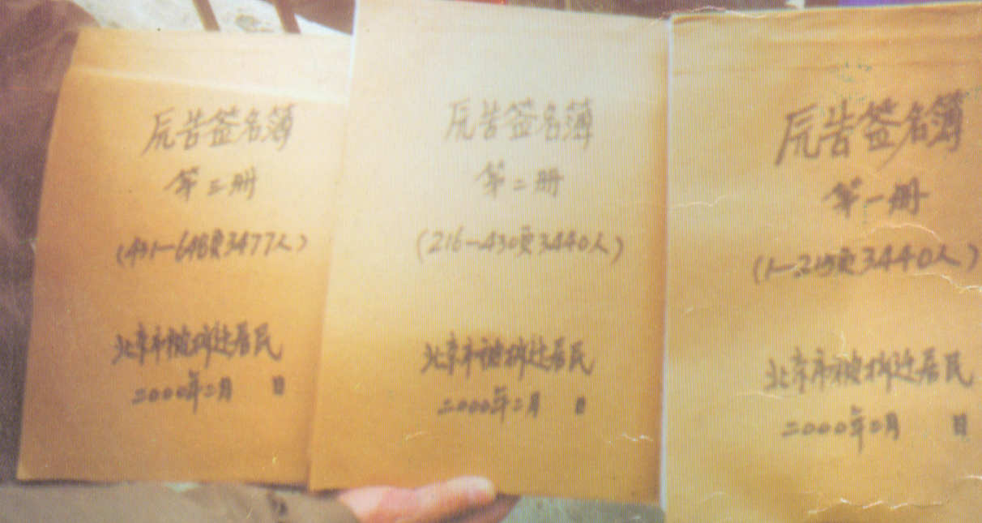
The Grand Litigation
The report letter was submitted in the 9th National People’s Congress (1999)
22nd, Feb, 2000. 7 representatives of the Grand Litigation in front of the court with the plaint and the book of 10357 people’s signatures.

Slide 9
Empirical puzzle
Chinese background
Nearly no tradition of civil society
Limited opportunities for ‘legal’ protest
How could this confrontational movement be possible in such background?
How could it be safe? (legitimacy )
How could it be effective? (protesting space)
Notes:
As people suing government, in Chinese background.
Should be both safe and effective. Stratege must be very exiquist. Always stemping on but not cross the line. How do they do it? Very complex

Slide 10
Theoretical Puzzle
What’s the change of the relationship between the authoritarian state and individuals when China heading to the modernity?
How dose it change? Under what condition? What’s the outcome?
What kind of individualization will come out in Chinese background?
The historical sequence of state/market/society
Chinese style rights：starting from the state, for national unification and state prosperity.
Dose the use of LAW challenges or enforce the authority?
The breaks or continuity of the individuation/modernization process.
the pre-modernization, modernization and post-modernization go one after another or mixed up at the same time?
mixed up -- selective using as basic strategy
Notes:
Is it changing? How? Under what condition?

Slide 11
SUBJECTIVITY in TCM/Social Transformation
A selective mechanism of state-individual relationships
Actors as flexible and reflective individuals
Notes:
Can use every kind of resources in different historical period

Slide 12
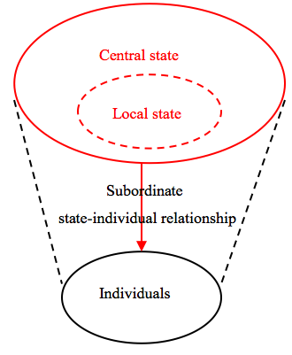
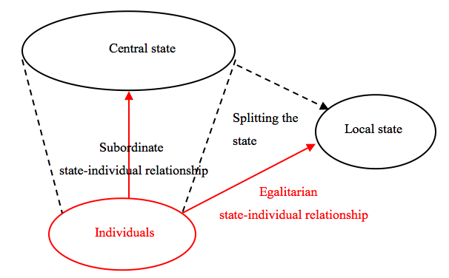
Subjectivity in TCM
Traditional pattern
Transitional Pattern:
A selective mechanism

Slide 13
Creating a selective mechanism STEP 1: SELF-EMPOWERMENT
Empowered by the textual meaning of the law: rights
Making individuals an equal subject/actor to the state
Subjectivity featured with western resources of modernity
Redefining “people”
People being evicted/ “刁 (tricky, slyness, unruly) 民 （people）”
V.S. Owners of property rights/ Citizens
Redefining the discourse of “demolition”
subordinated individuals’ obligation to the city development, as it is for common good
V.S. The adjustment of property relations between independent subjects

Slide 14
Creating a selective mechanism STEP 2 : SPLITING the levels of the state
Based on symbolic meaning of law: levels, hierarchy
The difference in the different levels of the laws means the betrayal of local government to central government
Subjectivity featured with Chinese tradition
Level of laws | Issued by | Hierarchy of governments
Constitution; Basic Laws; Regulations of … | NPC; State Council; State Administration of … | Central government
Policy of..; Rules of …; Implementing regulations of … | Municipal government; Municipal Commission of …. | Local government
Notes:
Differnerce lies in the processdure, the textual meaning, the scope, the difference in practice and text.

Slide 15
Creating a selective mechanism STEP 3 : BUILDING respective relationships
Creating egalitarian relationship with local government
Maintaining subordinate relationship with central government
Suing local government
The first case in Chinese protests
Key : Defining land use rights as the proper rights owned by citizens
Strategy:suing from the missing of legal procedures
Law: rights & rules
Letters and petitions to CPC and the State Council.
Making a psycho-alliance with the abstract “state”
“the infringement of citizens’ property rights (by local government) = the loss of state-owned resources”
“no radical acts”= the concern for state stability
Law: loyalty & symbol
Notes:
With two normative ways for protest in China

Slide 16
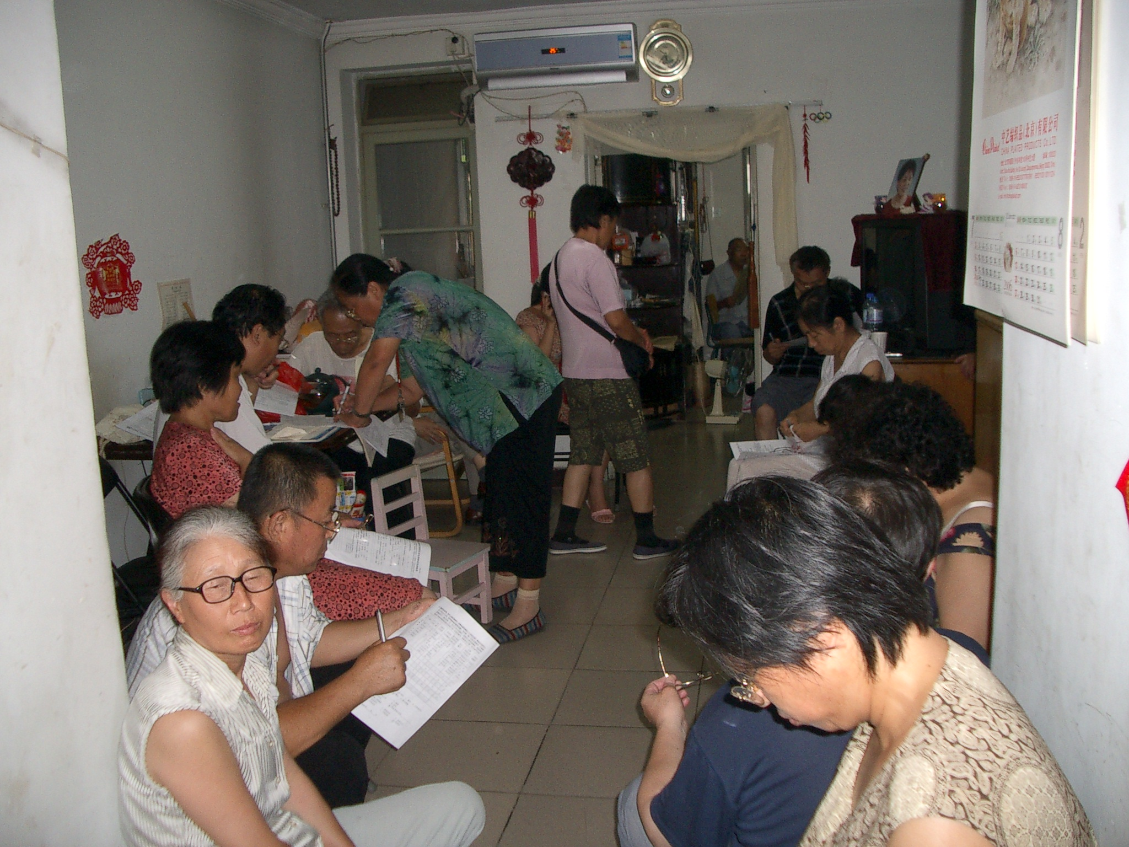
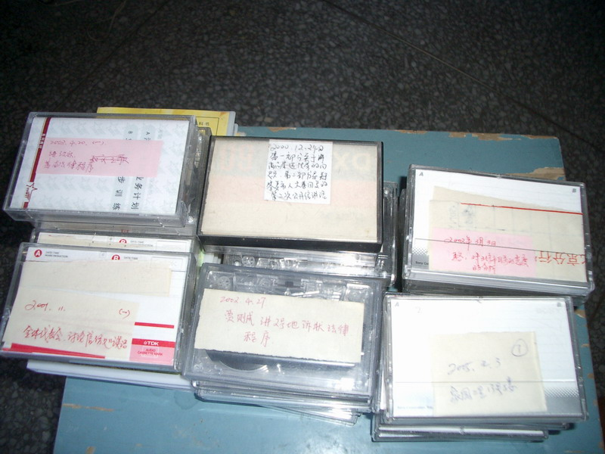
Multiple roles of Law Law Learning Group: a mobilization mechanism
Combining both roles of the law;self-empowerment & safeguarding

Slide 17
A paradox heading to the modernity
This mechanism exactly indicates the subjectivity of actors as the flexible and reflective individuals to adapting the ongoing social change.
A Paradox lies in this mechanism regarding Chinese background. The internalization of the state becomes the precondition of fighting against the state.
This special process indicates the continuity and difficulty for China when it steps forward to the modernity, in such short time with such heavy historical and political burden.

