Slide 1
Connecting the Two Sides Chinese Migrant Women E Commerce in Taiwan
Shanghai University
PhD Seminar
November 2017
Beatrice ZANI
Ph.D Candidate in Sociology
Lyon 2 University, TRIANGLE UMR 5206

Slide 2
1. Introduction: Gender, Labour and Migration
Pluralization and complexification of women’s migratory paths in internal China (countryside to the city, 打工 work) and from China to Taiwan (marriage-migration)
Situations of ethnic (Lan 2008) and gender discrimination (Tseng 2015; Cheng 2013; Tsai 2011) + economic marginalization in Taiwan
Culture of migration and of circulation (Massey et al. 1993; Tarrius 2002) to develop entrepreneurship and economic activities (Portes 2003; Waldinger 2008)
Emotional ties, culture of affection (Illouz 2006), transnational solidarity networks (Portes 2003)

Slide 3

1.1 Introduction: Research Questions and Hypothesis
Through which resources and under which forms individual and collective practices of resistance are produced?
Given the pluralisation of women’s migratory careers and social experiences, in China and in Taiwan, how are such actions displaced on a transnational level?
What is the role of affections and emotions in the production of women’s collective practices?
Gendered transnational networks + emotional capital moral economies of gender and subalternity
Centrality of affections and emotions in the development of physical and virtual practices of resistance which invest and connect the different (multiple) poles of women’s mobility
Sui generis transnational economic activities, ex. WeChat social network= a proactive response to discrimination
Emergence of a sustainable emotional transnational community

Slide 4
2. Qualitative Research on Gender and Subalternity: Fieldwork Sites
Physical Emotional Spaces
Taiwan: suburbs of the cities of Taipei (Nanshijiao南勢角, Sanchong三重, Banqiao板橋, Shulin 樹林), Hsinchu (Zhubei 竹北 and Zhudong 竹東) and Hukou 糊口: abundance of low-legitimated professional opportunities and low housing costs
Economic and commercial activities women produce together: small restaurants, shops, hairdressers, dance classes

Slide 5
2.1 Qualitative Research on Gender and Subalternity: Fieldwork Sites
2. Virtual Emotional Spaces
The chat groups created via the social network Wechat 微信
12 Wechat groups, Ex.:
- “The Group of Mutual Help among the Chinese Sisters in Hsinchu county” 新竹姐妹互相 群 (221 participants)
“Chinese Sisters–Hometown Group” 大陸姐妹 –家鄉群 (500 women)
“The Community of Chinese sisters in Taiwan” 大陸姐妹在台灣-社團群 (428 people)
The dance group “East Dance Class” 東方玄舞蹈班) (27 women)

Slide 6
2.2 Qualitative Research on Gender and Subalternity: Methodology
Multi-sited Ethnography (Marcus 1995) and Qualitative Approaches
In situ observation and group discussions: economic activities + solidarity networks Ex. Chinese ethnic minority dance classes in Banqiao, English classes 2nd floor lingerie shop in Nanshijiao
→ women’s interactions, perceptions, attitudes + production of norms, emotions, affections
110 Biographies and migratory careers (Rea and Martinello 2014)
Virtual Ethnography (Constable 2003): role of solidarity + production of transnational norms and and circulation of emotions between China and Taiwan

Slide 7
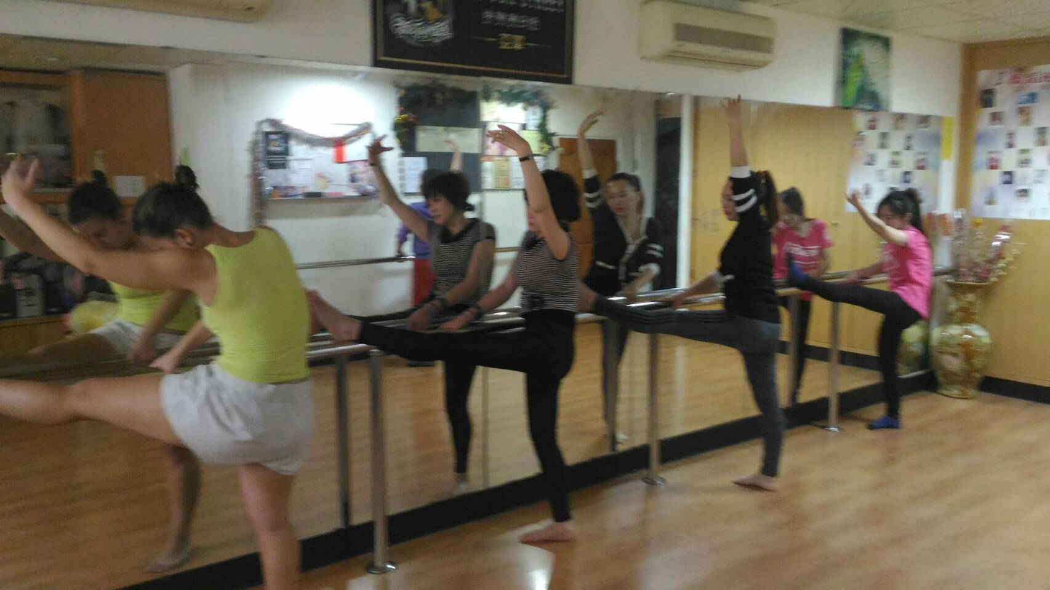
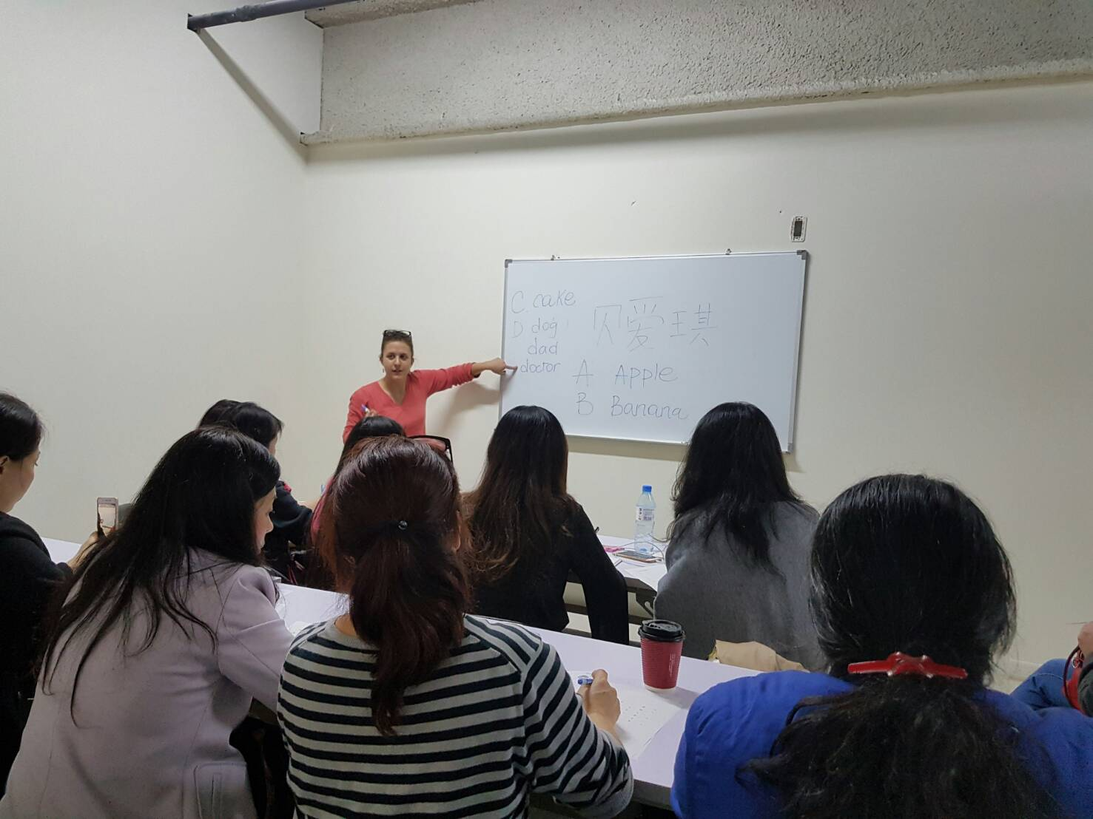

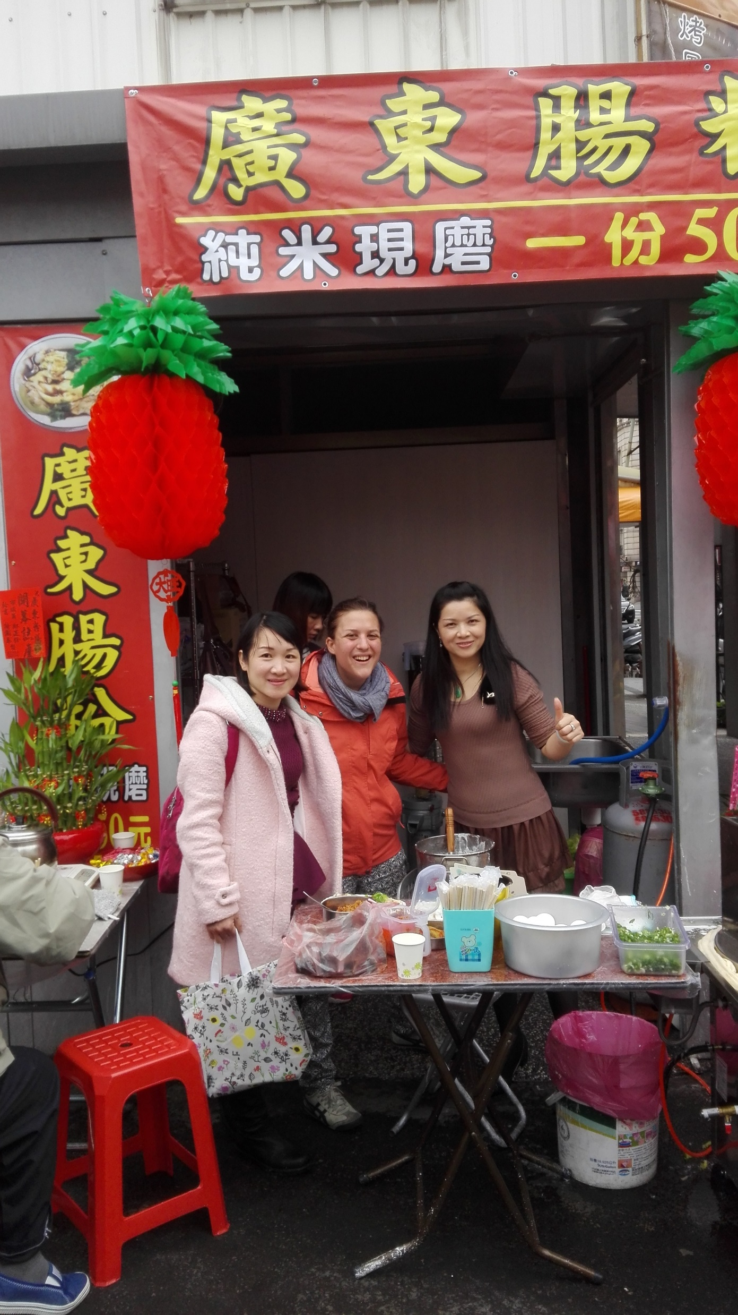
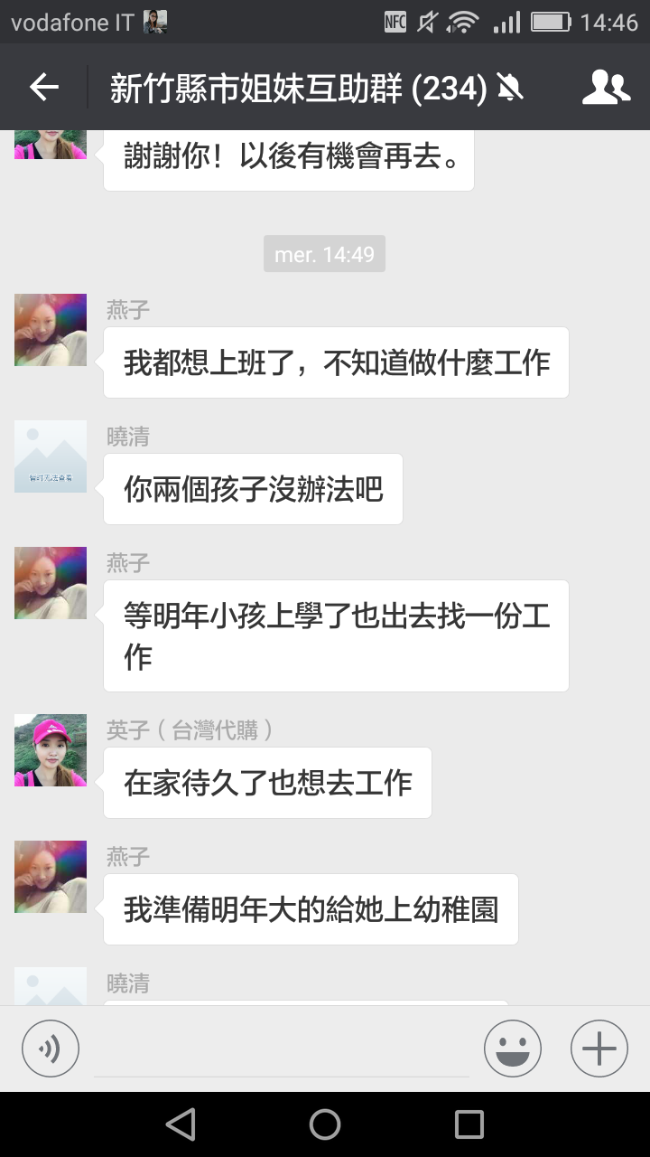

Slide 8
3. Emotions, Affections and Fictional Kinship
Condition of subalternity in Taiwan: social, gender discrimination + economic marginalisation in the labour market
Jiemei 姐妹: a “mutuality of being” (Sahlins 2011)
Women produce gendered social networks
Being “sisters” (姐妹) = post-natal means of kinship formation, culturally performed sisterhood = common affiliation to an affective tie, an injunction to affection
A “mutuality of being” (Sahlins 2011)

Slide 9
4. Virtual Moral Regions:WeChat Groups of Mutual Help
Gendered social networks of “sisters”, which provide women with protection, security and mutual help
Sustainable communities produced and enlarged on a virtual scale
Virtual “moral regions” (Park 1925) to exchange goods, services, advice but also emotions, intimacy and affections
Ex. Wenfeng’s business within the WeChat group “The Sisters from Chongqing” (重庆姐妹群)
Moral Economies (Fassin 2012) of gender and subalternity

Slide 10
5. Cosmopolitan Biographies and Transnational Communities
Self-employment as an “escape route” (Parker 2004)
Circulation and interconnection between the different (multiple) poles of women’s mobility: Chinese countryside- Chinese city- Taiwan
“Cosmopolitan biographies” (Beck 2006): being simultaneously here and there (Tarrius 2002; Waldinger 2008)
Transnational emotional community
Ex. Huang Jin’s migratory career

Slide 11
6. Conclusion
Centrality of affections and emotions during migratory experiences
Role of solidarity and gender solidarity to face subalternity
Production of emotional ties and of a culture of migration and of affection by Chinese migrant women in Taiwan
Emergence of transnational emotional communities, connecting China and Taiwan

Slide 12
7. Bibliography
Cheng, I. 2013. “Making Foreign Women the Mother of Our Nation: The Exclusion and Assimilation of Immigrant Women in Taiwan”, Asian Ethnicity 14 (2): 157-169.
Constable, N. 2003. Romance on a Global Stage. Pen Pals, Virtual Ethnography and “Mail-Order” Marriages, Berkeley, University of California Press.
Fassin, D. 2012. “Vers une théorie des économies morales [Towards a Theory of Moral Economies]” in D. Fassin and J. S. Eideliman (Ed.), Les économies morales contemporaines [Contemporary Moral Economies], Paris, La Découverte: 19-47.
Illouz, E. 2006. Cold Intimacies. Emotions and Late Capitalism, Cambridge, Polity Press.
Marcus, G. E. 1995. “Ethnography in/of the World System: The Emergence of Multi-Sited Ethnography”, Annual Review of Anthropology 24: 95-117.
Martinello, M., and A., Rea. 2014 . “The Concept of Migratory Careers: Elements for a New Theoretical Perspective of Contemporary Human Mobility”, Current Sociology 62 (7): 1079-1096.

Slide 13
Park, R. E. 1925. “The City: Suggestion for the Investigation of Human Behavior in the Urban Environment”, in E. W. Burgess et al. (Ed.), The City, Chicago, University of Chicago Press.
Parker, S. 2004. The Economics of Self-Employment and Entrepreneurship, Cambridge: Cambridge University Press.
Portes, A. 2003. “Theoretical Convergences and Empirical Evidence in the Study of Immigrant Transnationalism”, International Migration Review, 37 : 814-892.
Tarrius, A. 2002. La mondialisation par le bas: les nouveaux nomades de l’économie souterraine [Bottom-up Globalization. The New Wanderers of Underground Economy], Paris, Ballard.
Tsai, M. C. 2011. “Foreign Brides Meet Ethnic Politics in Taiwan”, International Migration Review, 45 (2): 243-268.
Tseng, H. H. 2015. “Gender and Power Dynamics in transnational Marriage Brokerage: The Ban on Commercial Matchmaking in Taiwan Reconsidered”, Cross-Currents: East Asia History and Culture Review, 15: 109-132.
Sahlins, M. 2011. “What Kinship is”, The Journal of the Royal Anthropological Institute, 1 (17): 2-19.
Waldinger, R. 2008. “Between `here´ and `there´: Immigrants Cross Borders Activities and Loyalties”, International Migration Review 41 (1): 3-29.

Slide 14
Thank you for your attention!

