Slide 1
“新流动儿童”问题研究 --从沪向徽流动的流动子女为例 "New Migrant Children" - A Case Study for Children Who Return to Anhui from Shanghai
乌尼日其其格
wuniriqiqige
上海大学社会学院
PhD Student, School of Sociology and Political Science, Shanghai University

Slide 2
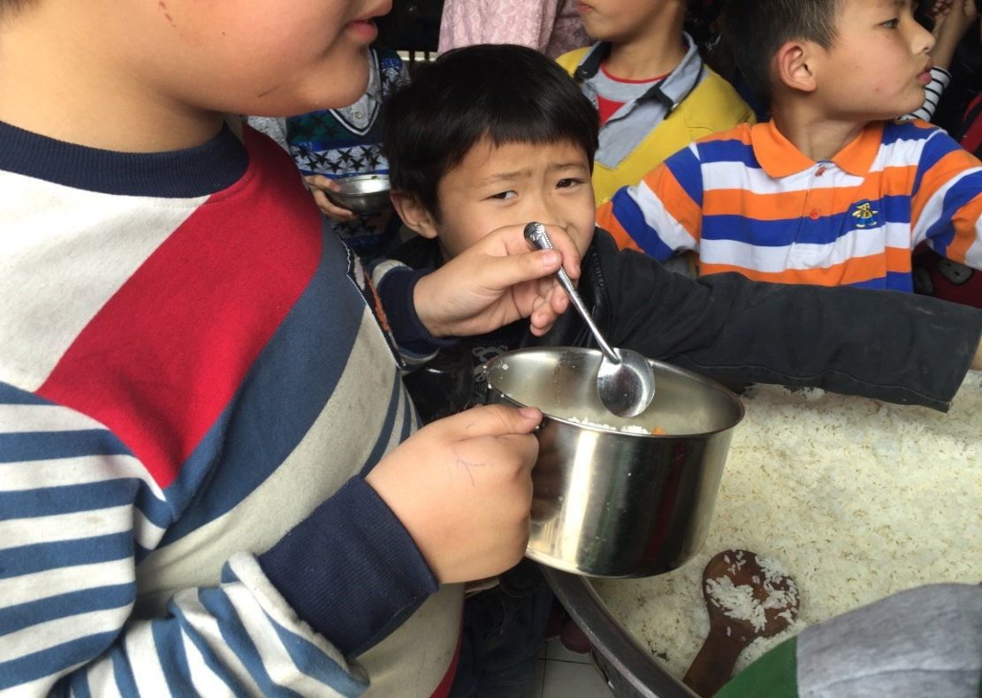
一 概念界定 Definition
新流动儿童
New Migrant Children
出生地
Place of birth
就学地
School place
出生地
Place of birth
年代
Generational
Vs回流儿童
Returning Children
Vs 流动儿童
Migrant Children

Slide 3
二 流动人口 Migrant worker population
数量：上海外来常住人口(单位:万)
Quantity: Shanghai Migrant worker population (unit: 10,000)
形式：家庭化形式
Form: family
子女：20世纪初 40 万人
Children: 400,000 in the early 20th century

Slide 4
三 上海市流动儿童教育发展历程 Shanghai migrant children education development history
简易的办学点
Basic infrastructure
民工子女学校
Migrant children's school
随迁子女学校
Follow your parents' children's school

Slide 5
（1）萌芽阶段及对策：
Policy in the preliminary stage
上海市1997年12月修正了《上海市实施中华人民共和国义务教育法》，规定“外省市来本市的适龄儿童、少年持常住户口所在地的县级教育行政主管部门或者乡级人民政府出具的证明，可以按照本市的规定申请借读，应当缴纳借读费”。
1998年8月，市教委与市公安局还颁布了《上海市外来人口中适龄儿童、少年就学暂行办法》妥善解决和处理他们的就学问题，并加强对这类学校的管理。

Slide 6
（2）发展并自由竞争阶段--21世纪初：
The stage of development and competition
- the beginning of the 21th century
2003年国务院办公厅转发教育部等部委的《关于进一步做好进城务工就业农民子女义务教育的工作意见》，明确了以“公办学校、流入地”为主的外来务工子女就学政策，凡符合条件的民工子女，进入当地公办学校读书不需要支付学杂费和借读费，还可以就近入学。
2004年也出台《关于做好进城务工就业农民适龄子女义务教育工作过的若干意见（试行）》，强调了区县政府和公办学校的责任。
到了2006年上海市免除了郊区公办义务教育阶段学生杂费，秋季起免除全市义务教育阶段学生学杂费，同时加大了对生均公用经费的拨款。

Slide 7
（3）转型并规范化(2008年)
Transformation and normalization (2008 )
条件不达标而被关闭(青浦区转（纳）民前37--29所)
The conditions are not up to standard and are closed (the qingpu district is transferred to the people 37 to 29).
上海市政府统一管理办学\生均拨经费。
The Shanghai municipal government unified management of running schools and funds
法人还是这些学校原来的举办者或者购买者，校长一般是举办者本人或者被举办者或购买者雇佣过来的公办学校校长或者老师.
纳民的方式：
Mode of transformation
政府委托评估公司将学校资产折旧评估并收购，校长由学校所有人、法人或举办者变成雇佣为副校长来管理学校，书面法人是一些企业单位，实际法人也就是政府，校长是上海市教育局委派的，一般都是公办学校退休校长或者老师.

Slide 8
就读于公办的流动儿童数量变化 The number of Migrant Children study in public school has changed

Slide 9
四 新流动儿童问题出现 The problem of neo-migrant children
（4）危机—关门阶段
the crisis of Migrant Children education which the “school” has to be closed because of the policy of polulation limitation
中共八届三中全会提出创新人口管理时，重申要“严格控制特大城市人口规模”。2013年上海市开始提高流动子女入学门槛。
In 2013, Shanghai began to raise the admission threshold of migrant children.
合法
居住
Legal residence
稳定
就业
Stable employment
社会
保障
The social security
入学
年龄
School age
无权
招生
no power to recruit students

Slide 10
办学点Easy school
无条件unconditional
无管理no management
借读
高额借读费High cost
高门槛入学difficult to get education
纳民
高条件Good condition
高管理management
控制
Limiting population
无入学机会
No chance to accept education

Slide 11
五 相关研究 Review
流动儿童: Migrant Children
教育：入学、升学机会平等 equality of opportunity to continue the education and entrance
学习：教育方式、教学内容—衔接问题
duplicate study or miss knowledge because of the difference province have the difference study plan
生活：歧视、融入、适应
Discrimination, integrate,adaptation
心理：刘杨（2013）--文化适应理论来对个体在新环境中的适应状况发现，流动儿童的父母教养是以忽视型为主。

Slide 12
流动儿童喜欢某一个地方的程度主要来自于熟悉和有伙伴的近一半45%（张晓梨，2008）。
45% of the migrant children like a certain place because of the sense of familiarity and their friends here (Zhang, 2008).
刘霞、赵景欣、申继亮(2007)还发现，留守儿童普遍具有孤独感、委屈感、敏感自卑和忧虑情绪。
Liu, Zhao and Shen (2007) found that left-behind children have the feeling of loneliness, grievance, sensitivity, inferiority and anxiety.

Slide 13
回流儿童（Returning Children）:
田施英（2008）通过对15个回流儿童访谈发现，这些儿童表现出强烈的来到城市跟父母生活在一起的愿望，原因是在老家没有伙伴而孤独寂寞还想念父母、有些还生活习惯不适应而不开心，对老家的一切持不满意态度。
Tian (2008) found that returning children express a strong desire to live with their parents. Because they are lonely in their hometown and they are not happy and cannot get used to the daily here.
该研究涉及到回流儿童的问题，与本文讨论的回流儿童问题有很多类似之处，但是本文主要涉及的是特大城市人口调控之后回流的儿童问题。
The subject of this study are similar with this paper. But this paper mainly concerns with returning children which caused by the policy of population control in large cities .

Slide 14
六 调研地点选择依据 Research sites

Slide 15
七 “新流动儿童”现状 The situation of new migrant children
（一）生活、家庭方面（daily life）
公办学校—城市走读生(没有住宿条件)
Public School- urban student （nonresident）
民办学校—留守儿童+新流动学生
Private School-left-behind children + new migrant children
义务教育之外（besides compulsory education）
寄宿+学费等成本（cost of accommodation & tuition fees）
资本欠缺：家庭经济条件、社会网络资本、教育资本等
Lack of economic capital、social capital & educational capital
父母一人：流动夫妻分居，影响了婚姻的完整和家庭的和睦—社会和谐
migrant couple live apart, affects the integrity of marriage and the harmony family - social
祖父母：社会需要照顾的两类人相互照应
亲戚:缺少感情交流和家庭教育Lack of emotional communication and family education

Slide 16
家庭教育严重缺失影响了学生的心理和生活、学习习惯，出现很大的道德真空状态。
lack of family education affects students' psychology well-being, daily life, learning habits. There might be a moral vacuum.
民办学校的校长及创办者:全校800个学生当中60个左右的小学生经常不回家，全托管的状态，有专门的生活老师负责洗衣服等生活管理，亲情的严重饥渴和家庭教育的完全缺失状态。
Private school principals and founders: 60/800 students in the school do not go home very often. There are life teacher helping them washing clothes etc. But there is no family education.
“由于父母常年在外工作，子女无法在身边照顾，觉得欠子女，所以子女有什么需求，都尽量满足，当然是更多的用物质方面来表达心意”，欠爱转成了过度溺爱，使得家庭教育性质的变化。
parents work outside all year round, they feel guilty for their children, so they try their best to meet their demand. Love turns into overindulgence, this change the nature of family education.

Slide 17
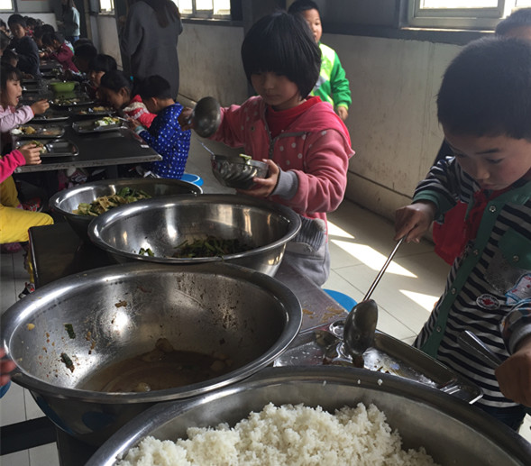
二楼宿舍楼和一楼食堂 The dormitory on the second floor and the canteen on the first floor

Slide 18
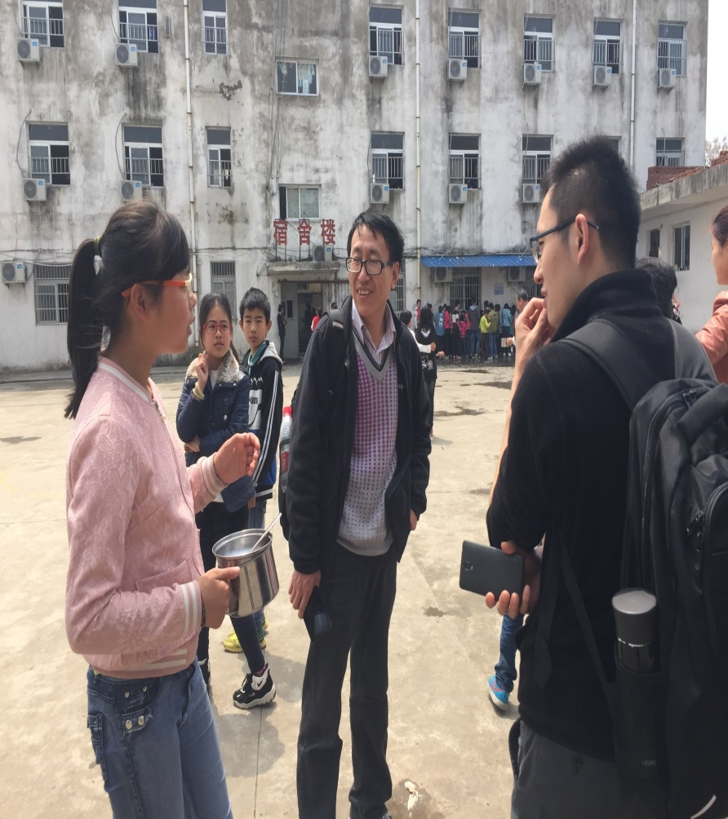
宿舍和校园 Dormitory and campus

Slide 19
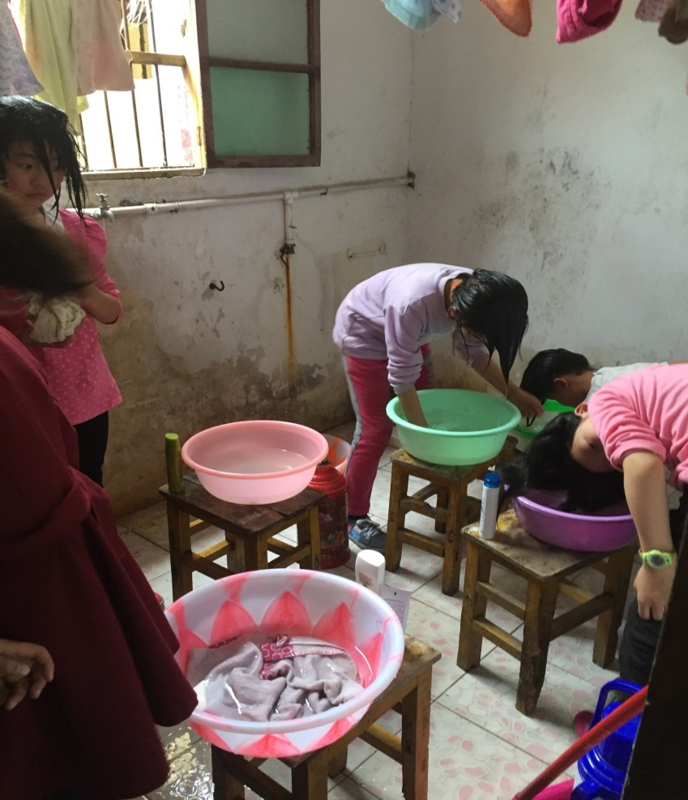
男生女生宿舍内部 Dormitory

Slide 20
八 问题的分析 Analysis of the problem
（一）城市治理角度Urban governance perspective
“城市病”：人口高度集聚于中心城区、道路拥堵、环境污染、违法违规、安全问题---控制人口—流动人口
"City sickness": the population is highly concentrated in central urban areas, road congestion, environmental pollution, violations of laws and regulations, safety issues --- controlling population-floating population
但是无法达到入学条件的流动人口也无法集中于中心城区、也无条件买车、买房，何谈环境污染和道路拥堵；
However, migrants who can not meet the admission requirements can not concentrate on the downtown area, can not buy cars and house. needless to consider environmental pollution and road congestion.
这些流动人口很大部分也都在城乡结合部和郊区，再与中心城区的治安条件对比远远不足，安全问题及违规违法相对于中心城区比较多是很大部分是城市管理和公共服务资源的配置不平衡导致。
Most of these floating population live in urban and rural areas and the suburbs. Compared with the central city of the security conditions, suburbs are far from enough, and security issues and violations more than the central area, because urban management and public service is imbalance.

Slide 21
（二）流动人口职业角度
The floating population occupational perspective
外来常住人口的70%的文化程度都是初中及以下，达到大专及以上的仅占14.7%，低于户籍人口学历程度。
70% of the permanent resident population have junior high school education and less than 14.7% college education and above, which is lower than that of the registered permanent residence.
杨东平等（2011）谈到低端服务业，认为低端服务业补充的是城市不可或缺，而城市人又不愿从事的非正规就业岗位。还发现近几年北京市劳动力市场的信息，低端人才供不应求趋势，导致该类职业的价格攀升，企业也出现用工荒现象。
Yang Dongping et al. (2011) talked about the low-end service industry and concluded that the low-end service industry complements informal jobs that are indispensable to urban areas, because urban residents unwilling to engage. He also found that in recent years, Beijing's labor market information, low-end talent demand trend, result in the price of such occupations climbed, the phenomenon of employment shortage also appeared.
职业教育毕业生
Vocational education graduates

Slide 22
（三）对人口控制做法的分析
an analysis of population control practices
特大城市的角度分析流动子女入学门槛的提高是担心入学条件过于宽松，可能会导致流动儿童数量的超常增长，给当地政府和教育行政部门增加各方面的压力。
Promoting the barriers of entrance of migrant children is that their worry about the extraordinary growth in the number of migrant children, which will put more pressure on local governments and educational administrations.
控制流动人口—新流动子女问题的出现
Controlling the Floating Population - The Emergence of New Migrant Children

Slide 23
八 结论
独生子女政策--人数减少，特别是现阶段的适龄儿童及义务教育阶段的人数。
One child policy – Numbers decrease, especially of current-age children and compulsory education.
不管是城市还是农村儿童，是未来国家和社会发展的主要支柱，如果他们没有得到很好的教育和技能，将来必定是一种灾害。
Both urban and rural children are the main pillars of state and social development. It would be a disaster if they do not have good education and skills.
不仅是一个个人问题，也不是一个家庭的问题，而是牵扯到整个国家的未来，给予他们何种何等教育直接关系到未来国家和社会各方面发展。
It is not only an individual issue, nor is it a family issue. It involves the future of the entire country. What kind of education should be given to them is directly related to the future development of the country and all sectors of society.

Slide 24
谢谢大家的聆听！
Thank you for your listening ！

